Slide 1
Data Strategy
Ben Harris

Slide 2
Data and The City of Tulsa
Strong-Mayor
16+ Separate Companies
Decentralized Applications
  35+ Applications
Limited BI Budget
Limited Dedicated Resources
  Automation versus Personal Management
Open Records Request
What Works Cities

Slide 3
Data Initiatives
Data
Governance
CDR
Analytics
Training
OQF/WWC

Slide 4
Data Governance

Slide 5
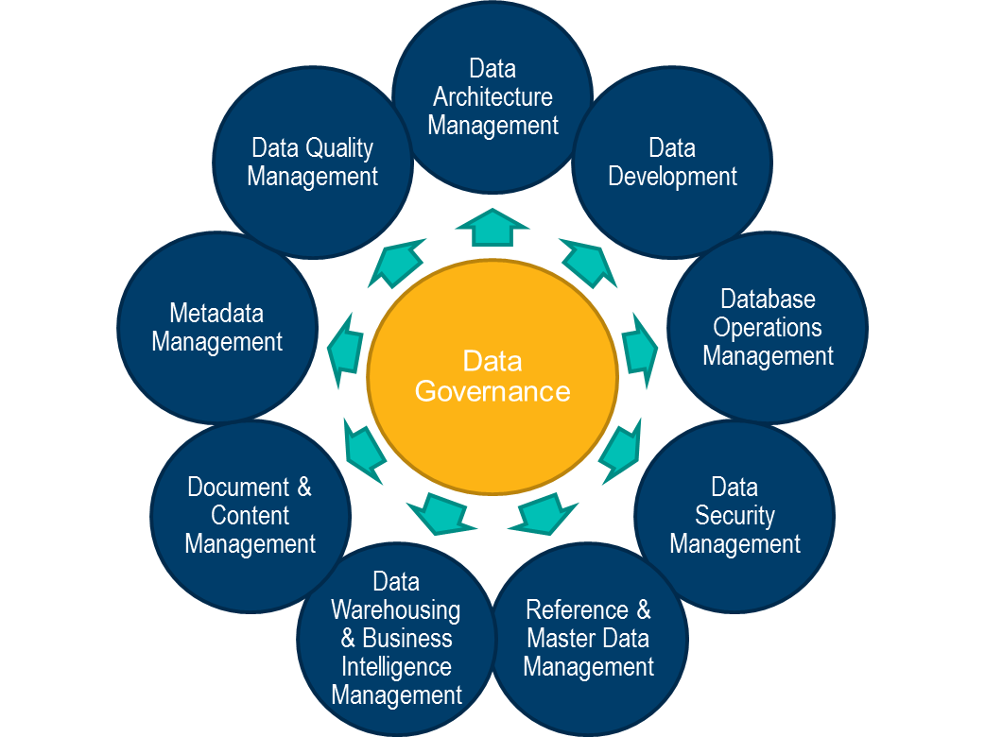

Slide 6

Analytics
CDR
Data Quality
Data Security
Data Governance
Data Integration
Data Provenance
Data Classification
Artificial Intelligence
Data Analytics Self Service
Notes:
Data governance is the foundation for all the work we are doing with data. It sets expectations for how we store, access, and use data. It consists of the following sub policies. Each of the sub policies reminds us of how data should be used. It’s not meant to be used as a stick but as a gentle guide.

Slide 7
Data Governance Committee
Notes:
The data governance committee encourages team work. It allows us recognize the differences between each organization, while also recognizing the similarities. Every department is part of the decision process.

Slide 8
Process

Slide 10
Data Quality

Slide 11
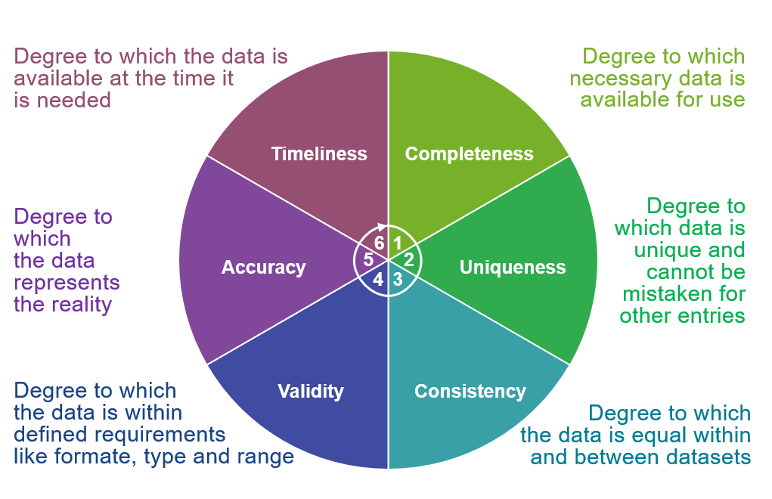

Slide 12
Where is our Data Quality?
Category | Implemented (%)
Timeliness | 100
Completeness | 95
Uniqueness | 85
Consistency | 85
Validity | 90
Accuracy | 50-75???
Overall | 84-88

Slide 13
How do we handle Data Quality?
We have a continuous improvement loop in the initial data governance process.
Through the Data Governance process we are covering the following parts of Data Quality
  Timeliness
  Completeness
  Uniqueness
  Partial Consistency
  Partial Validity (Depends on each department)
  Partial Accuracy (Depends on each department)
If a Data Quality issue is found we request a Data Quality form be submitted

Slide 14
Central Data Repository

Slide 15

Analytics
CDR
Data Security
Data Provenance
Data Governance
Public Classification
Sensitive Classification
Protected Classification
Notes:
Data virtualization allows us to consolidate many sources, audit ,and manage the data more easily. Instead of the data being downloaded from excel and tons of different reports. The information can be easily accessed from one central location.

Slide 16
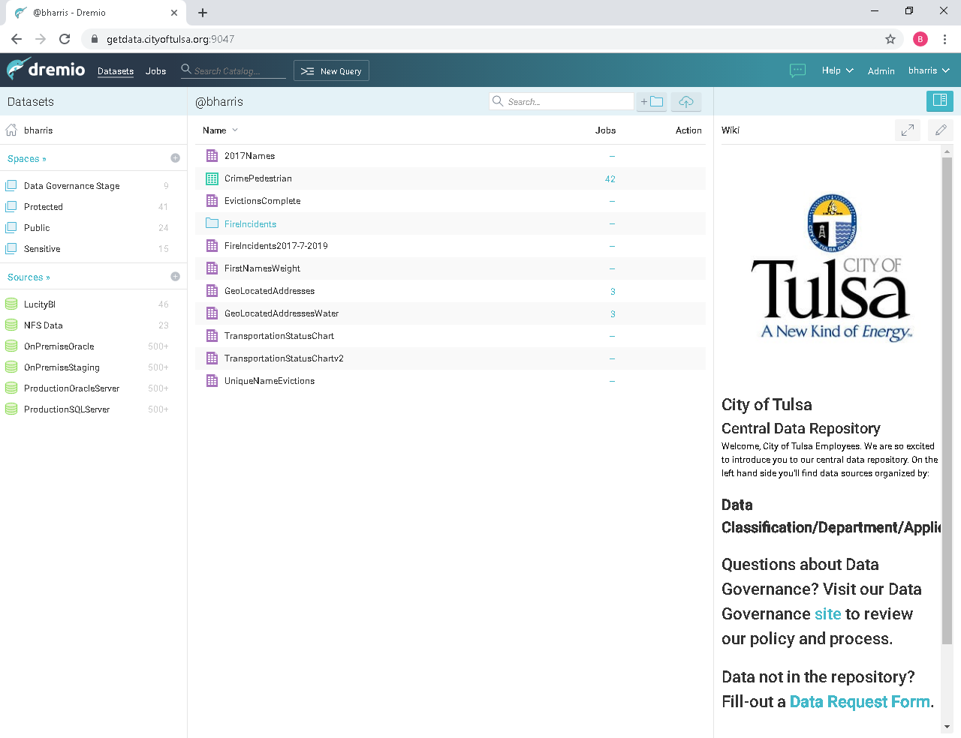

Slide 17
Open Data

Slide 18
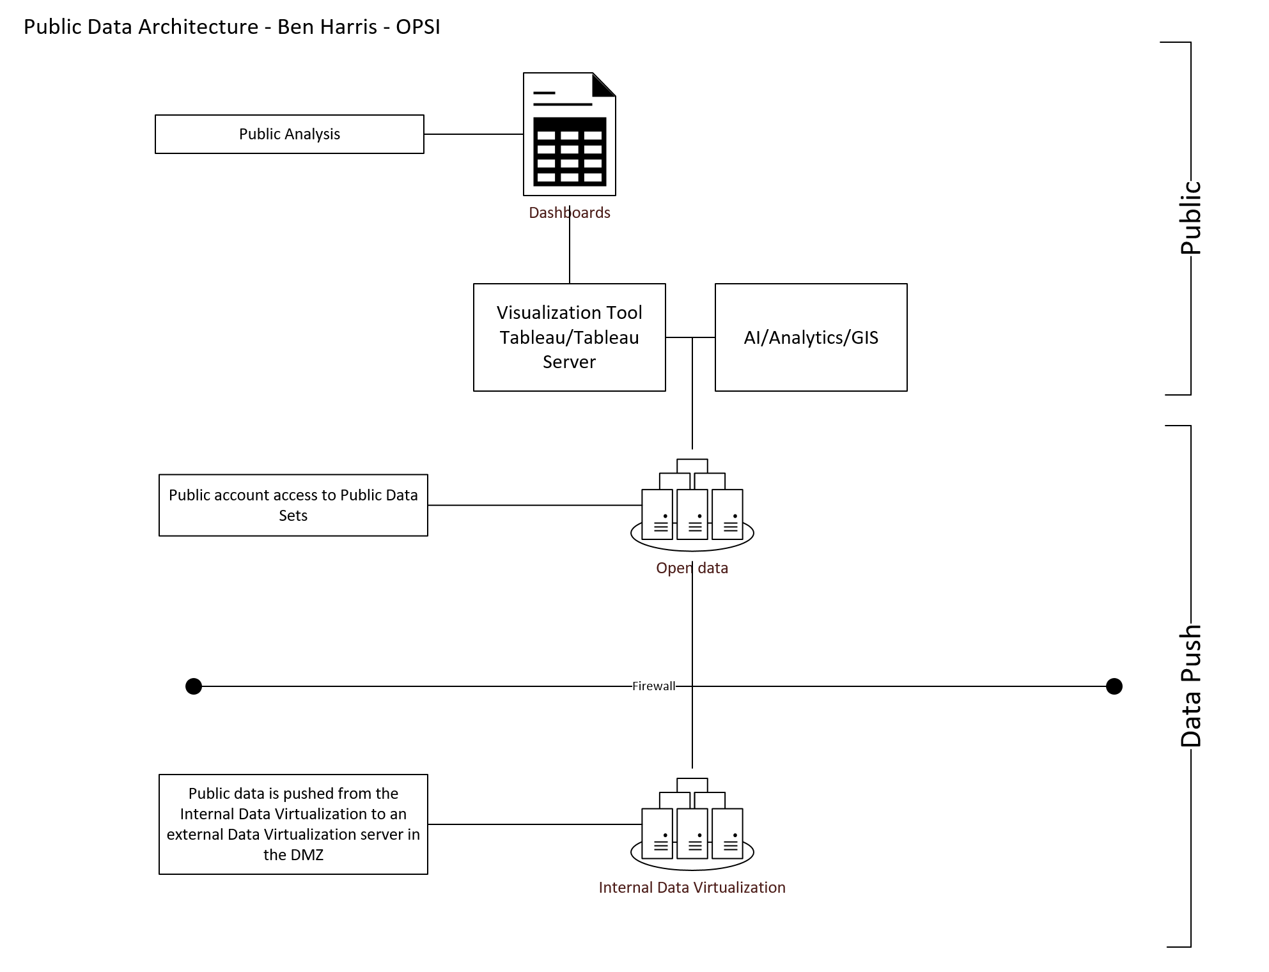
Notes:
Open Data allows us to improve transparency. All data that is classified as public gets automatically moved to the Open Data Portal.

Slide 19
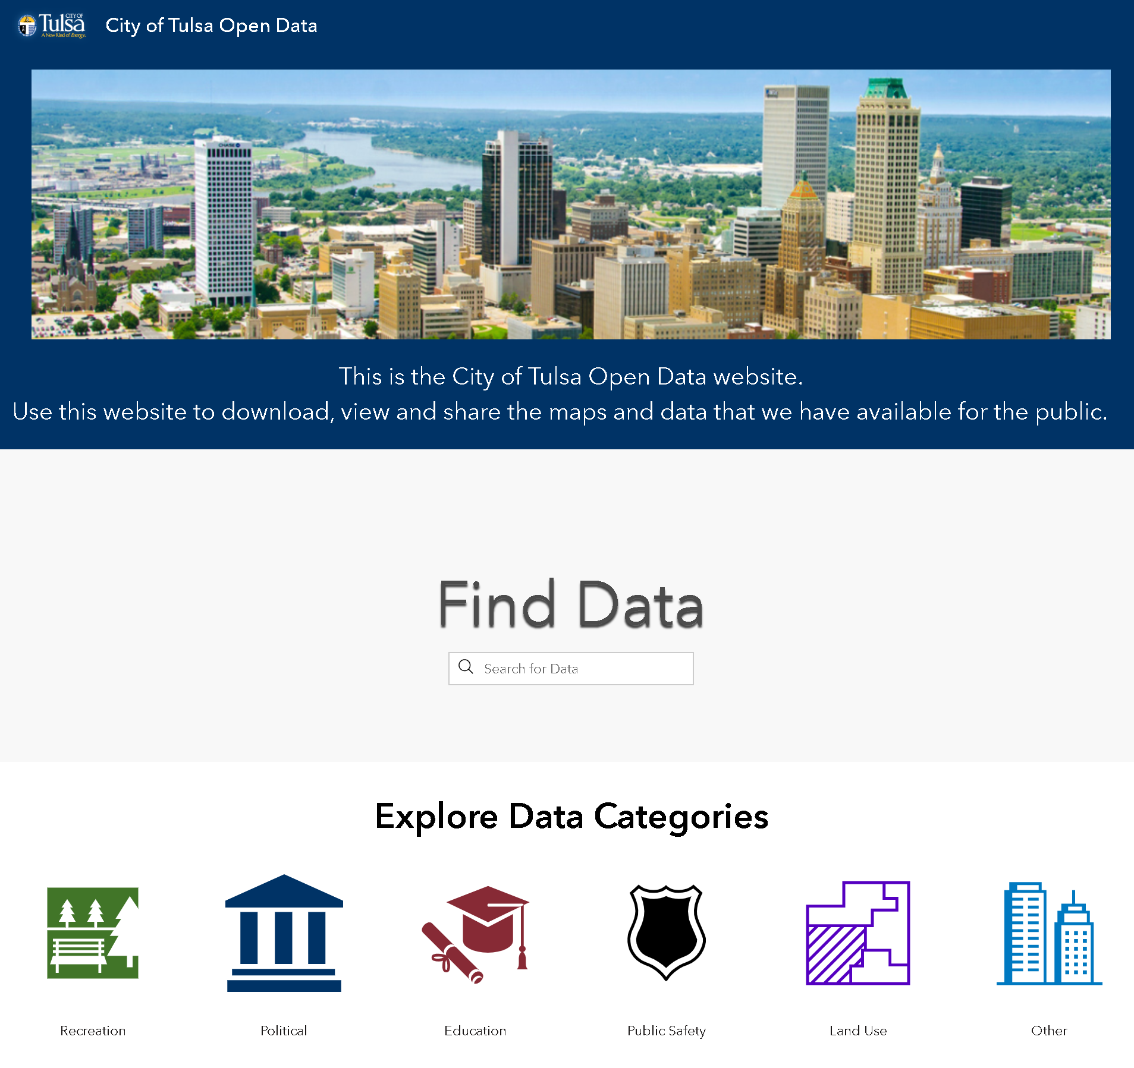
Notes:
The City of Tulsa's Open Data portal.

Slide 20
Analytics

Slide 21
Analytics
Management Control Systems
Research
CPI
AIM
Dashboards
AI
RPA

Slide 22

Management Control Systems
Notes:
The data governance committee encourages team work. It allows us recognize the differences between each organization, while also recognizing the similarities. Every department is part of the decision process.

Slide 23

Dashboards
Notes:
The data governance committee encourages team work. It allows us recognize the differences between each organization, while also recognizing the similarities. Every department is part of the decision process.

Slide 24
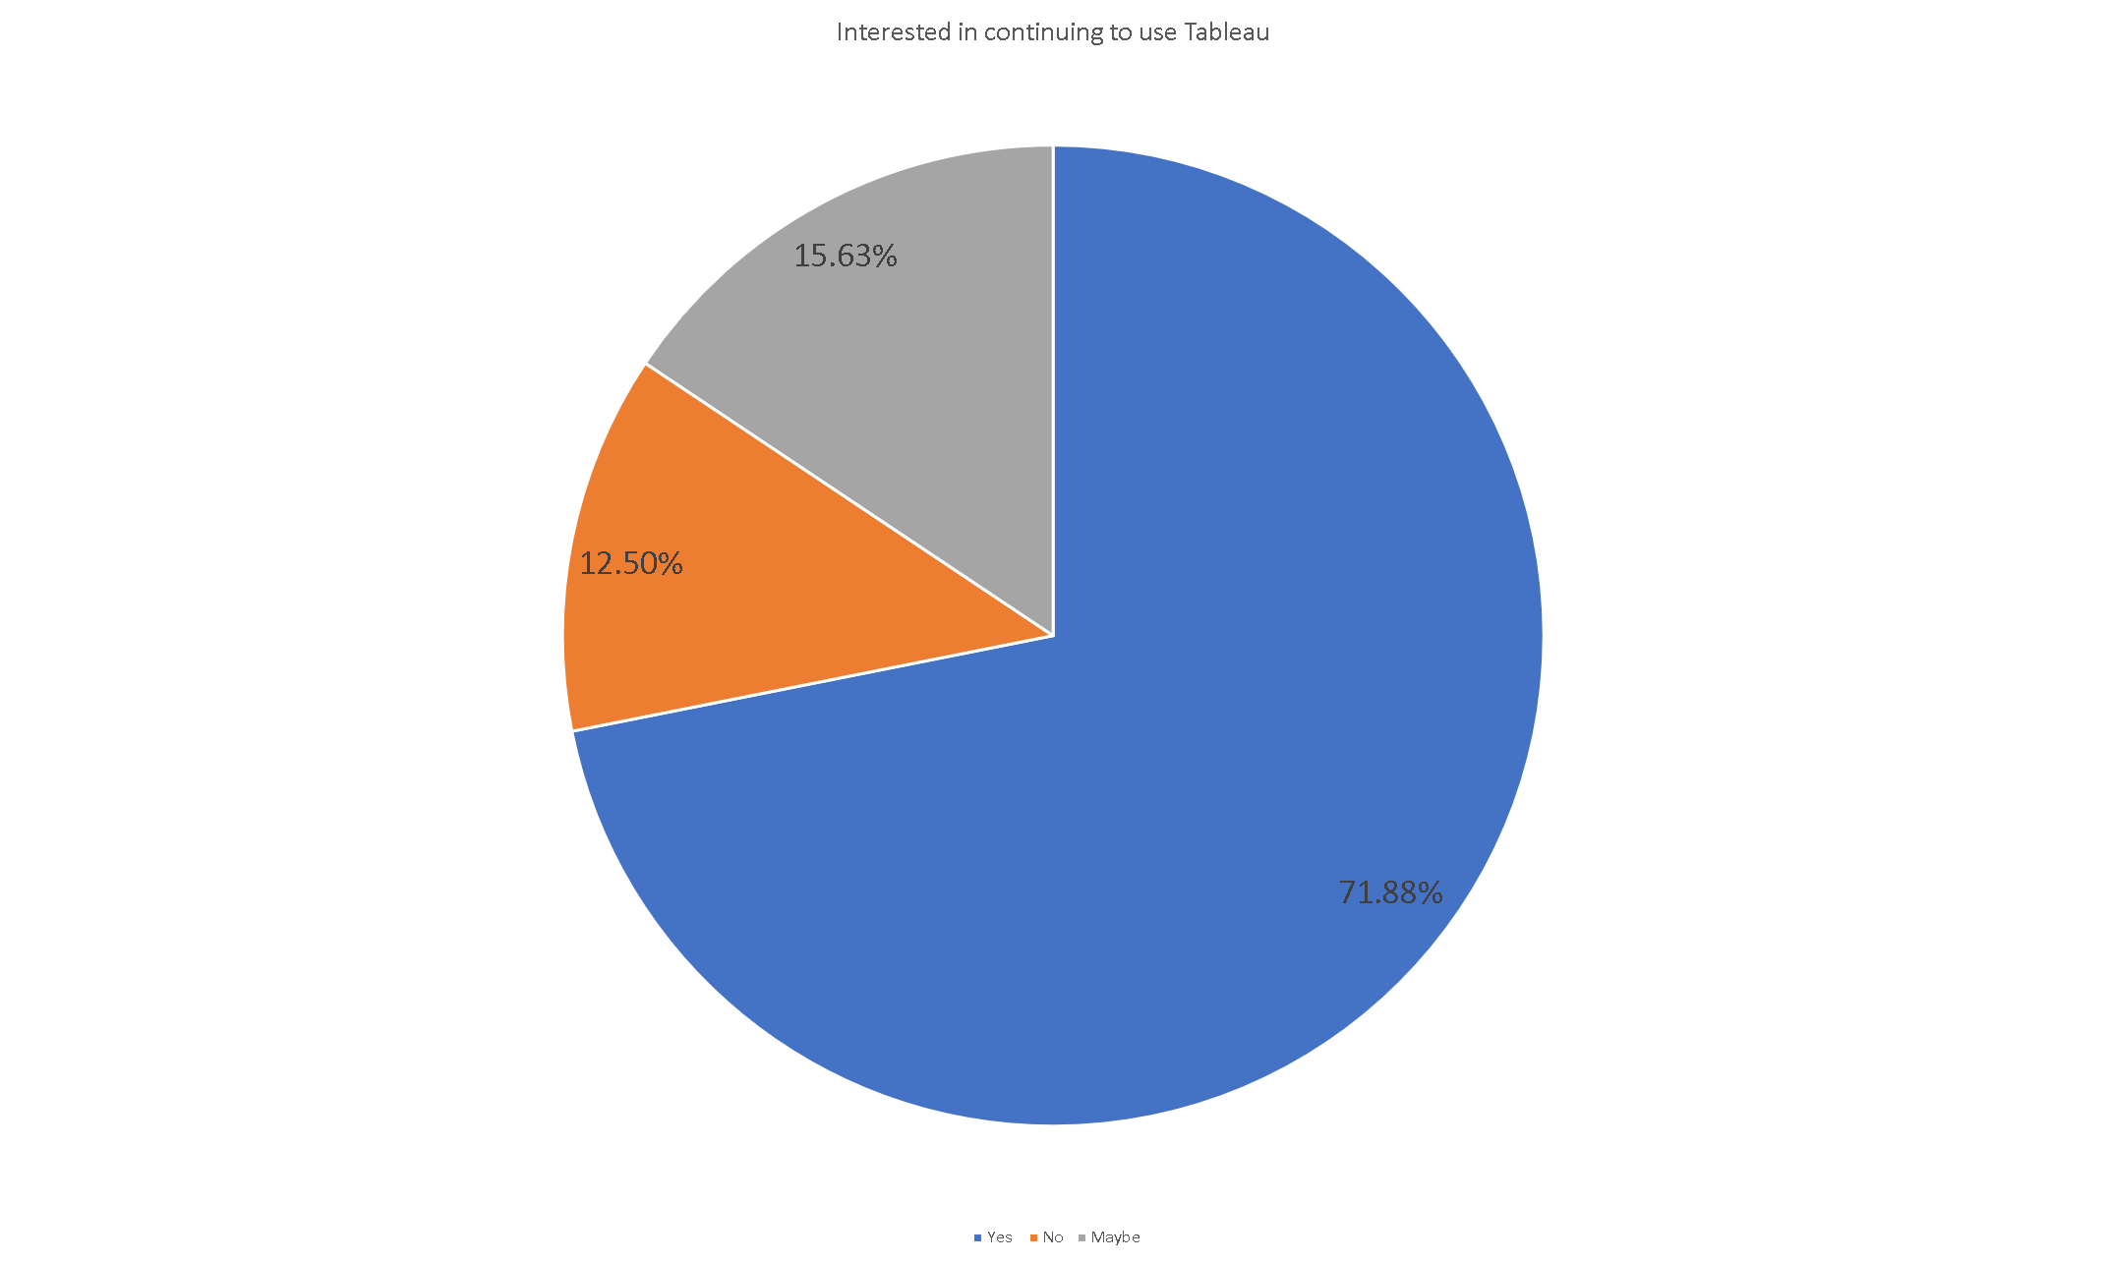

Slide 25
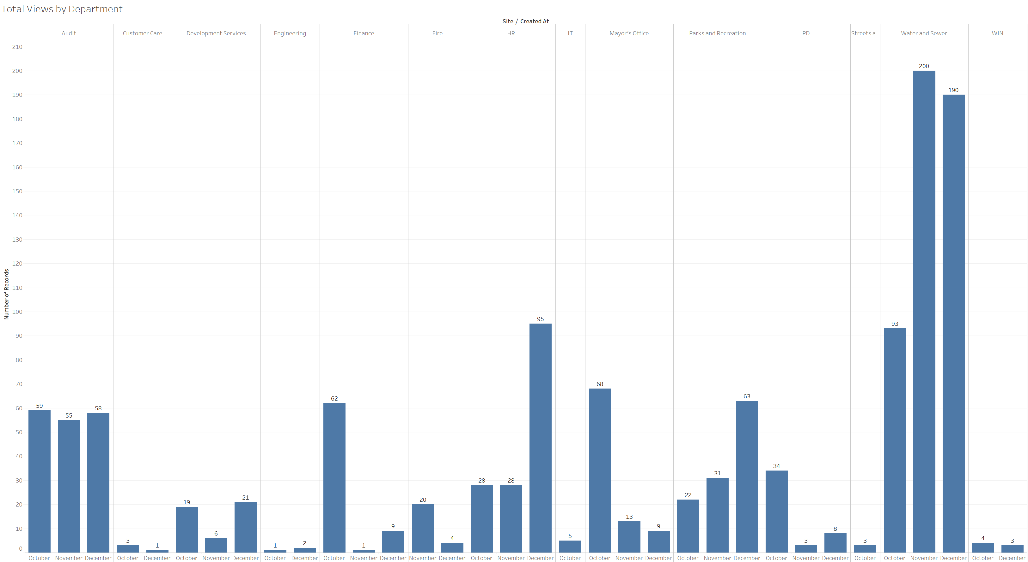

Slide 26
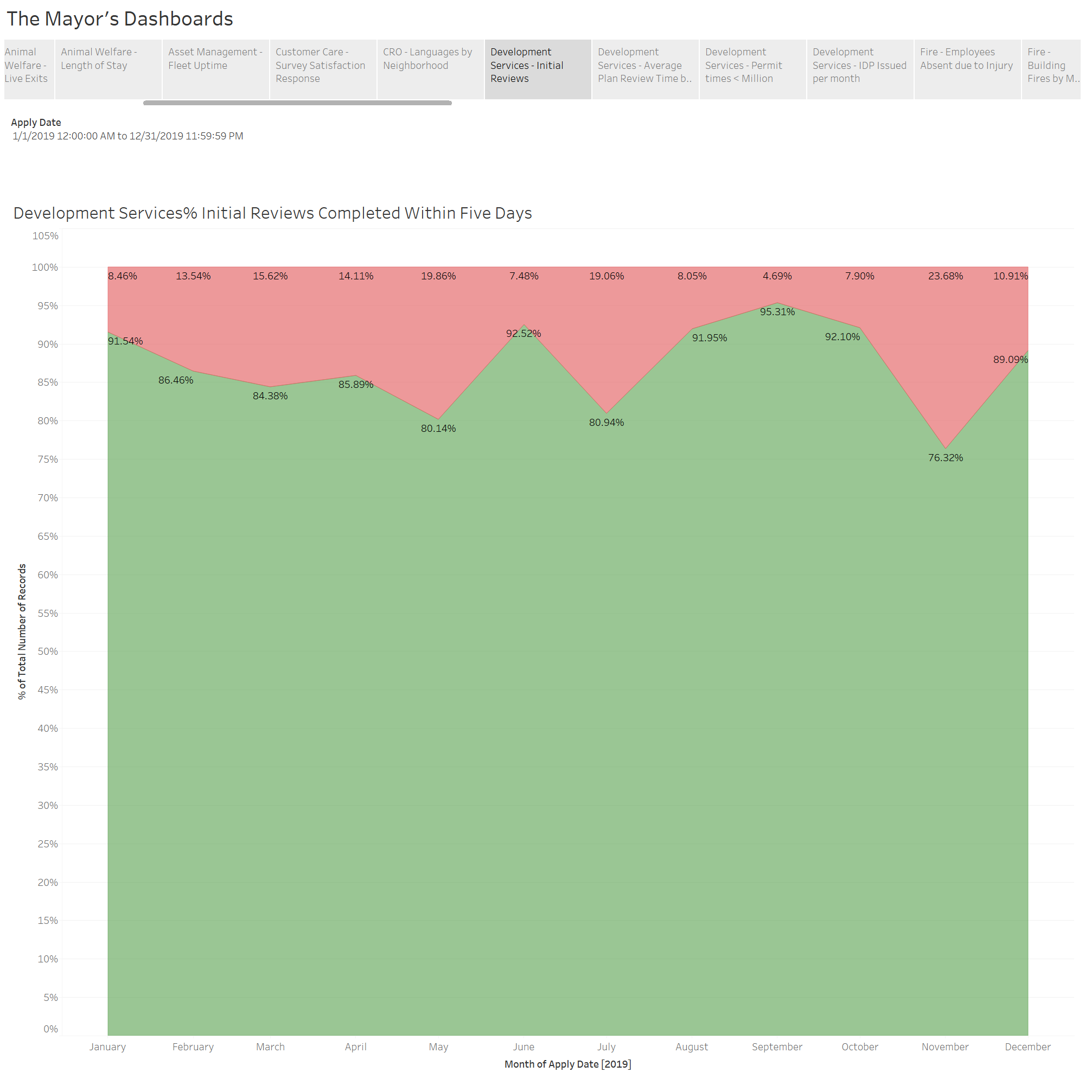

Slide 27
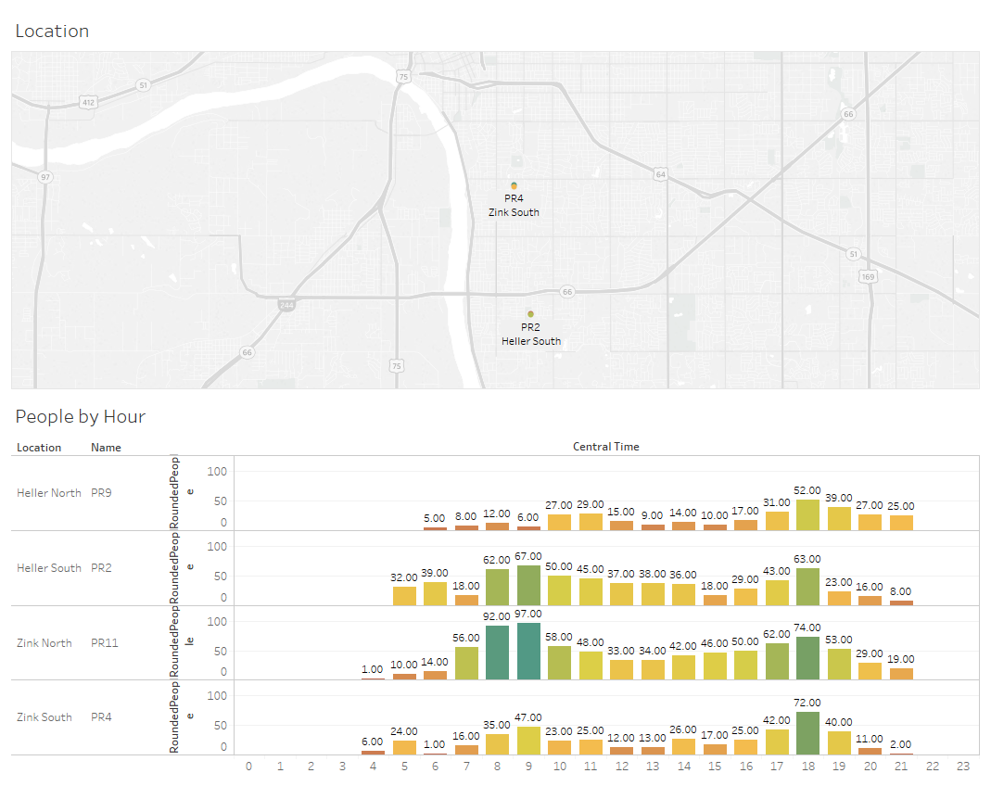

Slide 28
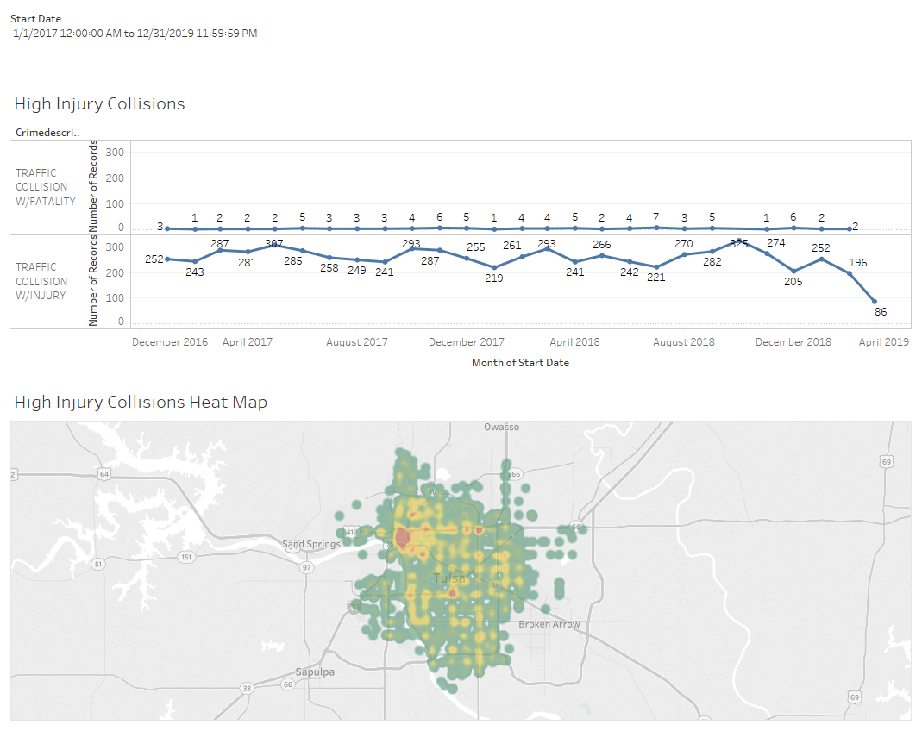

Slide 29
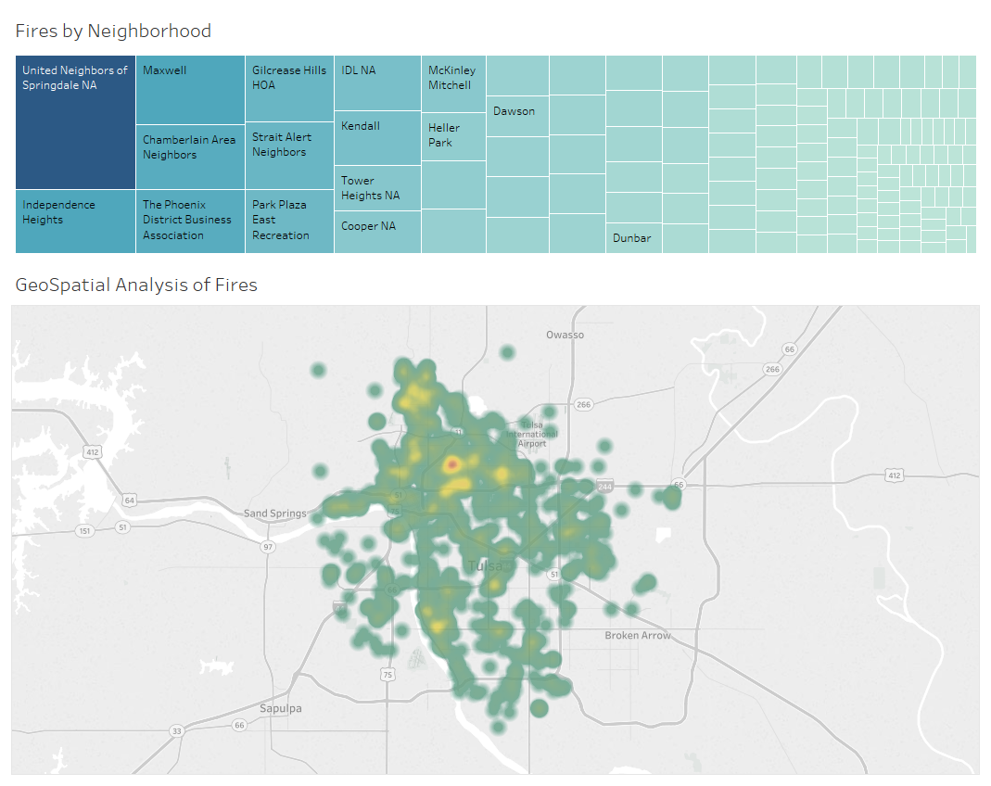

Slide 30
Artificial Intelligence

Slide 31
Current AI Implementations
AI
Vision
Text
Supervised
Edge
Refuse
Tennis
Sentiment
Evictions
Time
Risks
Ethical / Public Perception

Slide 32
AI Policy
The goal of AI is to automate processes or repetitive tasks, ultimately leading the organization to become more efficient.
AI’s purpose is not to replace jobs, but to use human capital most effectively. For example, if an employee retires, their position may be reimagined.
Each AI model developed should strive to remove bias. No model will go into production until equality and equity outcomes have been considered.

Slide 33
A few implementation approaches
Slow Gradual
  Healthier for the employees
  More Training
  Dependent on workforce
  …
Disruptive
  Faster
  Potentially better ROI
  Unhealthy for employees
  …
Mixed

Slide 34
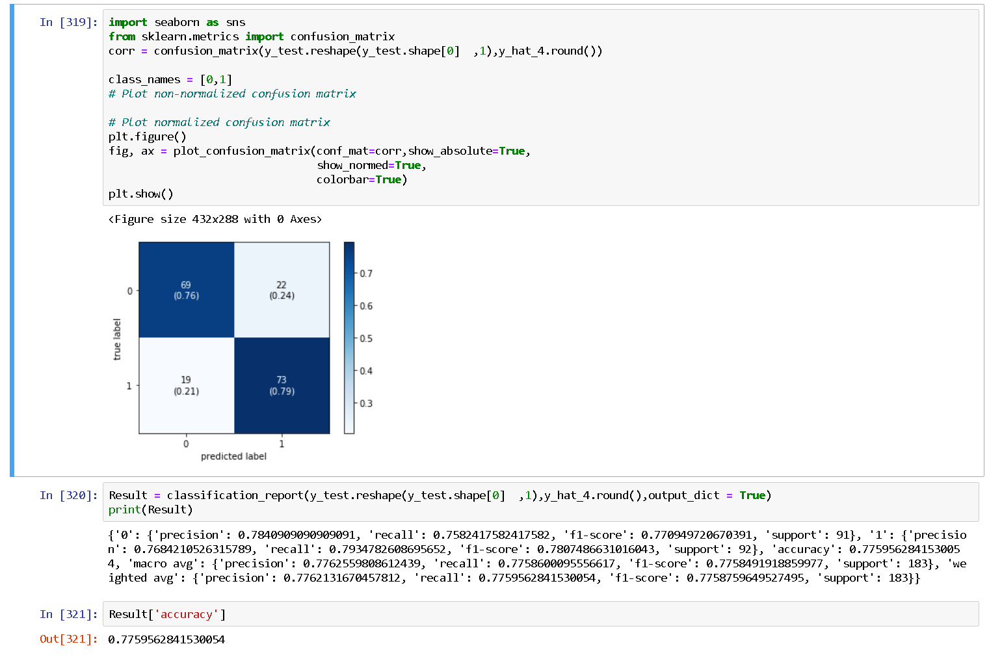
Eviction Project

Slide 35
Refuse Project
Objective of experiment: Use AI to perform object detection to locate nuisance violations.
AI performance goal: 80% accuracy

Slide 36
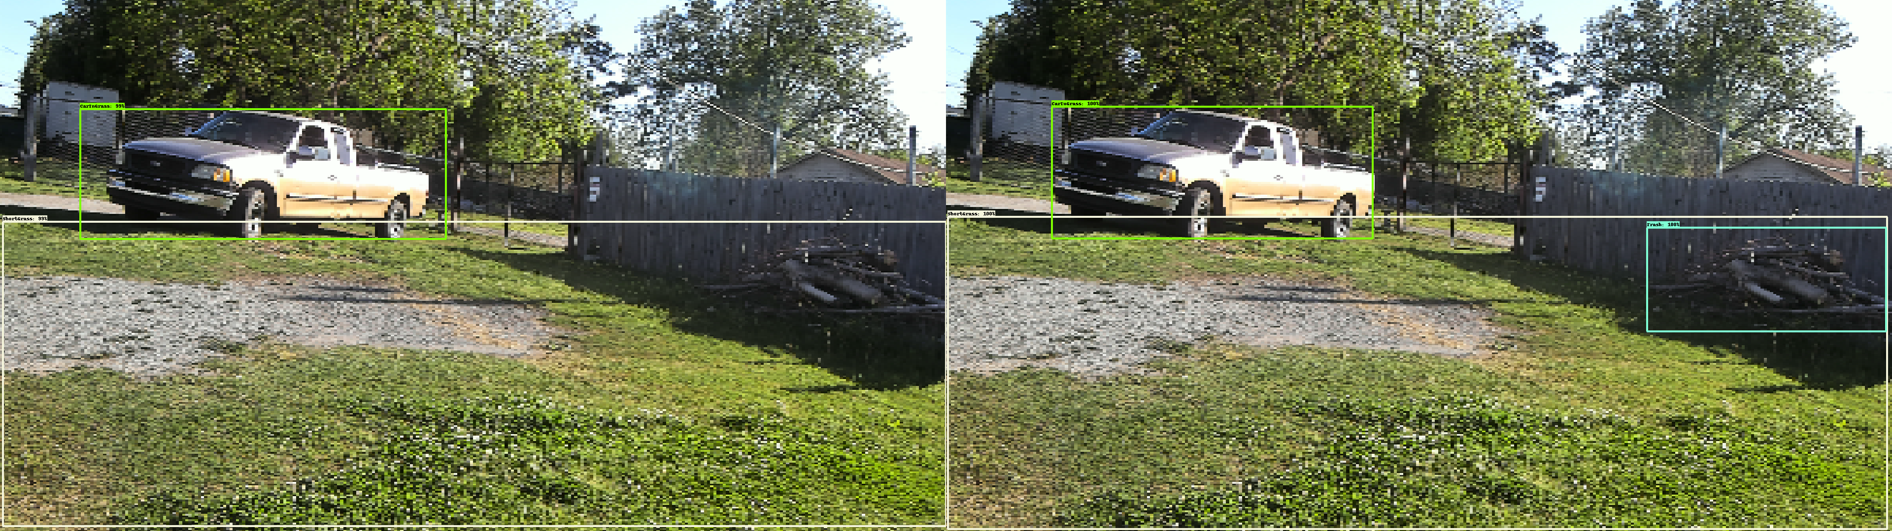
Model Results
Expected Results

Slide 37
Tennis Court Project
Objective: Use AI to track tennis court usage.
AI performance goal: Track usage on every tennis court(100+) for a month within the City.

Slide 38
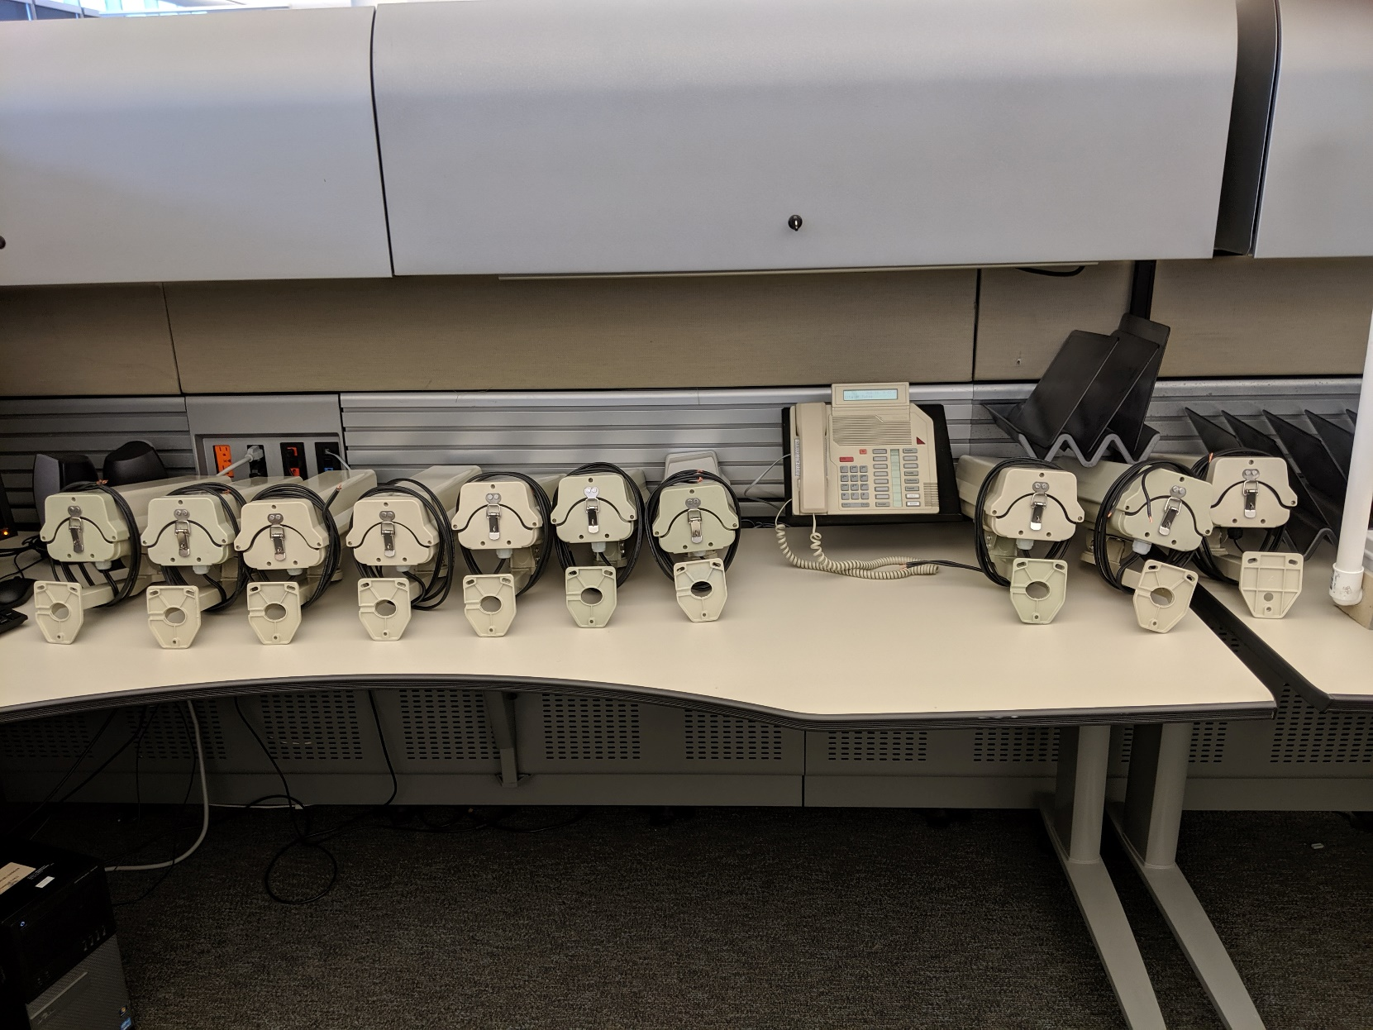

Slide 39
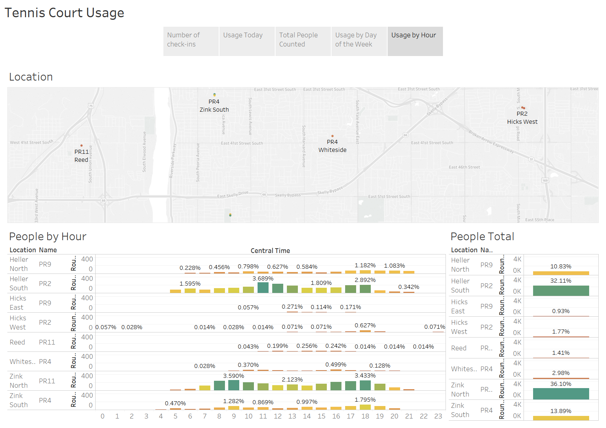

Slide 40
Training

Slide 41
Training Initiatives
Training
Tableau
UDP
Badges
Monthly
2 Day
12 Week Project
Merit

Slide 42
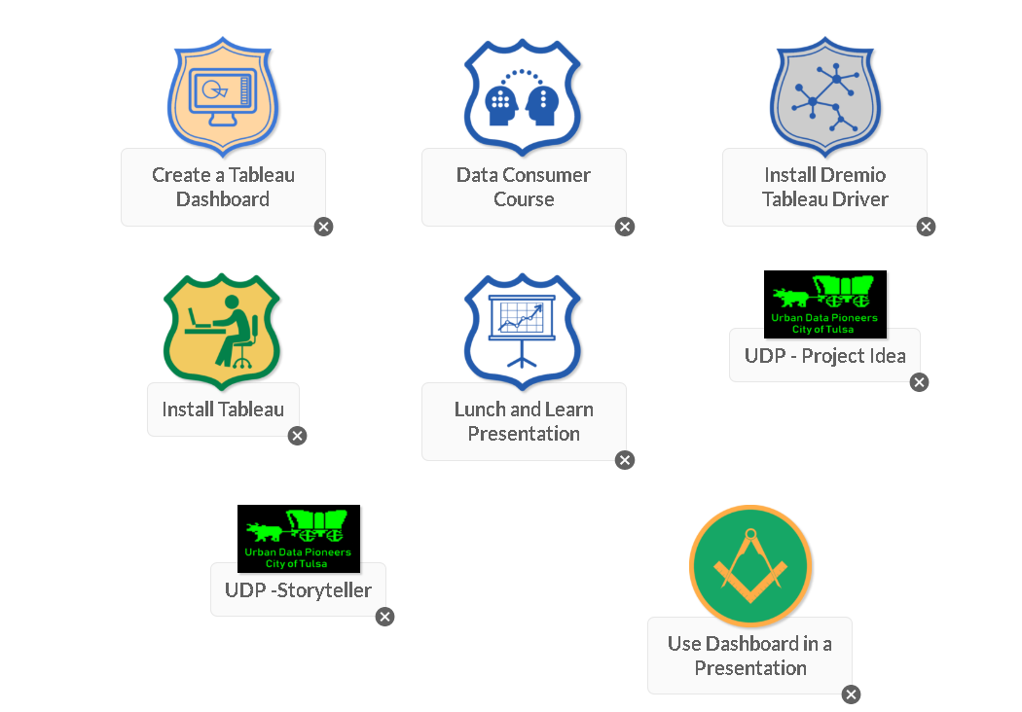
Tableau/Badges

Slide 43

Urban Data Pioneers

Slide 44
UDP Projects
Below are the projects we’ve completed with methodology documentation.
311 IVR Project
911 Call Center Staffing
HR Job Analysis
Refuse AI
Tennis Court Project
Properties most likely to catch fire
Snap Utilization
Pedestrian Crash Assessment

Slide 45
OQF/WWC

