Slide 1
Tulsa Race Massacre Investigation
Oaklawn Summary report
Forensic Analytical section

Slide 2
Oaklawn test excavations (Oct. 19-22, 2020)
Revealed a mass grave
Combined test excavations exposed nearly 27 square meters (290 square feet)
Mass grave could encompass an area that measures about 131 square meters (1410 square feet)
Based on soil core data

Slide 3
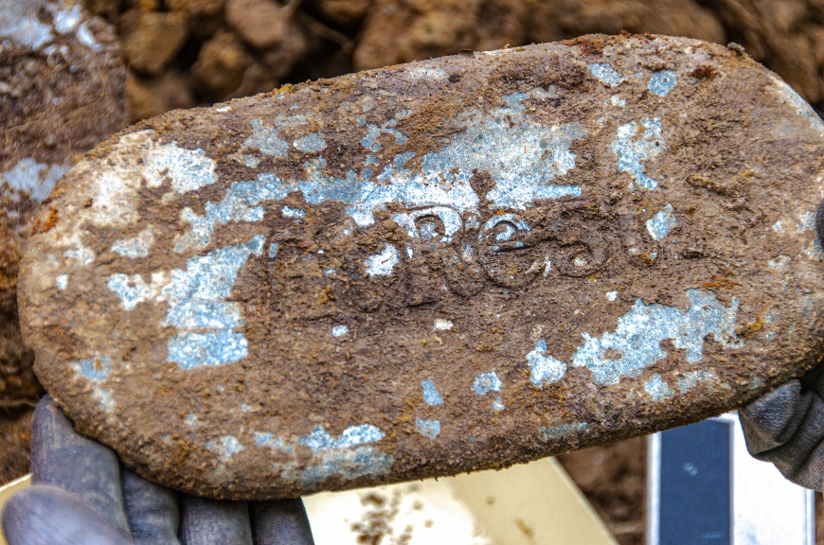
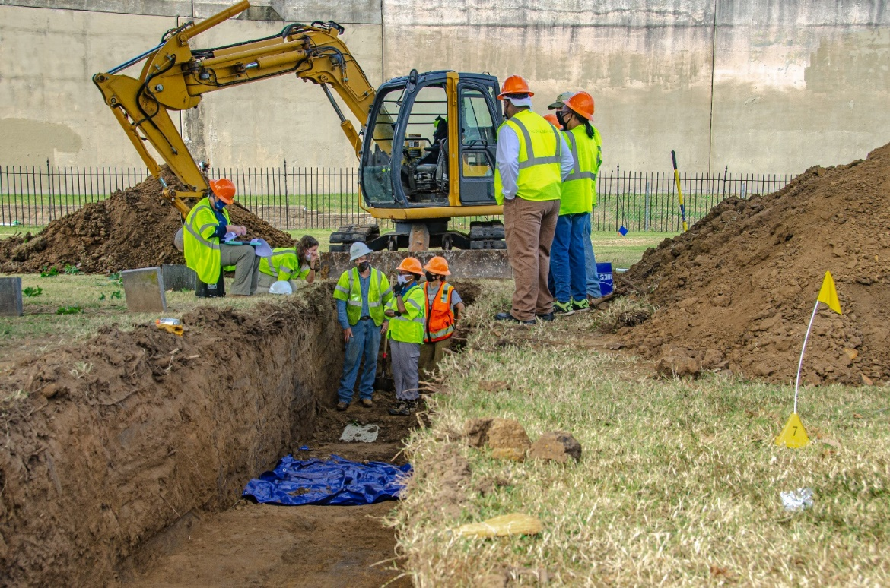
Oaklawn test excavations
At least 12 individuals
based largely on evidence for coffins and coffin hardware
Total number could include more than 30 individuals
If stacking of coffins took place, that number could be higher
Exposed coffins, but not remains themselves
(except Burial 1)
Additional investigations are needed to confirm initial assessment and whether these are Massacre victims

Slide 7
Death Certificate Data
Original 18 Death Certificate Data
N | Last Name | First Name | Cause of Death | Date of Burial
1. | Alexander | Gregg | GSW | June 2, 1921
2. | Walker | Henry | GSWs | June 2, 1921
3. | Adams | Ed | GSW | June 2, 1921
4. | Miller | Joe | GSW | June 2, 1921
5. | Unidentified Negro 1 |  | GSW | June 2, 1921
6. | Ree | Sam | GSW | June 2, 1921
7. | Unidentified Negro 2 |  | Thermal | June 2, 1921
8. | Lewis | Lewis | GSW | June 2, 1921
9 | Unidentified Negro 3 |  | Thermal | June 2, 1921
10. | Walker | Curly | GSW | June 2, 1921
11. | Howard | Ed | GSW | June 2, 1921
12. | Unidentified |  | GSW | June 2, 1921
13. | Unidentified |  | Thermal | June 2, 1921
14. | Stillborn |  |  | June 2, 1921
15. | Everett | Ruben | GSW | June 2, 1921
16. | Doe 1 | John | GSW | June 2, 1921
17. | Doe 2 | John | Killed | June 2, 1921
18. | Unidentified |  | Thermal | June 2, 1921
19. | Lockard | Ed | GSW | June 5, 1921

Slide 8
recovery and analysis Steps
1) application of a reversible preservative to most bones
2) in situ metal detection and possibly radiography to screen for projectiles
3) reconstruction of skeletal components relevant to identity, if preservation allows
4) examination and documentation of the morphological features of sex, ancestry, and age at death
5) examination and documentation of traumatic features or features that might be associated with a cause of death

Slide 9
Plans for the next phases of the investigation at Oaklawn…

Slide 10
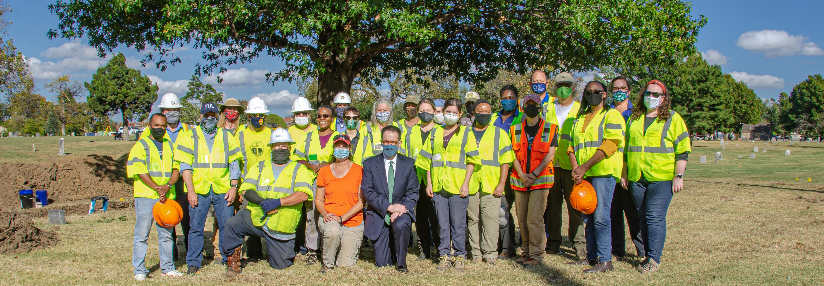
City of Tulsa: Mayor G. T. Bynum, Deputy Mayor Amy Brown, Michelle Brooks, Terry Ball, Mark Hogan, Tim McCorkle, Streets and Stormwater Division staff Cultural monitors (Public Oversight Committee): Brenda Alford (Chair), Kavin Ross (Greenwood Tribune), Chief Egunwale (African Ancestral Society), Greg Robinson (MET Cares Foundation) Physical Investigation Committee: Scott Ellsworth (Chair), Phoebe Stubblefield, Angela Berg, Carlos Zambrano, Alicia Odewale, Leslie Rankin-Hill, Amanda Regnier, Scott Hammerstedt, Kary Stackelbeck, Bob Brooks Other Field Crew/Advisors: Leland Bement (OAS), Debra Green (OAS), Jessica Cerezo-Roman (OU-Dep’t. of Anthropology), Heather Walsh-Haney (Florida Gulf Coast University), Robert Pickering (TU-Retired), Betsy Warner, graduate students from UF and FGCU (Rose, Raphaela, Sonya, Siobhan) and one undergraduate from OU (Noah Place)

