Slide 1
International Credential Recognition
December 1, 2020
Flourish Tulsa: Skilled Immigrant Integration Program
Global Talent Bridge

Slide 2
I. Welcome & Introductions
City of Tulsa Mission, Vision, Values
Resilient Tulsa
New Tulsans Initiative
Flourish Tulsa
Partners
WES Global Talent Bridge
II. Skilled Immigrants and Refugees in the U.S.
III. Credential Evaluation and Recognition
IV. Resources
V. Q&A

Slide 3

Interpretation & Translation
Spanish closed captioning (CC) is available
Use chat box to ask questions in Spanish or English during the Q&A
We will email the PowerPoint in English, Spanish, and Zomi

Slide 4
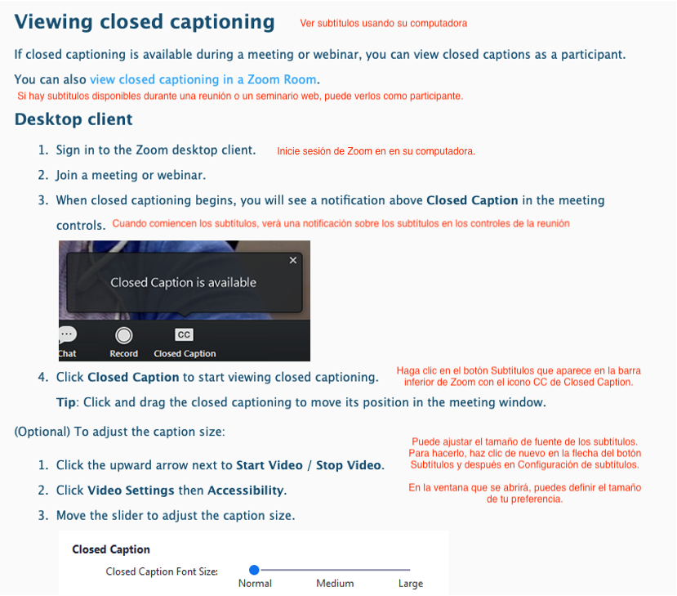
CC Zoom Feature

Slide 5

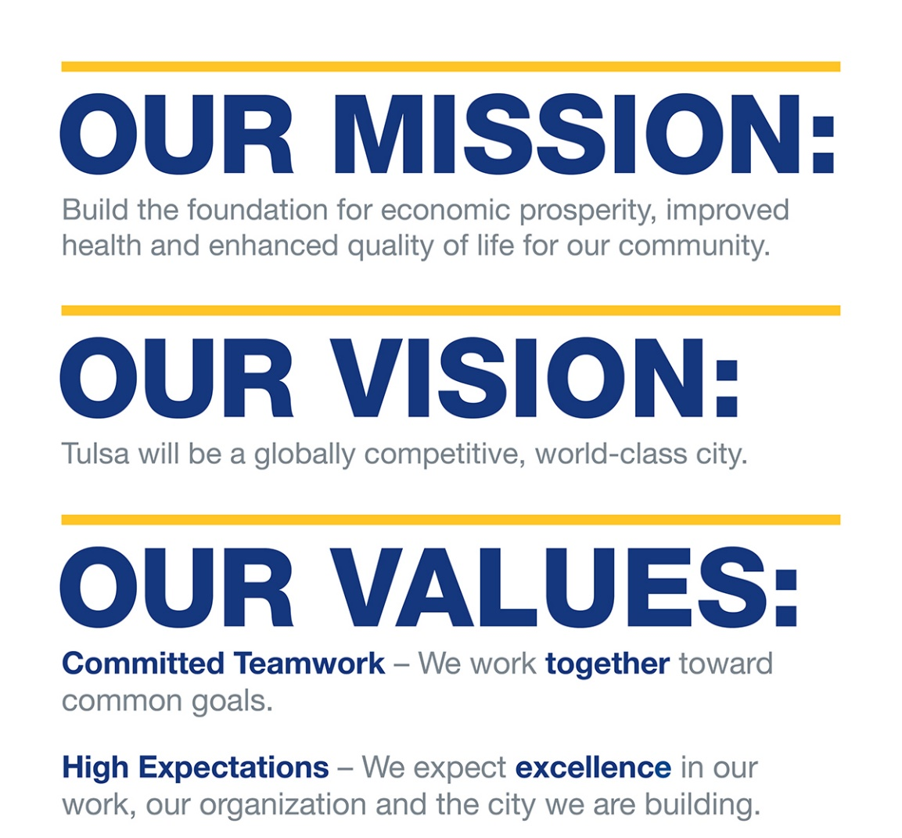
City of Tulsa Mission, Vision, and Core Values

Slide 6
A Vision for Tulsa
An inclusive future that honors all Tulsans
Tulsans equipped to overcome barriers and thrive
Economic opportunity for all Tulsans
City and regional systems transformed to improve outcomes for all Tulsans

Slide 7

Resilient Tulsa
Tulsa’s resilience strategy serves as a roadmap to address Tulsa’s most pressing challenges and seeks to build capacity among residents, city systems, and community partners to build a more resilient city.
Robust community engagement and input
Released in the summer of 2018
Contains 41 policies, programs, practice changes, and events
www.cityoftulsa.org/resilienttulsa

Slide 8

New Tulsan Initiative
The New Tulsans Welcoming Plan is comprehensive roadmap for building a more cohesive and equitable Tulsa and fostering connections between all immigrant and long-term residents.
Ultimately, the Welcoming Plan is a commitment to the social inclusion of all immigrants and promoting the shared prosperity for all Tulsans.
Notes:
- September 2017, Mayor GT Bynum announced the launch of the New Tulsan Initiative(NTI)
- During the first year, the City collaborated with Tulsa Regional Chamber of Commerce and New American Economy (NAE) to prepare an economic impact report of Tulsa Immigrants
- Mobilized and led multisector partnerships to develop the New Tulsans Welcoming Plan (November 2017 summit with over 120 stakeholders, subcommittees for each of the five areas, focus groups etc.)

Slide 9
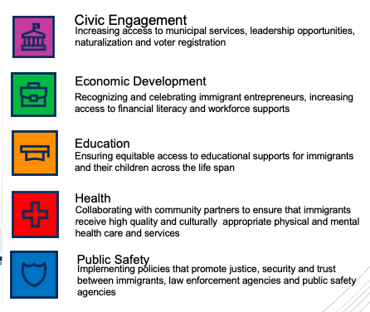
New Tulsans Welcoming Plan

Slide 10
Flourish Tulsa
Supporting immigrants to fully utilize their skills and education through credential recognition, Pathways guides, and cultural competency trainings.
Notes:
Mention WES SIIP program

Slide 11
Overview
Outcome 1: Support employers/workforce providers with credential assessment and help the immigrant community access resources for credential recognition
Outcome 2: Develop 3 career pathways guides for internationally educated immigrants that meet sector need
Outcome 3: Offer trainings for employers and workforce providers on cultural competency in working with skilled immigrant professionals

Slide 12

Partners

Slide 13


Slide 14
Mosaic’s foundational pillars
  CEO COMMITMENT Visual and vocal commitment to diversity and inclusion work.
  DIVERSE SUPPLIERS Written diversity supplier statement, policies and procedures.
  PEOPLE Recruit, train, develop, support and promote diverse candidates and employees.
  INTERNAL POLICY Supports and creates equity for full employment base around race, religion, sexual orientation, etc.
  COMMUNITY OUTREACH Publicly supports diverse groups, organizations and programs in their community.

Slide 15

Mosaic’s PERKs
Membership has its perks!
Mosaic’s PERKs
Membership has its perks!
Partnership
Mosaic supports visual & vocal commitment to diversity, equity & inclusion from the top down within organizations and between organizations.
Engagement
Mosaic promotes engagement with groups, organizations and initiatives that support inclusivity within the community.
Resources
Mosaic promotes best practices that help recruit, train and develop diverse and inclusive candidates and employees.
Knowledge
Supports and creates equity for full employment base around race, religion, sexual orientation, etc.
Notes:
Mosaic’s five key metrics mirror best practices adopted by programs across the country.

Slide 16

HOW WE HELP
Creek | Osage | Pawnee | Tulsa
Our Services:
Job Readiness: Resume Workshops Social Media Etiquette Interview Prep
Job Placement: Trainings and Certifications Work Experiences
On the Job Trainings
Youth Programing, Support Services, and More!
Immigrant and Refugee Specific Services: Workforce Tulsa connects you with our partners like the Oklahoma Successful Adulthood (OKSA) program and the Tulsa Dream Center to help address your needs.
CONNECT WITH US
www.workforcetulsa.com 918-796-1200

Slide 17
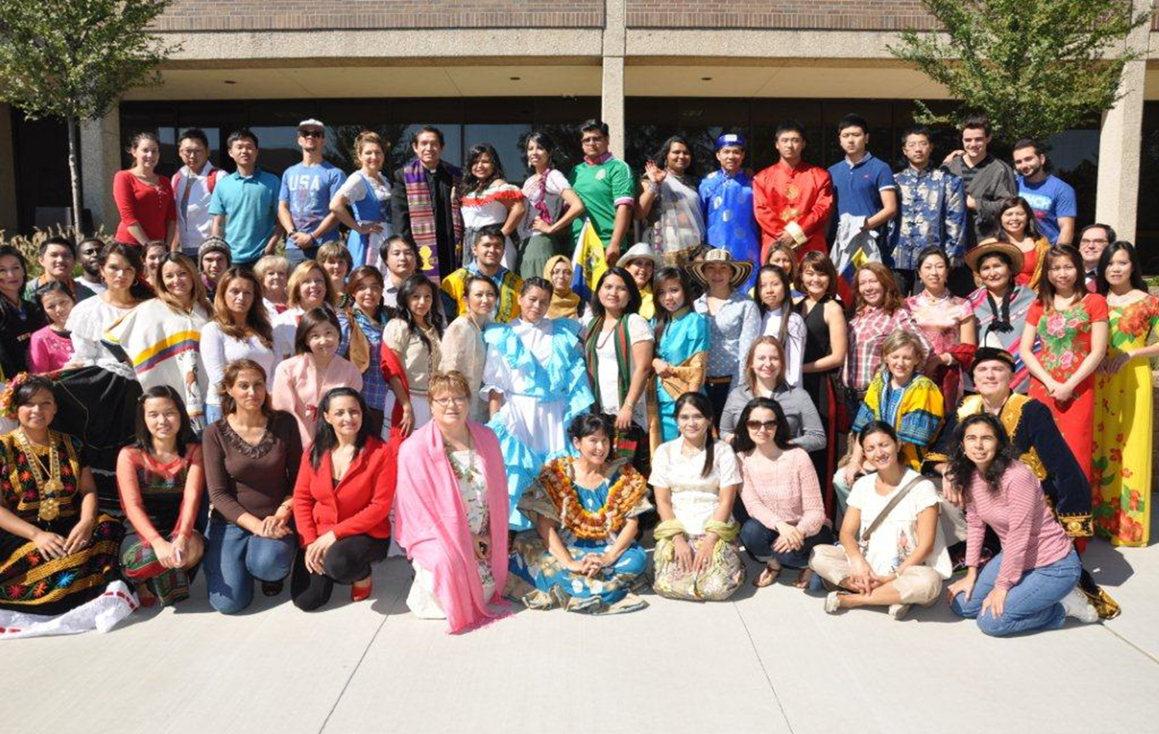
The ESL Office at NEC provides services across all TCC campuses

Slide 18
English as a Second Language Program (ESL)
The ESL office at Northeast Campus provides services across all TCC campuses.
It is a diverse program welcoming students from 35 countries and 15 different language groups.
The program provides pathways to college through completion of the Intensive English Program (Bridge to College) or passing the TOEFL, Duolingo, or IELTS English proficiency exam.
ESL blended and online courses prepare students to succeed academically and in the workplace.

Slide 19

SUCCESS is..
"receiving what you need for your life.
English has helped me have the confidence to move forward for the future.
I want a professional job and happy life."

Slide 20

OUR SERVICES
Immigration and Refugee Services
  Citizenship Services
    Citizenship Classes
    Citizenship Legal Services
  Legal Services
    Consultation to identify eligibility and Legal Representation for eligible cases
    Translation of documents and notarization
  Refugee and Asylee Services
    Social Services
  Adult and Family Education
    ESL classes
    Classes for young children during the adult classes (not during COVID)
    In school and after school tutoring in partnership with schools
  Employment Services
    Partnership with employers to place immigrants and refugees in employment
    Career Pathway guidance
    Job preparation
  Translation and Interpretation Services
    Community, Medical, Legal, etc.
    Current languages include Arabic, Burmese, French, Hmong, Russian, Spanish and Zomi.
  Health and Wellness Services
    Gym and fitness classes

Slide 21
NUESTROS SERVICIOS
Servicios para Inmigración Y Refugiados
  Servicios de Ciudadanía
    Clases de Ciudadanía
    Servicios Legales para Ciudadanía
  Servicios Legales
    Consultas para identificar Eligibilidad y represetacion legal para los casos eleginles
    Traducción de documentos y notrización
  Servicios para Refugiados y Asilados
    Servicios Sociales
  Educación para Adultos y Familias
    Clases de Inglés
    Clases infantiles durtante las clases de adultos (suspendidas debido al COVID)
    Tutoria en escuelas y fuera de escuelas en conjunto con las escuelas
  Servicios relacionados a Empleo
    Cooperación conjunta con empleadores para promover plazas de trabajo para la comunidad inmigrante
    Guía para la trayectoria profesional
    Preparación para la aplicación a empleos
  Servicios de Interpretación y Traducción
    Interpretaci{on y traducción comunitaria, médica, legal, etc.
    Idiomas: Árabe, Birmano, Francés, Hmong, Ruso, Español y Zomi
Servicio de Salud y Bienestar
    Gimnasio y clases de ejercicios grupales

Slide 22
If you want more information
Please visit our website:
www.ywcatulsa.org
Or call our main line (918)663-0377
Si quiere más información
Por favor visite nuestra página:
www.ywcatulsa.org
O llame a nuestra línea principal (918)663-0377

Slide 23


World Education Services (WES) is a non-profit social enterprise dedicated to helping internationally educated individuals achieve their educational and professional goals in the United States and Canada.
WES Global Talent Bridge is
a program of WES that helps skilled immigrants and refugees fully utilize their talents and education in the United States and Canada.
Notes:
A little bit about World Education Services (WES)
We are a social enterprise dedicated to helping international students and professionals achieve their educational and professional goals in the United States and Canada
WES was founded in 1974 in New York and we have an office in Canada
WES evaluations are used by universities, colleges, professional licensing bodies, and employers
Global Talent Bridge is a program of WES, committed to:
Elevating the issues of immigrant integration
Develop programs and policies to meet the needs of skilled immigrants, and
Serve as the hub of networks that advance the opportunities for skilled immigrants to contribute their talents to their full potential

Slide 24
Skilled Immigrants & Refugees in the U.S.
Notes:
Today, I would like to talk to you about helping internationally trained professionals get back to their profession or continue their education in the US using their credentials.
To help frame our discussion, I’m going to define some terms I will be using during the presentation.

Slide 25


Skilled Immigrants and Refugees
Individuals with post-secondary degree or certification and/or professional experiences earned abroad
Individuals seeking to work in their profession or pursue further education to qualify for a career in the United States
Notes:
First, when I’m talking about skilled immigrants and refugees what I’m talking about are individuals with high school education or higher.
Most of the resources I will be sharing are for people looking to get back to their profession or continue their education

Slide 26

What is Brain Waste?
The underutilization of skills and education in the workplace despite high professional qualifications, resulting in unemployment and underemployment.
Notes:
A research term, Brain Waste has been used to reflect the underutilization of skills and education in the workplace resulting in unemployment and underemployment by the Migration Policy Institute

Slide 27
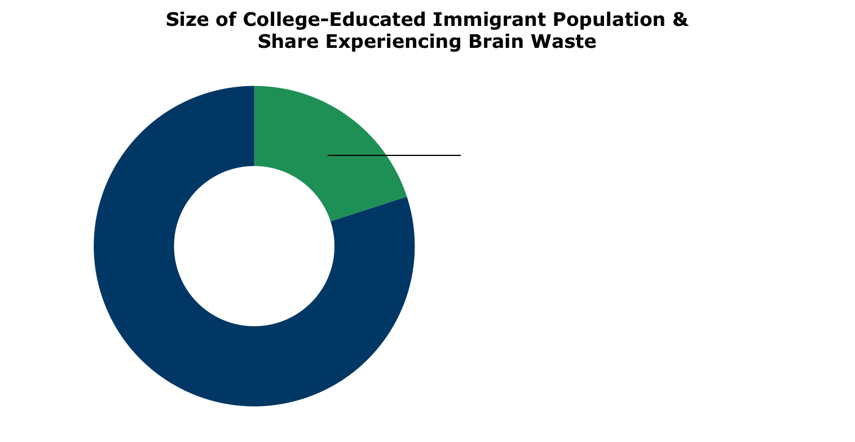
Brain Waste: How Does It Affect Skilled Immigrants and Refugees?
2+ million
23.4% of the 9.3 million college educated immigrants are either working in low-skilled jobs or are unemployed in the U.S. labor market
9.3
million
Source: Migration Policy Institute (MPI) tabulations of the U.S. Census Bureau American Community Survey (ACS) and Decennial Census, 2018.
Notes:
The Migration Policy Institute through their research found about 1 in 4 or 23.4% of college educated immigrants are underemployment or unemployed in their field.
That’s over 2 million of the 9.3 million college-educated immigrants in the US
So, what are some of the reasons why a quarter of immigrants are underemployed or unemployed in their field…

Slide 28




Factors Driving
Brain Waste
Why does a person with skills, education, and high professional qualifications in the workplace find themselves in unemployment or underemployment?
  Inadequate recognition of international education and credentials
  Lack of education and/or work experience in the U.S.
  Low social capital
  Limited English proficiency
Notes:
Some factors we at WES have identified,
Credentials earned outside of the US are not recognized, and immigrant might not know how to get credentials recognized
Not having additional education completed in the US – short-term or long-term study / certificate program.
Being new to the country, not having community or network. What we refer here as low social capital. These networks include alumni and colleagues, family friends, etc
Lastly, limited English proficiency
Next slide

Slide 29
Credential Evaluation and Recognition
Notes:
Today, we will be talking about credential recognition.

Slide 30

What Is Credential Evaluation?
  Compares academic accomplishments to standards in the U.S.
  Provides a U.S. academic equivalency
  Helps receiving institutions better understand the academic background of internationally educated professionals
Notes:
A credential evaluation is a comparison of academic credentials to the education standards in the US.
It provides immigrants and international students a US equivalency of their education. And it helps institutions like schools, employers, and licensing boards better understand internationally educated professionals’ academic background.
For your clients this means helping them validate their education and plan their careers in the US. The evaluation report is a tool that helps them make key decisions in their next steps whether they want to re-license in their profession, further their education, or seek employment opportunities.
The most challenging part of getting a credential evaluation is gathering the required official academic documents. We have different requirements for different countries. In some cases, the clients have to go back or ask someone to get the documents on their behalf.
But it’s our strict document requirements that have helped us build our reputation (at WES). Many institutions don’t accept other reports than those issued by WES. The effort the clients make to get their documents pays off once they have the report in hand and it’s accepted by a high number of institutions.

Slide 31

Obtaining a Credential Evaluation
No universally accepted evaluation service
www.naces.org
Notes:
Different trusted evaluation agencies are available through the National Association of Credential Evaluation Services (NACES).
Understanding the requirements of the receiving institution will help determine evaluation source and type.

Slide 32
Credential Recognition
Acceptance of international academic
credentials or credential evaluation by the receiving institution (employer, regulatory body, academic institution, and immigration authorities)
Evaluations are advisory in nature; it is the recipient’s decision to recognize/accept the equivalency
No universally accepted service
Notes:
In summary, A credential evaluation provides a US academic equivalency of international education.
Credential recognition however, is the Acceptance of international academic credentials by employers, regulatory bodies, and academic institutions.
The clients submit their reports to these institutions, which we call Recipients or End-Users, with the hope that their international credentials will be recognized.
There isn’t a universally accepted credential evaluation service in the US.
As I mentioned earlier, you should be encouraging your clients to contact the institution that requires their evaluation to understand their specific requirements.
For example - Do they need a dxd, cxc, or does the institution do their own assessments.
Are there any questions regarding what a credential evaluation is, it’s main purposes and the acceptance of it?

Slide 33



Using a Credential Evaluation
Apply to college/university
Higher Education
Start licensing process in a specific industry and state
Licensing
Meet job requirements that match prior educational and professional experiences
Employment
Notes:
NOTE: How many of you have been told to get a second bachelor or even worse a GED? How many of you have been told you need to restart anew in the US since your education from aboard doesn’t matter? What did we say earlier –INTERNATIONAL EDUCATION AND EXPERIENCE IS VALUABLE. So why would they tell you otherwise? Are they right? Always move forward, if you have a bachelor and want to go back to school get a masters, if you have a masters but it’s not in the field you want to purse in the US get another masters. Unlike most foreign education systems in the US graduate programs don’t require you to have a specific undergraduate degree (i.e. a Math major can purse a law degree, a Biology major can pursue an MBA). Always think of your end goal, chart a course to help you get to your end goal.

Slide 34
World Education Services (WES)
Credential Evaluation Process
Notes:
As an example, I will share the WES evaluation process

Slide 35
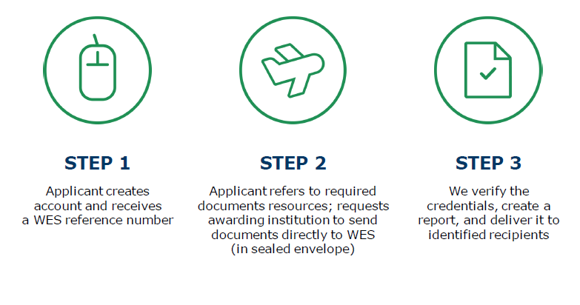
Overview of Evaluation Process
Notes:
WES evaluation begins with applicants creating an account at wes.org
Once an account created the applicant will get a reference number. This will be an id for all WES evaluation correspondence
The second step is to collect all the required documents and send to WES, including transcripts and other documents from awarding or recording keeping institutions directly to WES in a sealed envelop
Once, all necessary documents have been submitted and payment is made WES will verify and issue an evaluation report

Slide 36
Required Documents
Notes:
This is a resource you can review before opening an account to find out what documents you’re required to submit

Slide 37
Required Documents

Slide 38
Steps of Credential Evaluation
Applicant submits official academic documents and English translation
Evaluators then:
  Verify the status of the credentialing institutions and authenticity of the credentials
  Evaluate credentials according to admissions requirements, education levels, institution types and objectives of the educational programs
  Measure the credentials against U.S. standards and converts credit hours and grades on a 4.0 scale
Evaluation reports are reviewed and sent to applicants
*Based on WES evaluation process
Notes:
From WES Website:
“WES reserves the right to verify all documents submitted for evaluation. WES will contact your institution or other authorized source to authenticate your documents. Once a response is received, WES will proceed with your evaluation.”
WES employs more than 200 credential evaluators from more than 30 nations, and our evaluation database includes more than 45,000 academic institutions, one million courses and 1,600 grading scales from around the world.

Slide 39


Types of Evaluation Reports
Document-by-Document (DxD)
Provides the U.S. equivalency of the credential obtained abroad
Use: first-year admissions, employment
Course-by-Course (CxC)
Provides the U.S. equivalency of the applicant’s courses and grades, and a U.S. GPA
Use: transfer credits, graduate school, licensure
Notes:
Let’s discuss now the type of credential evaluations that WES issues.
Document-by-Document
Provides the US equivalency of the credential
Typically used for first-year university admissions and for employment purposes
Course-by-Course
Provides the US equivalency of applicant’s courses, grades and the US GPA
It is typically used for transfer credits and graduate university admissions, and for professional licensing

Slide 40
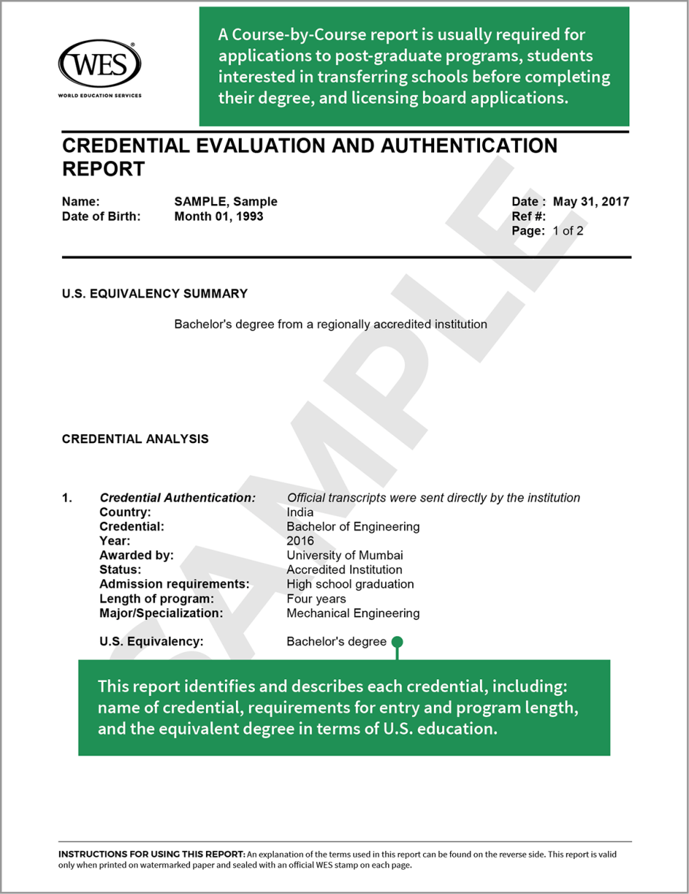
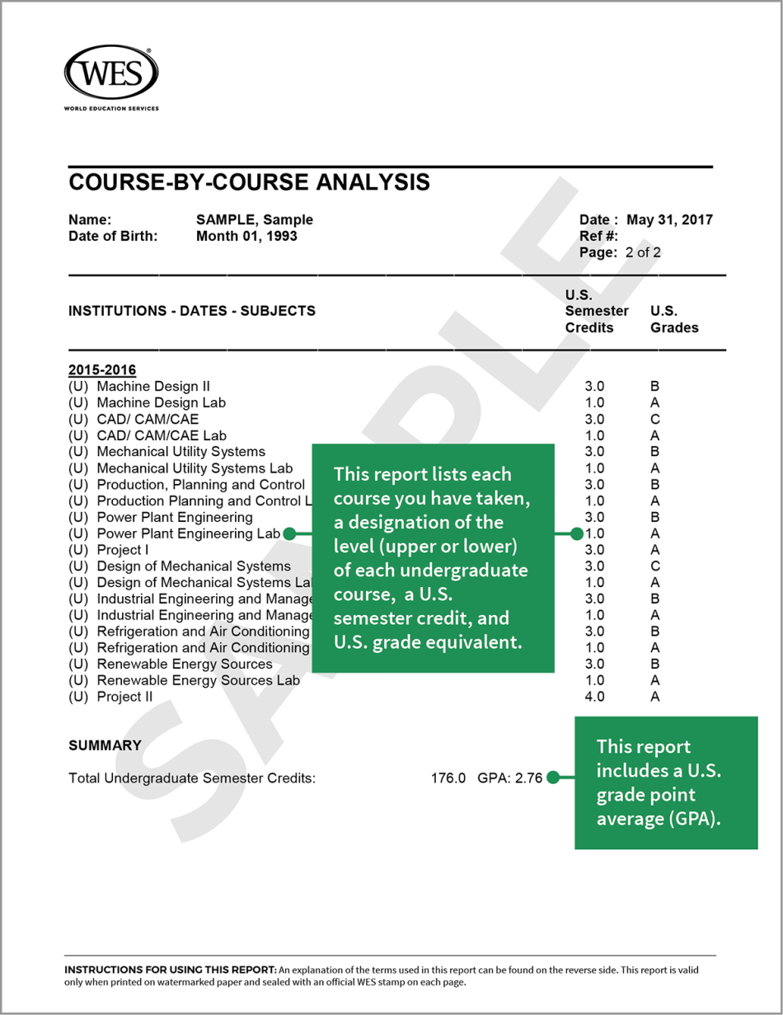
WES Credential Evaluation Report

Slide 41
Trusted Evaluation Agencies
www.naces.org

Slide 42
Resources

Slide 43



WES Career
Pathway
Guides
Provide guidance to internationally trained immigrants seeking to use their education in the United States. Each guide explores career and academic pathways as well as alternative and related careers in a specific field.
  10+ industries
  Strategies for achieving career success
  Links to resources to support professional success
  Requirements for licensing and certification
  Success stories spotlight professional skilled immigrants
  Alternative career opportunities
wes.org/advisor-e-guides/
Notes:
For a particular professional field:
The definition of the industry in the U.S.
Academic requirements in that field
Licensing and certification requirements
Unpacking regulated vs. unregulated professions in specific industries
How to gain credential recognition
Transferable skills and how to apply them in related/alternative careers

Slide 44
Tools and Resources in Pathways
Clear outlines of educational pathways
Step-by-step guides for licensing/certification
Planning worksheets
Case studies in each industry
Helpful tips
Links to state-specific information and industry-specific websites

Slide 47





Connect with Us
Subscribe to our newsletter, The Bridge
wes.org/gtb/subscribe
Our newsletter provides community organizations and public agencies that assist skilled immigrants with tools, training and other resources that help them improve their services and achieve their goals. We feature relevant developments from across the field, highlighting innovative programs, policies, and services.
  Visit our website: wes.org/gtb
  Follow us on Twitter: @WESGlobalTalent
  Need more information about our resources? Email: nyc@wes.org

Slide 48
Questions
Krystal Reyes
Mayor's Office of Resilience and Equity
kreyes@cityoftulsa.org ​
​
Leticia Calvillo ​
Mayor's Office of Resilience and Equity
Lcalvillo@cityoftulsa.org ​
Austin Britt
Mayor's Office of Economic Development
Abritt@cityoftulsa.org
Kuma Roberts
Tulsa Regional Chamber
kumaroberts@tulsachamber.com
Rachel Hutchings
Workforce Tulsa
rhutchings@workforcetulsa.com
Daniel Chaboya
Tulsa Community College
daniel.chaboya@tulsacc.edu
Diane Eason Contreras
YWCA Tulsa
deason@ywcatulsa.org
Eva Stenzel
YWCA Tulsa
estentzel@ywcatulsa.org

