Slide 1

Suzanne Grooms| Human Resources,
HR Payroll and Onboarding Administrator|sgrooms@cityoftulsa.org

Slide 2
Introductions and Housekeeping
Suzanne Grooms
Cell phone etiquette for today
Restrooms
Snacks, breaks and lunch
Safety contact

Slide 3
Outline for Today
8:00 – 9:00
  Welcome
  Paperwork
  Parking
9:00 – 10:00
  AIM Strategic Plan
  Resilience Plan
  Ethics
BREAK
11:00 – 12:00
  Benefits
  Retirement
  Tulsa Time/Munis
12:15-1:15 LUNCH
12:30 – 1:45
  Customer Service
  Drug Free Workplace
1:45 – 2:00: BREAK
2:00 – 3:00
  IT Communications, Use and Security
  Respectful Workplace
  Leave/FMLA
  AFSCME

Slide 4
Government

Slide 5
Government Hierarchy
President of United States has executive power
Congress has legislative power
(435 Reps; 100 Senators)
Supreme Court has judiciary power
Constitution of the United States of America
Governor has executive power
State Legislature has legislative powers
(101 Reps; 48 Senators)
Oklahoma State Supreme Court has judiciary power
Oklahoma Constitution
Mayor has executive power
Tulsa City Council (9) has legislative power,
including budget approval
Municipal Court has judiciary power
City of Tulsa Charter

Slide 6
Our Mayor
Mayor G.T. Bynum
G.T. Bynum was sworn in as the 40th Mayor of Tulsa on December 5, 2016.
Prior to his election as Mayor, Bynum served for eight years on the Tulsa City Council. During that time, he was elected as the youngest City Council Chairman
in Tulsa history.

Slide 7
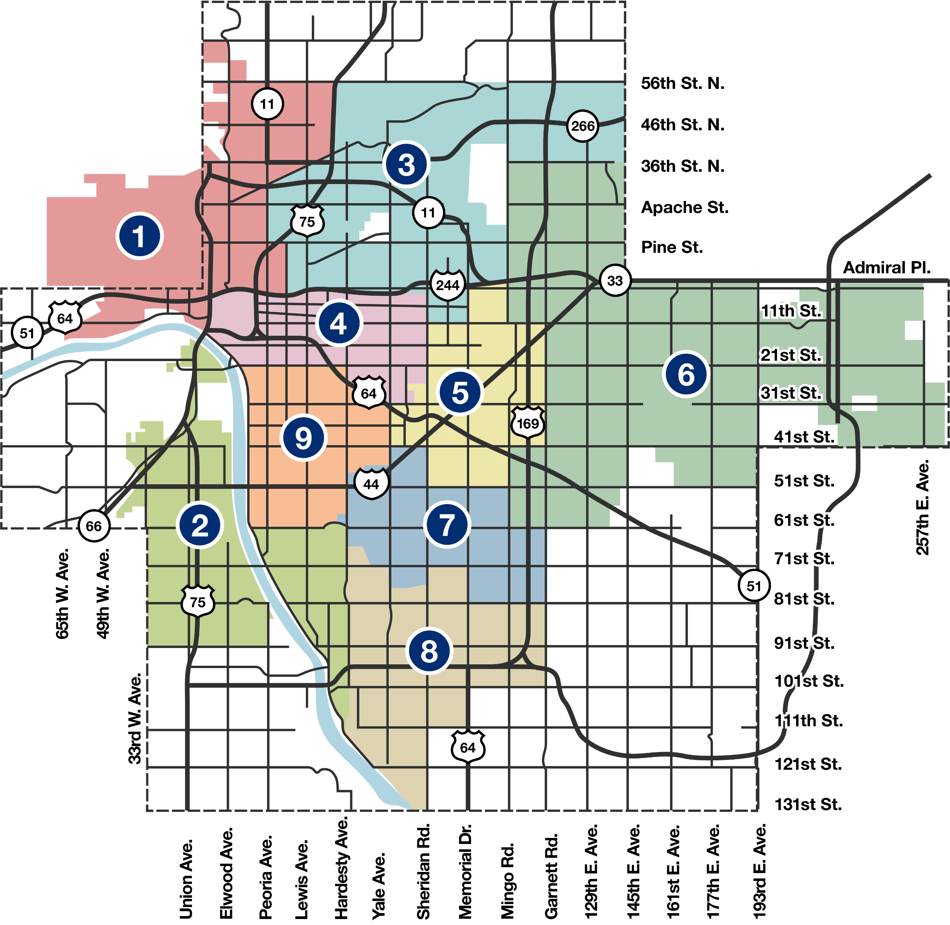
Tulsa CITY Council District Map

Slide 8

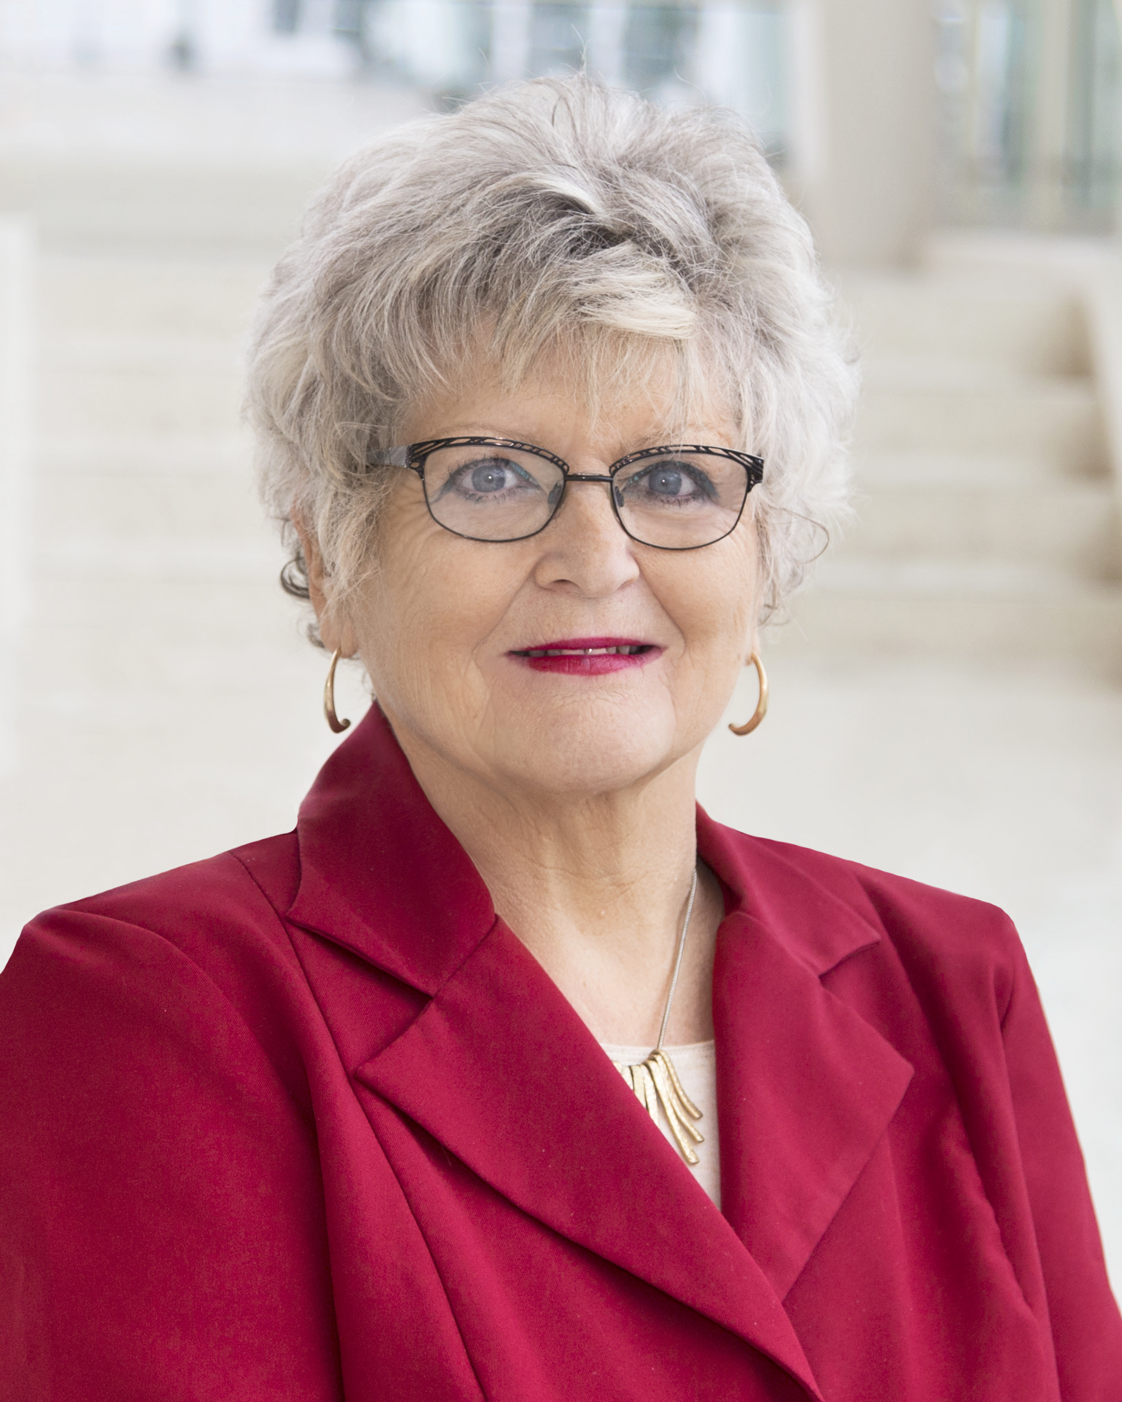

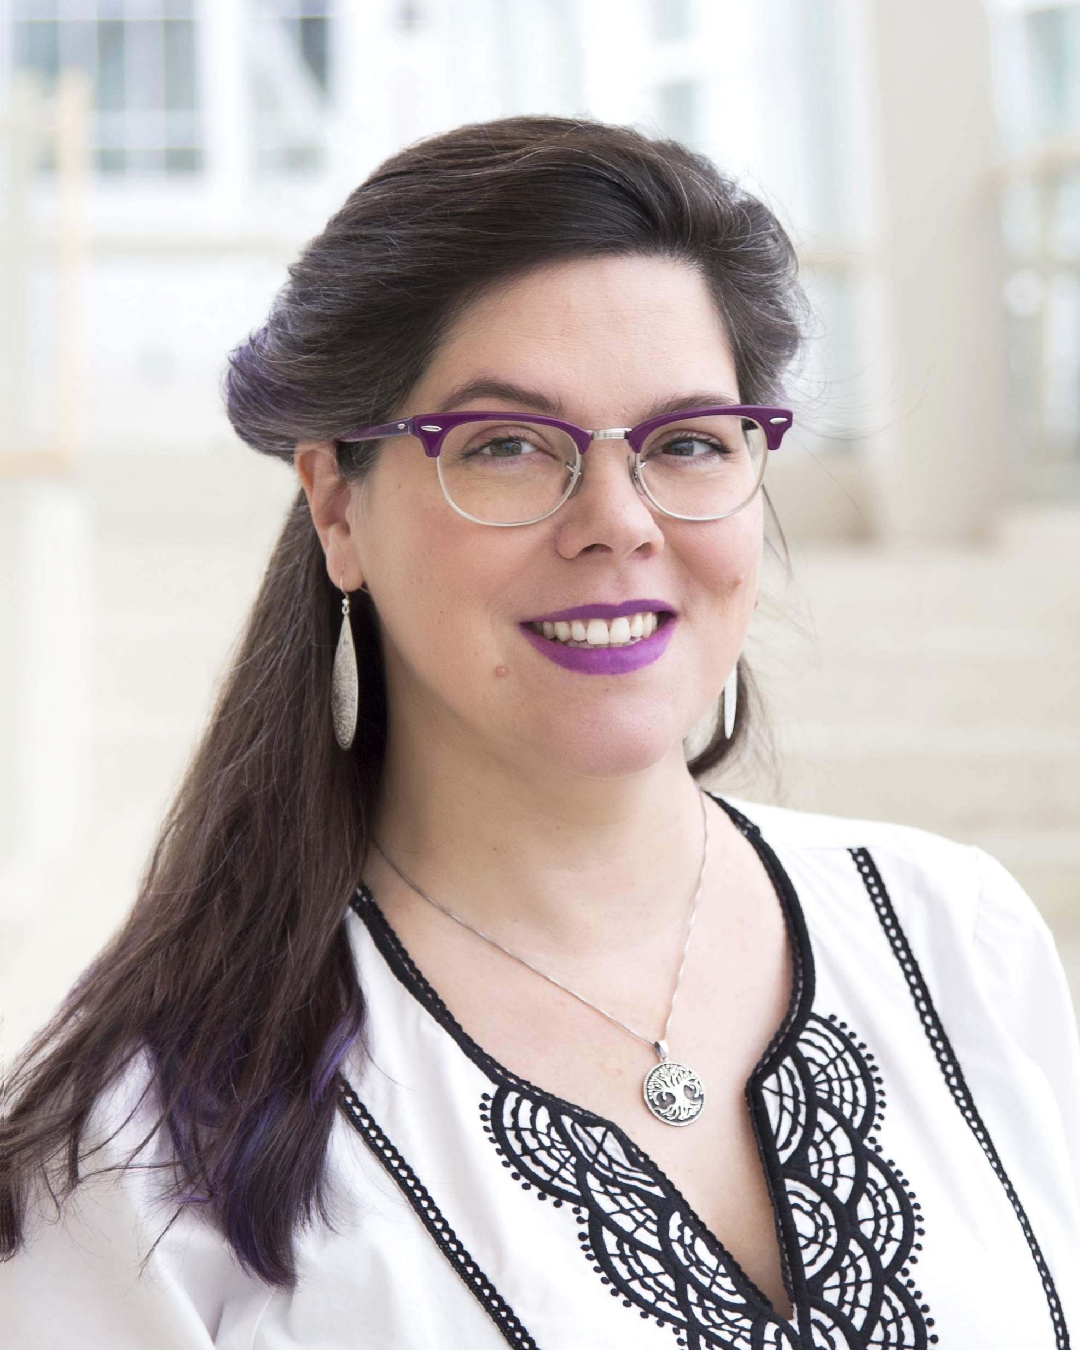
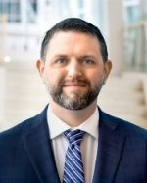
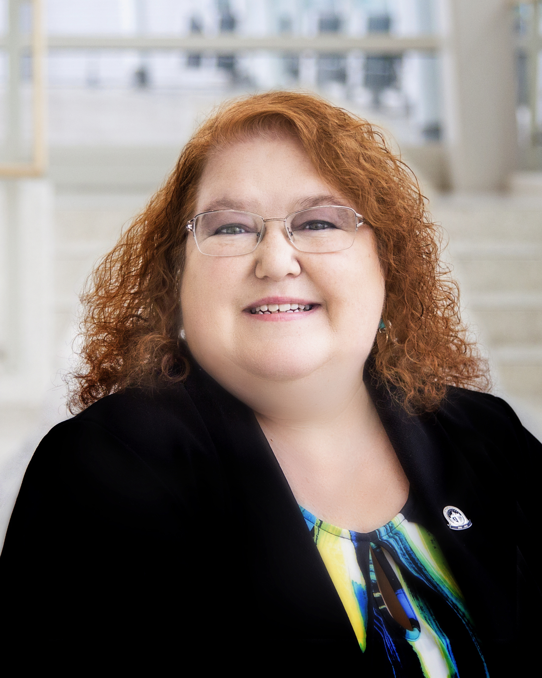
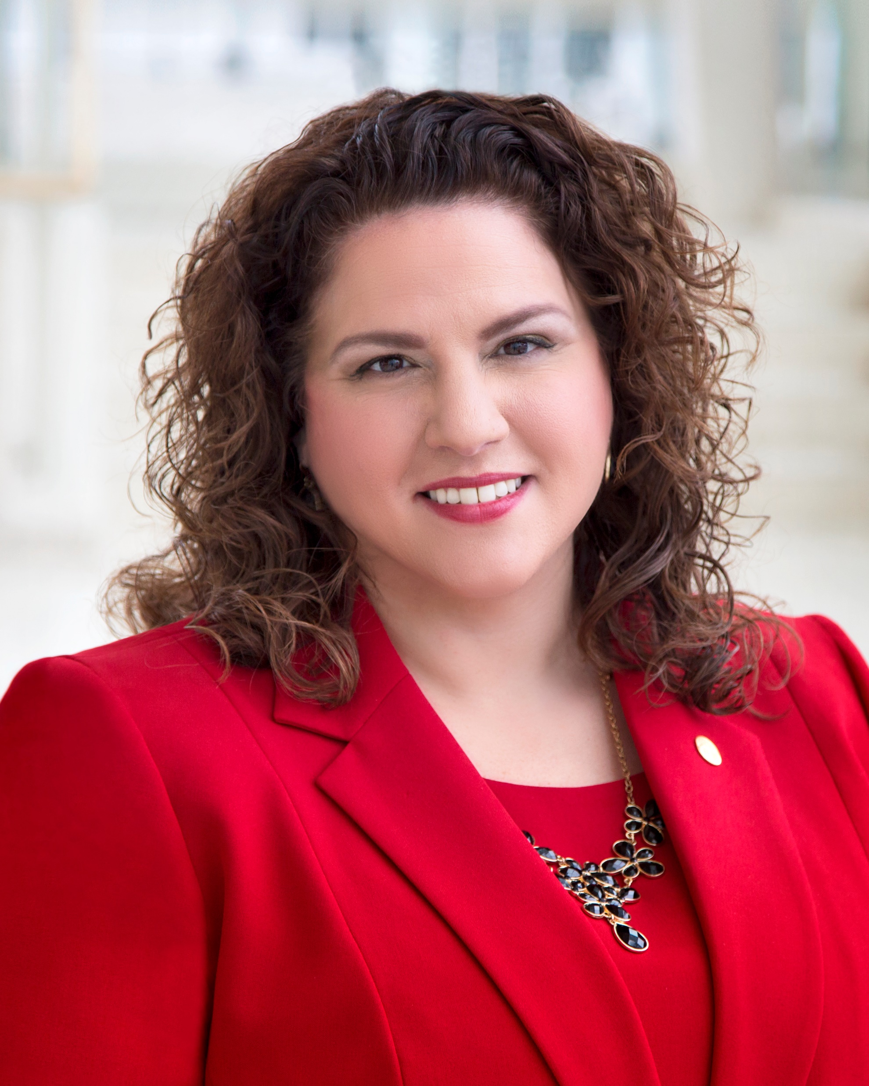
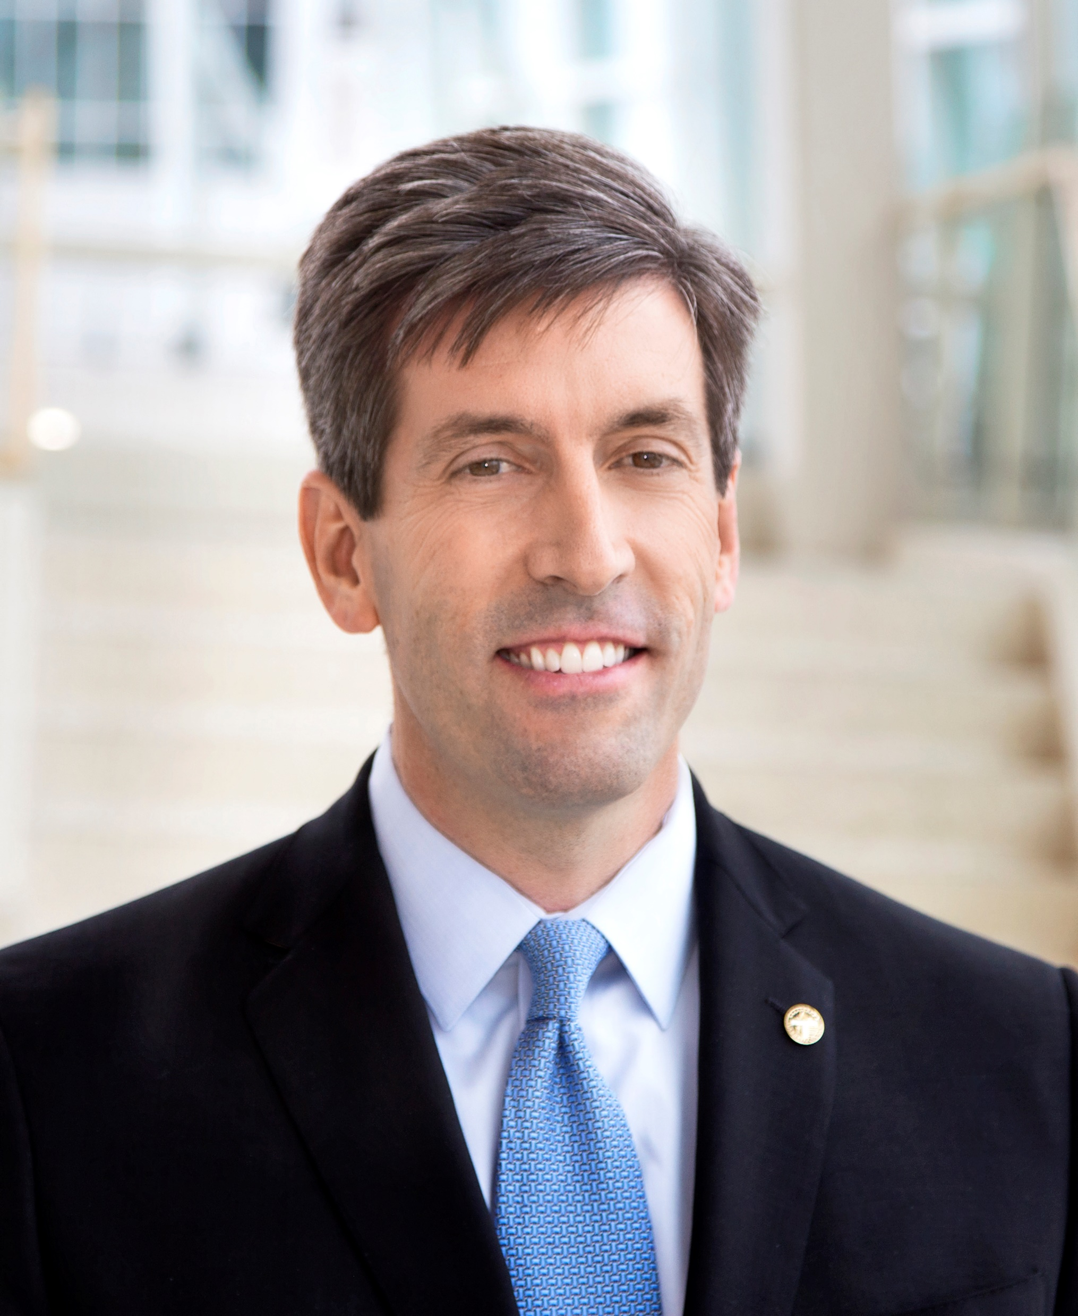
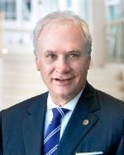
Tulsa City Councilors
District 1
Vanessa Hall-Harper
District 2
Jeannie Cue
District 3
Crista Patrick
District 4
Kara Joy McKee
District 5
Mykey Arthrell-Kenezik
District 9
Jayme Fowler
District 6
Connie Dodson
District 7
Lori Decter Wright
District 8
Phil Lakin, Jr.
District 9
Ben Kimbro

Slide 9
City Government
City of Tulsa established in 1898
  Oklahoma statehood 1907
City Charter
  First adopted July 3, 1908
  Amended May 8, 1990; changed from Commission form of government to City Council
  Preamble and 12 Articles
    Examples of Articles include: Corporate Powers, The Council, The Mayor, The City Auditor, Boards and Authorities, Civil Service Commission, etc.

Slide 10
City Charter
Examples of powers granted to City of Tulsa:
Adopt and enforce ordinances necessary or proper to protect the public peace, health, order, morals, and safety, and to promote the general welfare of the City and its inhabitants
Construct, maintain and operate public works
Engage in public business
Levy, assess, and collect taxes
Incur indebtedness

Slide 11
AIM Plan and
Continuous Improvement
Office of Performance Strategy and Innovation
Notes:
KEY MESSAGE: You are the most important part of the organization.
Our goals for the next 20 minutes:
Pass the leadership baton to managers and supervisors
Learn the Mission, Vision and Values
Learn how your work fits in and helps the City achieve its mission and vision
Before we begin, it’s important to understand that this presentation represents a passing of the baton of leadership. We’ll talk about the Mission, Vision and Values of the organization, but it’s up to you to carry out the details and day-to-day tasks.
Working for a city is a unique opportunity. Your work has an impact on the lives of 400,000 people.

Slide 12

Notes:
KEY MESSAGE: You are the most important part of the organization.
Our goals for the next 20 minutes:
Pass the leadership baton to managers and supervisors
Learn the Mission, Vision, Values
Learn how your work fits in and helps the city achieve its mission and vision
Before we begin, it’s important to understand that this presentation represents a passing of the baton of leadership. We’ll talk about the Mission, Vision, and Values of the organization, but it’s up to you to carry out the details and day-to-day tasks.
Working for a city is a unique opportunity. You have an impact on the lives of 400,000 people.

Slide 13
ORGANIZATIONAL OVERVIEW
Strong Mayor
  CEO of the organization
9 City Councilors
  primarily pass laws and approve the budget
Revenue
  Primarily sales tax
Departments
  19 department and approximately 3600 employees
Notes:
Notes:
Not all Oklahoma cities are organized the same way.
City councilors serve in defined geography, not at large

Slide 14

Why do we exist as an organization?
Build the foundation for ECONOMIC PROSPERITY,
IMPROVED HEALTH and enhanced QUALITY OF LIFE
for our community
Notes:
________________________________________________________________
Animation
SHOW Mission Statement and read it.
Their Opportunities in education, jobs and businesses = Economic Prosperity
Their Wellness = Improved Health
The way they experience the City = Quality of Life
Ask people to commit this to memory. Be able to say it to friends and colleagues.

Slide 15

What does success look like?
To be a globally competitive, world-class city
Notes:
What do we want to become?
We don’t want to compete with our Broken Arrow and Jenks neighbors. Instead, we want to set our sights on competing with Austin, Dallas, Denver and other cities competing on at a global scale.

Slide 16

COMMITTED TEAMWORK
We work together toward common goals.
HIGH EXPECTATIONS
We expect excellence in our work, our organization and the city we are building
Notes:
Our values define how we deliver our work.
WE focus on two things: Teamwork and High Expectations.
Teamwork means that we are not competitors, instead we are collaborators. Like players on a football team, we all play a position, and it’s important for the future of the city.
High expectations means we come to work everyday with a expectation that we’ll be setting big goals constantly improving. We never get to a point where we’re fully satisfied with our work. We recognize that we’re a learning organization and that we’re always improving.
Ask for questions before moving on.

Slide 17
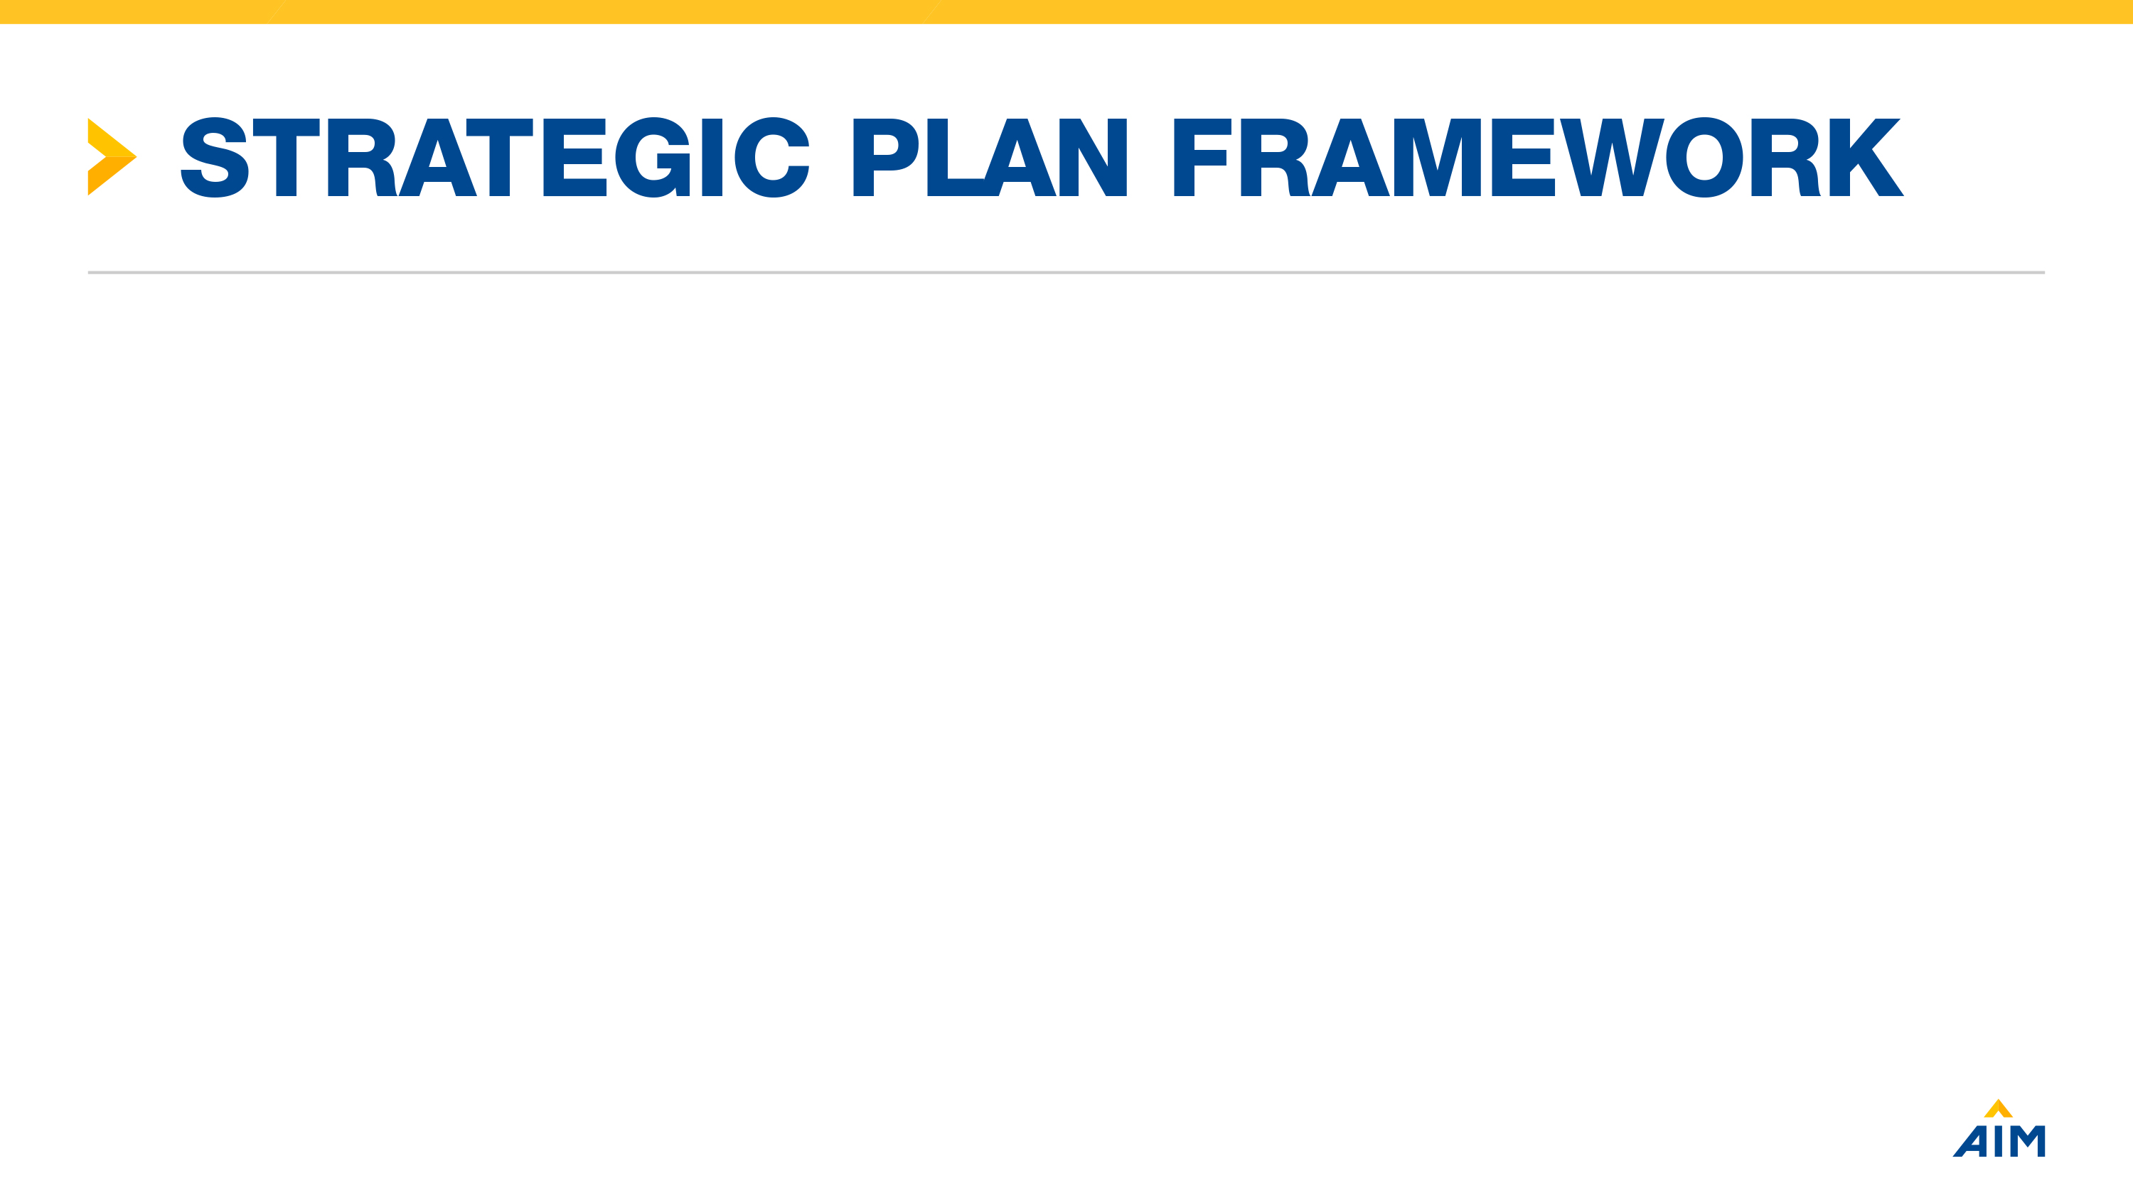
4
13
X
Economy
Neighborhoods & Infrastructure
Social Connection
Strategies
Action Steps
AIMs
High Quality
Notes:
We have 4 AIM Areas – Well being, opportunity, the city experience, and inside city hall.
The first three are focused on our residents & businesses. The last addresses what we need to do to deliver the first three.
These are tied to our Mission Statement
AIM is what’s intended to be achieved – a goal
Strategy is a plan to move toward the desired goal

Slide 18
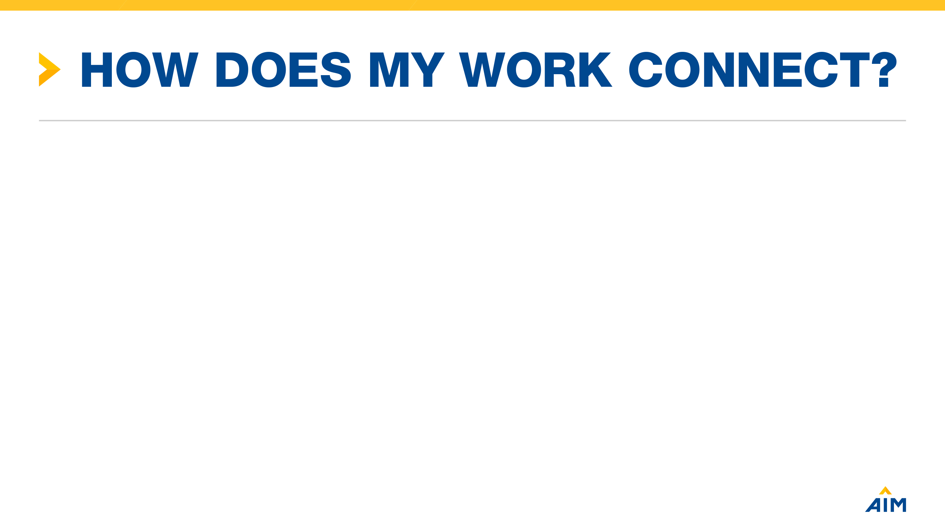
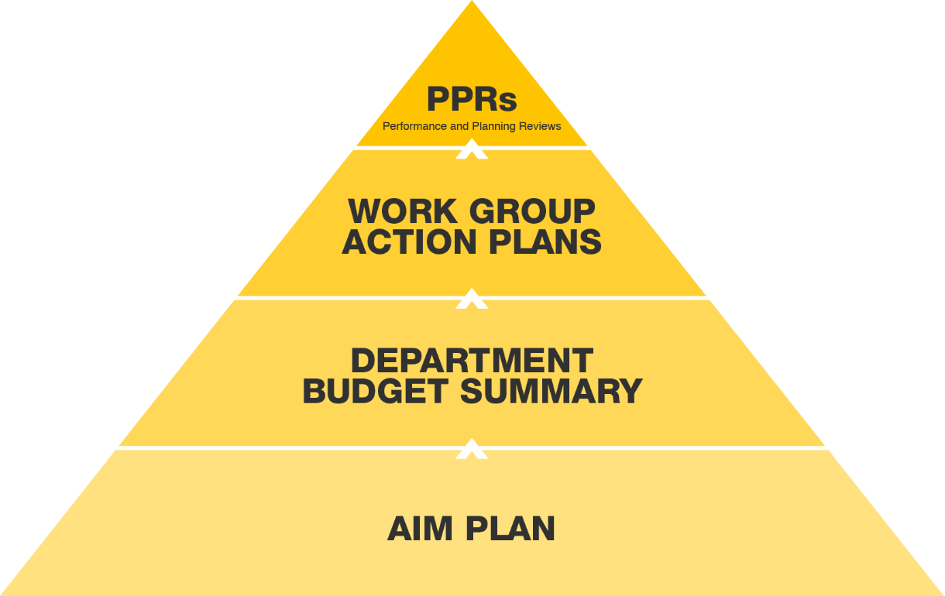
YOU & YOUR SUPERVISOR
PEOPLE
MANAGERS
PROCESSES
DEPARTMENT HEADS
PURPOSE
MAYOR/COUNCIL
Notes:
The AIM Plan is designed to connect the people, YOU to Processes - your work plans, to Purpose. – Building the foundation for economic prosperity, improved health, and enhanced quality of life.
The Mayor and council set the goals (AIMS)
They cooperate with the department heads to create the strategies to achieve the AIMS
Your department translates those goals and strategies into a budget
Your supervisor takes the budget and lays out a work plan for your group
In your performance review you will be asked to connect up the part of the AIM plan, Mission, Vision and Values that connect to your performance.
Take questions.

Slide 19

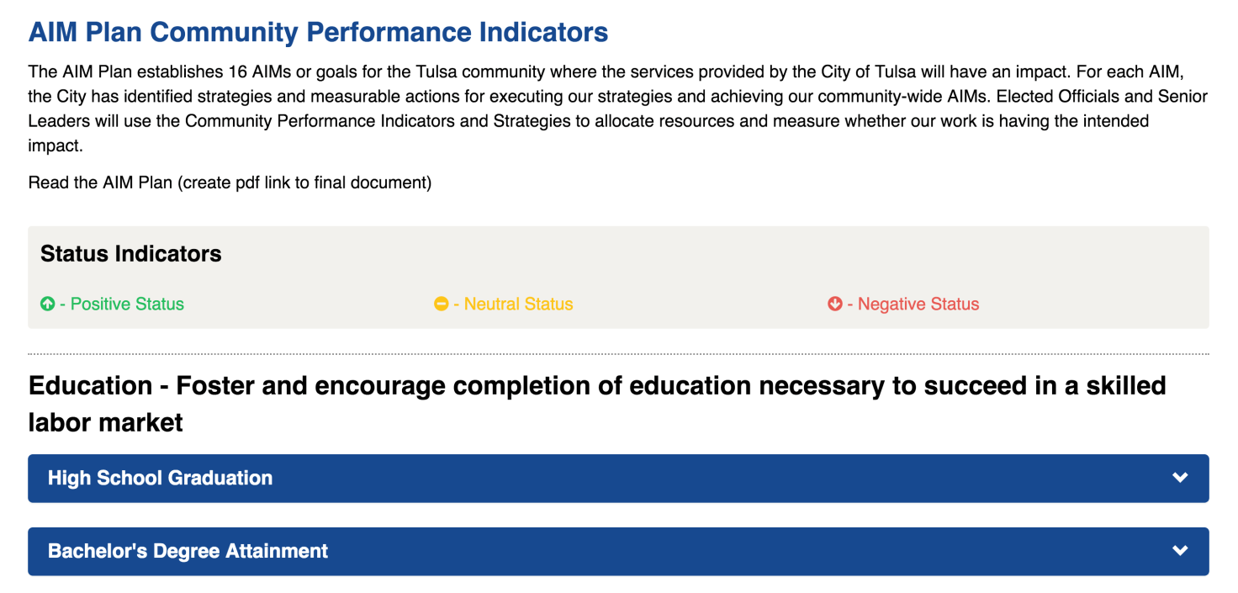
www.cityoftulsa.org/dashboards
Notes:
We are committed to making decisions based on data. We measure a lot of things in our community and inside city government.
How can you stay engaged?
We’ll be tracking each AIM on a dashboard. The page will be fully available in the coming weeks, and will detail the data we’re tracking and why.

Slide 20

JOURNEY TO EXCELLENCE
Notes:
In the spirit of our value of High Expectations we are on what we call the Journey to Excellence and are in pursuit of the Malcolm Baldrige National Quality Award. This is an award that is managed by the National Institute of Standards and Technology. Organizations that win this award are considered to be the absolute best in their industry. To win the award you must demonstrate that you are an organization that those in your industry routinely look to as an example of how to behave and deliver services.

Slide 21
JOURNEY TO EXCELLENCE
Leadership
Strategy
Customers
Measurement & Knowledge Management
Workforce
Operations
Results
Notes:
There are 7 categories of the Baldrige framework. Our application for the award includes a description of how we do each of these things.
How do leaders lead and ensure ethical behavior?
How do we choose strategies & make sure we carry them out effectively?
How do we listen to our customers and make sure that we improve to better serve their needs?
How do we set goals and measure performance? How do we share and protect information internally?
How do identify the skills we need from employees? How do we make sure we hire the right people? How do we develop our employees to keep them continuously engaged?
How do we manage our processes to make sure that we meet customer needs? How do we innovate?
What our are results? Are we meeting our targets and how are we doing in comparison to competitors or similar companies?

Slide 22

URBAN DATA PIONEERS
Teams form around data problems
12 weeks to work on projects
Examples Projects
Reducing 911 Call Wait Times
Effects of Zoning on Sales Tax
Blight and Violent Crime
Reducing Evictions
Identifying Repeat Property Code Violations

Slide 23

READING PARTNERS
Notes:
One of the easiest ways to contribute to our community is to become a reading partners volunteer. After your probationary period, ask your supervisor about the opportunity to spend 1 hour per week in paid time to help a 3rd grader read at grade level.
Research shows that if we can get all of Tulsa’s 3rd graders reading at grade level, their chances of graduating from high school, pursuing college or training, and making a higher wage over their life time improves.

Slide 24
INNOVATION CHAMPIONS
Over 150 employees trained in Continuous Improvement Tools & Methods
BIG and small projects to improve services for residents and customers
Cross-departmental teams
Opportunity to learn more about how the City operates
Notes:
In commitment to high expectations, we regularly offering trainings to employees to learn some great continuous improvement tools and use them to improve what we do at the City. The program is a great opportunity for City employees to be a part of positive change and build relationships with employees they wouldn’t otherwise work with and learn about how different areas operate.
So this is another example of our values of teamwork and high expectations. Project teams bring together diverse perspectives and create opportunities to innovate and learn together and they are always focused on improving what we deliver to our customers.

Slide 25
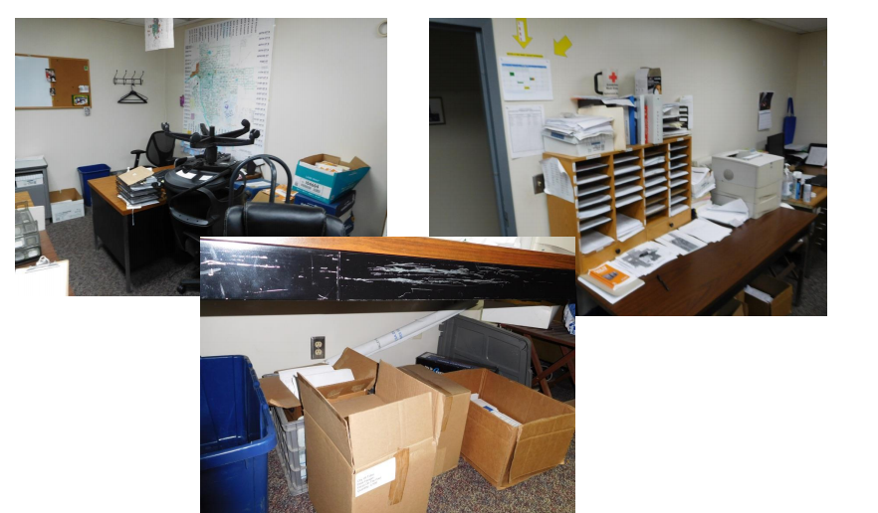
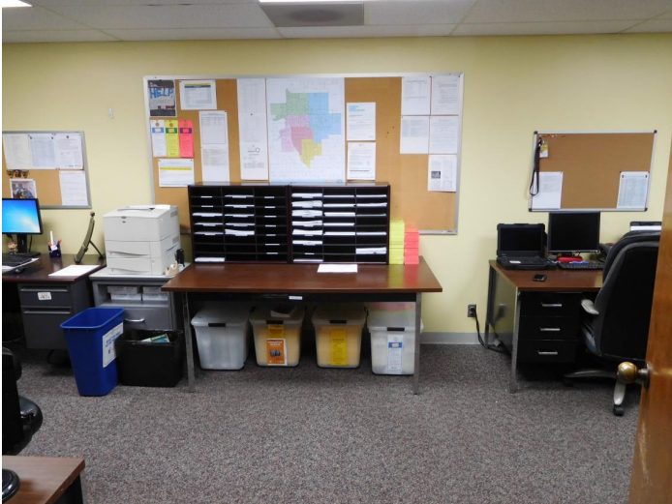


INNOVATION CHAMPIONS
Before
After
Notes:
There can be a lot of work that goes into projects, but they are all centered around one of two things (1) improving customer satisfaction and (2) improving the spaces and processes that our employees work in. The top 2 pictures here show the difference in a work space from a 5S project done by Innovation Champions. Imagine how much more effective the team using that space can feel with an organized space and how much better their work can be. The bottom two pictures just show the goal with non-space related projects. We start with a service that isn’t meeting customer expectations and we use a consistent method to identify what is causing our failure. We try to identify innovative ways to overcome failures and improve and we work to make sure that our improvements can be sustained by the teams who manage the services involved.
If you’re interested in learning more about the program you can reach out to Penny Macias or your training registrar once you get to your work space and they can help you see if there are future classes you might be able to take.

Slide 26
Welcome to the City of Tulsa!
Questions?
Notes:
Review fill in the blank handout that appears in their binders

Slide 27
Ethics
Cathy Carter
City Auditor

Slide 28
Ethics Ordinance
Title 12 Chapter 6
City Officials
Use of city resources
Personal, financial or organizational interest
Gifts and favors
Information
Contracts
Ethics Advisory Committee

Slide 29
Other Guidance
Oklahoma Statutes - conflict of interest
City Charter and Ordinances – conflict of interest,
ethics ordinance
Executive orders – conflict of interest, donations
Personnel Policies and Procedures – conflict of interest,
gifts and donations

Slide 30
City Officials
Defined in ethics ordinance
City Official means every City of Tulsa elected official, officer,
or employee; member of City of Tulsa Board, Authority, Commission, or Committee; or Trustee appointed by the City
to a public trust with the City of Tulsa as a beneficiary

Slide 31
Use of City Resources
Not permitted to use City resources for personal or private purposes, except as provided by rules adopted by the appropriate appointing authority to address minor or incidental uses common to an ordinary workplace

Slide 32
Conflicts of Interest
Personal, financial or organizational interest
No City Official shall participate in any City business in which they have
a personal, financial or organizational interest.
The City Official shall not discuss the matter, other than to state the
conflict of interest.
Disclosure is required by filing a written statement of the conflict with
the City Clerk.
The possibility, not the actuality of conflict shall govern.
Contracts - City Officials must disclose if they or their immediate family
has an interest in a business receiving City funds, directly or indirectly, through a business agreement with the City or a City contractor.

Slide 33
Gifts and Favors
City Officials and their immediate family shall not directly or indirectly solicit or receive gifts, entertainment, or other favors which may influence or be reasonably perceived as influencing a City Official in the performance of their duties.
Personnel Policies set a bright line at $35 – This is not per gift. It is the maximum.

Slide 34
Use and Disclosure of Information
A City official is prohibited from disclosing or offering to disclose information not available to the general public and acquired by reason of his position with the City to any party not entitled to receive such information, nor shall he use such information for personal gain or benefit.

Slide 35
Use and Disclosure of Information
A City official is prohibited from disclosing or offering to disclose information not available to the general public and acquired by reason of his position with the City to any party not entitled to receive such information, nor shall he use such information for personal gain or benefit.

Slide 36
Ethics Advisory Committee
Any elected official; Charter division or department head; member of a City of Tulsa Board, Authority, or Committee;
or Trustee of a public trust with the City of Tulsa as a beneficiary may request an opinion from the Ethics Advisory Committee on an ethical issue arising under this chapter.

Slide 37
Outside Employment
Personnel Policy 815 describes the rules for jobs employees
may hold outside their City of Tulsa employment
It is important for employees to notify their supervisor in writing
of any outside employment

Slide 38
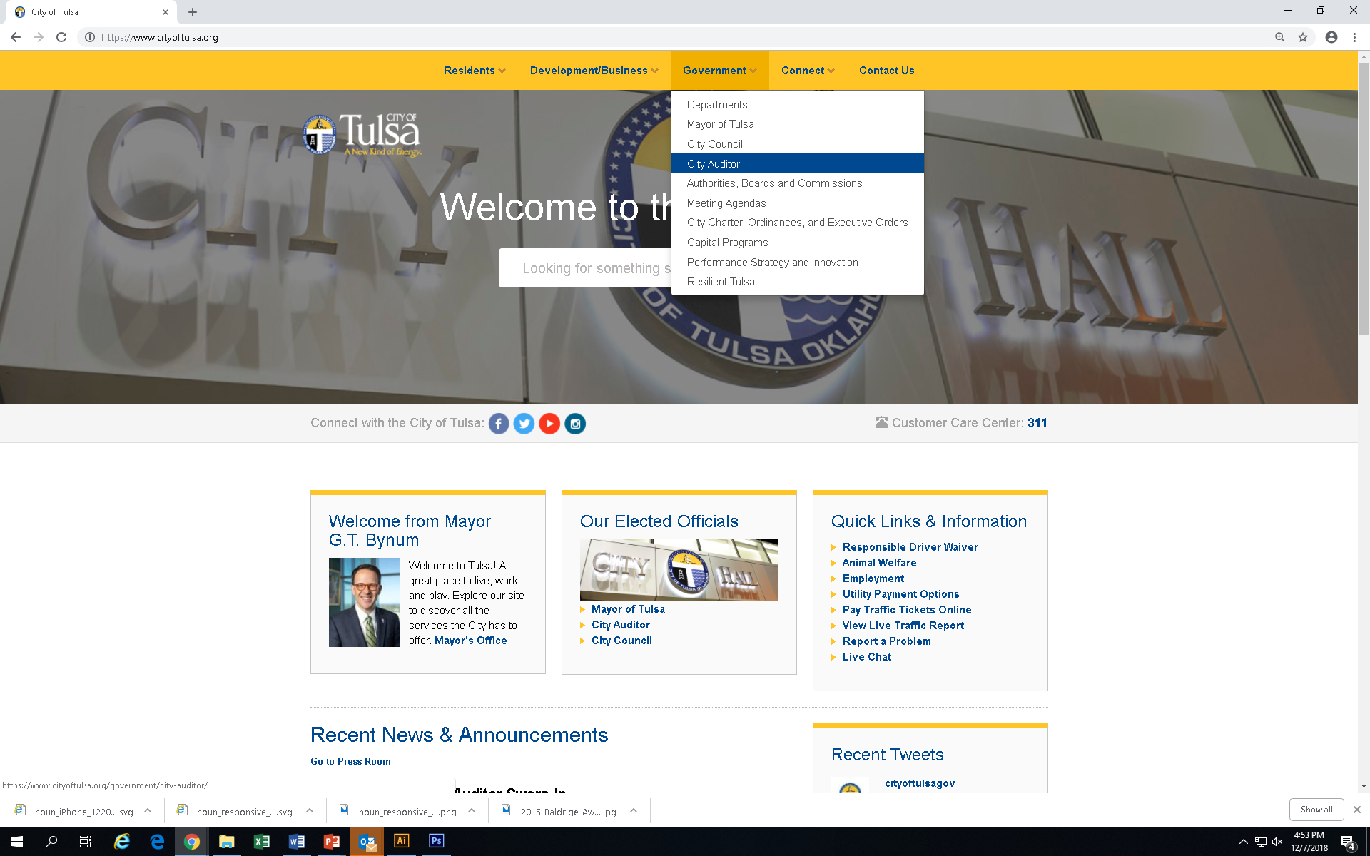
How to find the rules

Slide 39
Making ethical choices
Bottom line: Act in a manner that promotes public confidence
in your integrity and fairness.
Decide what your baseline will be.

Slide 40
Reporting ethics matters
Your supervisor
Human Resources Department – Email to: HRDirector@cityoftulsa.org
City Clerk’s Office – 1st floor of City Hall
Located in customer service area
Ethics Hotline – Find it on the City’s website
Search on “Ethics Hotline”

Slide 41
Bottom line
If you have questions about how the ethics rules apply to your particular situation, please contact your supervisor or Human Resources.
It is much easier and safer to get advice ahead of time rather than trying to undo inappropriate actions.

Slide 42
Resilient Tulsa
An equitable, action-oriented,
and collaborative roadmap for
all of Tulsa

Slide 43
Background
In recent years, the City of Tulsa has launched numerous initiatives that demonstrate a commitment to making Tulsa a World Class City
Tulsa also boasts a robust and energized philanthropic community that is devoted to the city and its residents.
Yet, while Tulsa’s growth has benefitted many citizens, not all Tulsans have experienced this elevated prosperity.
Building a more resilient Tulsa begins by confronting historic discrimination and inequality

Slide 44

What is a resilient city?
Urban resilience is the capacity of individuals, communities, institutions, businesses, and systems within a city to survive, adapt, and grow no matter what kinds of chronic stresses and acute shocks they experience.
Seven qualities of a resilient system, project, or city:
  Reflective, Resourceful, Inclusive,
  Integrated, Robust, Redundant, Flexible
Notes:
CHRONIC STRESSES
weaken the fabric of a city on a day-to-day or cyclical basis
Examples include: high unemployment, inefficient public transportation systems, endemic violence, and chronic food and water shortages.
ACUTE SHOCKS
are sudden, sharp events that threaten a city
Examples include: earthquakes, floods, disease outbreaks, and terrorist attacks.

Slide 45

Purpose
The Resilience Strategy serves as a roadmap to address Tulsa’s most pressing challenges and seeks to build capacity among residents, city systems, and community partners to build a more resilient city.
  Released in the summer of 2018
  Contains 41 policies, programs, practice changes, and events

Slide 46
A vision for Tulsa
An inclusive future that honors all Tulsans
Tulsans equipped to overcome barriers and thrive
Economic opportunity for all Tulsans
City and regional systems transformed to improve outcomes for all Tulsans

Slide 47
1. CREATE AN INCLUSIVE FUTURE THAT HONORS ALL TULSANS
Confronting the past is the only way to foster stronger social bonds for the future of Tulsa. The city must celebrate cultural diversity and reverse the negative outcomes that have resulted from systemic discrimination.
Example actions: 918 Day, New Tulsans Initiative, Memorialize Black Wall Street

Slide 48
2. EQUIP ALL TULSANS TO OVERCOME BARRIERS AND THRIVE
All Tulsans should have the ability to flourish, regardless of their race, ethnicity, neighborhood, health, income, gender, or criminal history. The city must ensure equal access to opportunities for residents of all backgrounds.
Example actions: Ban the Box, healthy food coalition, disaster preparedness workshops for businesses

Slide 49
3. ADVANCE ECONOMIC OPPORTUNITY FOR ALL TULSANS
Not all Tulsans have the necessary tools to secure and maintain gainful employment irrespective of changes in labor demands. The city must work to eliminate the economic barriers that hinder some residents’ ability to achieve long-term financial stability and prosperity.
Example actions: Support business that Ban the Box, financial empowerment and counseling

Slide 50
4. TRANSFORM CITY AND REGIONAL SYSTEMS TO IMPROVE OUTCOMES FOR ALL TULSANS
As the city grows and changes, so do its residents’ needs. The city must model and advocate for local and regional systems that accurately identify and effectively address community needs on a day-to-day basis.
Example actions: Creation of the Mayor’s Office of Resilience and Equity, Housing Policy Director, Resilience in the city’s comprehensive plan, Implicit Bias Training

Slide 51
Join us and Stay involved
Every Tulsan plays a critical role in realizing our city’s more resilient future. Through collaboration and a shared commitment, Tulsa can take its rightful place as a world-class city for all people.
To learn more visit: www.cityoftulsa.org/resilienttulsa
To stay up to date and follow @ResilientTulsa on Facebook
Questions? Email us at resilient@cityoftulsa.org

Slide 52
2022 Benefits
Retirement
Jamie Cowan
Benefit Analyst
Kerry Kavanaugh
Human Resources
October 17, 2018

Slide 53
New Employee
Orientation

Slide 54
AGENDA
2022 Employee Benefits Overview
Preparing for Enrollment

Slide 55
When will my Benefits Start?
When Will My Benefits Start?
You will be able to access the enrollment portal next Monday.
Enrollment MUST be completed within the first 30 days of your employment.
Your benefits will begin the first day of the month following 30 days of employment

Slide 56
Important enrollment information
Our system to enroll and maintain your benefits – Empyrean
- You will need to Register for an account through this URL: https://compass.empyreanbenefits.com/COT
- Once you are registered, please keep your password in a secure place to retrieve for future reference
REMEMBER YOU HAVE TO ENROLL WITHIN THE FIRST 30 DAYS OF YOUR EMPLOYMENT

Slide 57
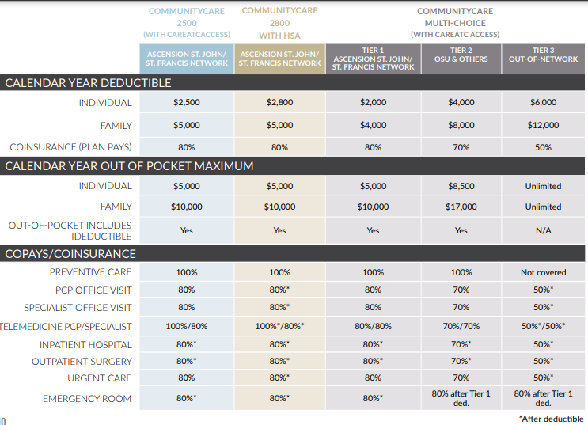
Medical benefits

Slide 58
IMPORTANT information
If you are enrolling in the HSA medical plan, City of Tulsa will contribute up to $1,500 annually into an account on your behalf. For those employees whose benefits begin on or after January 1st, 2022, will receive a pro-rated HSA contribution of $57.70 for the remaining pay periods for 2022.
Medical - CommunityCare
Dental and Vision are through Blue Cross Blue Shield of Oklahoma as well
Life/AD&D and Disability provider - Blue Cross Blue Shield of Oklahoma
Supplemental Life and AD&D will be bundled
Employee Supplemental Life insurance is available

Slide 59
Medical benefits – rx options
The prescription plan is 80/20.
CareATC Option
CareATC Formulary
80/20 - NO DEDUCTIBLE (Pharmacies)
HSA Option
HSA Preventative List
80/20 - Deductible Applies
TIP: To keep your cost down, ask your doctor if there is a generic equivalent or a discount card or program.

Slide 60

MEDICAL BENEFITS
Clinic and Preventative services offered to eligible employees and their families at no cost
100% HIPAA compliant
Convenient, shorter wait times, fewer pharmacy visits
TIP: CareATC does not replace your health insurance, it works jointly with it as needed.

Slide 61


Medical benefits
CareATC Prescriptions
Top Available Prescription Categories
Allergy
Antibiotics
Antifungal
Asthma
Blood Pressure
Cardiovascular
Cholesterol
Diabetes
Heartburn

Slide 62

personal health assessment (PHA)
All 3 Medical plans have access to CareATC for PHA’s
Healthy
Abnormal
High Risk
An accurate measurement of your overall health status

Slide 63
PeRSONAL Health Assessments (PHA)
Premium Incentive
Employees who are enrolled in any of the medical plans have 60 days from the coverage effective date to schedule an appointment to receive a PHA/Biometric Screening at CareATC, in order to receive the discounted medical rate
If an employee does not complete this within the 60 days, the medical premium will go up by $23.08/bi-weekly (600.00 annual)

Slide 64




HOW TO SCHEDULE APPOINTMENTS
Visits by Appointment Only
Some same day appointments available – Please call ahead to check availability
Phone
Talk to a real person
800-993-8244
Online
Via the patient portal
careatc.com/patients
App
iOS and Android

Slide 65

Health savings account
Health Savings Account Highlights
Contributions are made pre-tax.
Use your account to pay for eligible expenses.
It’s your account; you own it! The funds roll over each year and it’s portable – even if you retire or leave the City of Tulsa.
If you are enrolling on the CommunityCare 2800 with HSA medical plan, City of Tulsa will contribute an annual contribution up to $1,500 to your HSA
For 2022, contributions (including City of Tulsa’s contribution) are limited to the following: $3,650 for individuals and $7,300 for families. The IRS also allows a $1,000 catch-up contribution for employees age 55 or older.
Qualified Expenses include:
Medical and pharmacy deductibles and coinsurance
Medical, pharmacy, dental and vision care services and products
Medical expenses for your spouse and dependents
See a complete list at www.irs.gov

Slide 66
Health savings account
Are You HSA Eligible?
You are eligible to open and fund an HSA if:
You are enrolled in an HSA-eligible High Deductible Health Plan – City of Tulsa’s medical HSA plan qualifies.
You are not covered by your spouse’s non-HDHP health plan.
Your spouse does not have a health care Flexible Spending Account or Health Reimbursement Account.
You are not eligible to be claimed as a dependent on someone else’s tax return.
You are not enrolled in Medicare or TRICARE.
You have not received Department of Veterans Affairs medical benefits in the past 90 days for non-service-related care. (Service-related care will not be taken into consideration.)

Slide 67

Flexible spending account
Flex your spending power!
Health Care Flexible Spending Account
Contribute up to $2,750 with pre-tax dollars (increases take-home pay)
Pay for eligible expenses with FSA debit card (avoid waiting for reimbursement)
Limited Use Flexible Spending Account
Contribute up to $2,750
For reimbursement of eligible Dental and Vision Expenses
Flexible Spending Accounts (FSAs) allow you to set aside pre-tax payroll deductions to pay for out-of-pocket health care expenses such as deductibles, copays and coinsurance, as well as dependent care expenses.

Slide 68
Flexible Spending Account
Dependent Care Flexible Spending Account
Set aside up to $5,000 pre-tax
Account is “use it or lose it;” doesn’t roll over from year to year
Eligible dependents include children younger than 14 and dependents who are incapable of caring for themselves
Reimbursable expenses include day camp, after-school care and preschool

Slide 69

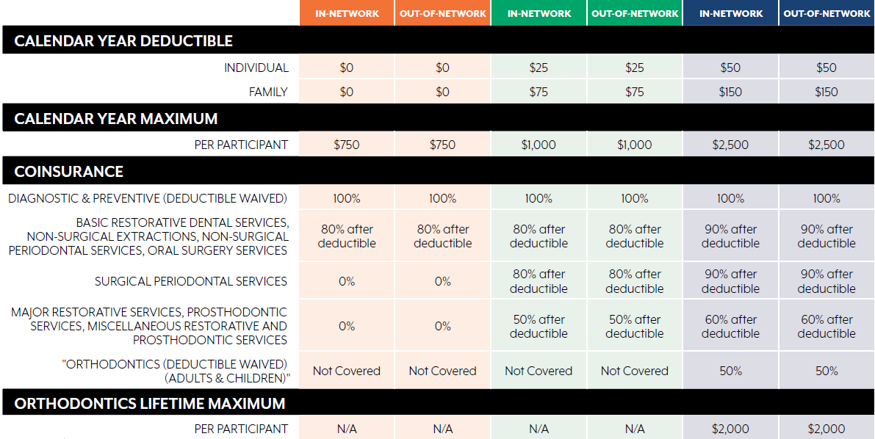
Dental benefits
Tip: If you choose to use a dentist who doesn’t participate in your plan’s network, your out-of-pocket costs will be higher. To find a network dentist, visit Blue Cross Blue Shield of Oklahoma at www.bcbsok.com (BlueCare Dental network).

Slide 70
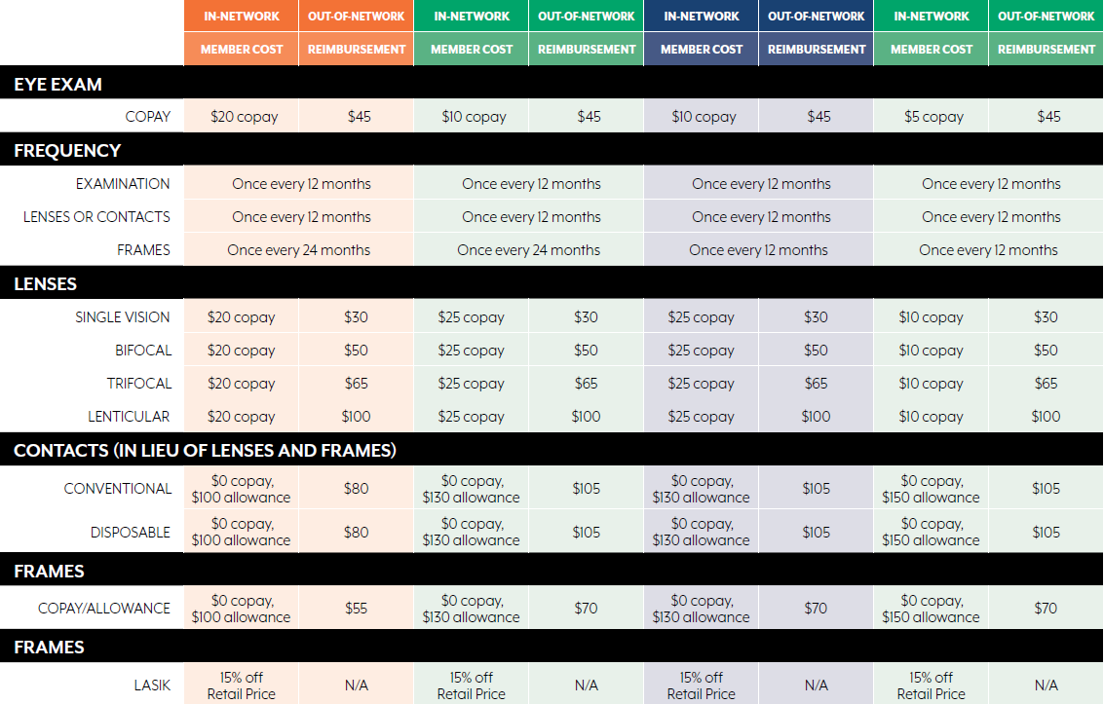
vision benefits

Slide 71
Survivor Benefits – Blue Cross Blue Shield of OKLAHOMA
Life and AD&D Insurance
It’s difficult to think about what would happen if something ever happened to you, but it’s important to have a plan in place to make sure your family is provided for.
Basic Life Insurance in the amount of 2 times your basic annual earnings provided to you at no cost
Accidental Death and Dismemberment is also provided at no cost, it matches the Basic Life amount
Don’t forget to complete the beneficiary designation form!
Additional Life and AD&D benefits are available for purchase via post-tax payroll deductions

Slide 72
Survivor Benefits – Blue Cross Blue Shield of OKLAHOMA
Supplemental Life and AD&D Insurance
Employee Benefit:
  Increments of $10,000 up to $500,000, not to exceed 5x basic annual earnings
  Guarantee Issue Amount of $200,000 (Newly Eligible)
  EOI (Evidence of Insurability) is required for any amount if a late entrant in the future
  Spouse Benefit:
  Increments of $5,000 to $100,000, not to exceed 50% of the employee’s covered supplemental life benefit
  Guarantee Issue Amount of $50,000 (Newly Eligible)
  Evidence of Insurability will be required when making an election greater than $50,000 or for any amount if a late entrant
  Dependent Child Benefit
  $1,000 for child(ren) from birth to 6 months
  $1,000 increments to $10,000 for child(ren) 6 months – to age 26
  Guarantee Issue Amount of $10,000
  No eligible person may be covered more than once under the Policy. If a person is covered as an Employee, he/she cannot be covered as a Spouse or Dependent child of another employee. If both parents are covered as insured employees under the policy, only one may enroll for life insurance coverage on Dependent Child.
Employee must be covered for Supplemental Life/AD&D to insure dependents.

Slide 73

Income Protection – Blue Cross Blue Shield of OKLAHOMA
Short Term Disability (STD)
Short Term Disability (STD) benefits are available for purchase on a voluntary basis. You have three different plan options to choose from:
40% of your basic annual earnings to a maximum of $750 weekly
50% of your basic annual earnings to a maximum of $1,000 weekly
60% of your basic annual earnings to a maximum of $1,250 weekly
Minimum Benefit: $25 weekly
Elimination period: 7 days for injury/sickness
Benefits begin: the 8th day of disability
Maximum benefit duration: 26 weeks
Certain exclusions, along with pre‑existing condition limitations, may apply. See your plan document for details.

Slide 74
Income Protection – Blue Cross Blue Shield of OKLAHOMA
Long Term Disability (LTD)
Long Term Disability (LTD) benefits are available for purchase on a voluntary basis. You have three different plan options to choose from:
40% of your basic annual earnings to a maximum of $10,000 monthly
50% of your basic annual earnings to a maximum of $10,000 monthly
60% of your basic annual earnings to a maximum of $10,000 monthly
Minimum Benefit: $100 monthly
Elimination period: 180 days
Maximum Benefit Duration: Payments will last for as long as you are disabled or until you reach your Social Security Normal Retirement Age, whichever is sooner
Evidence of Insurability is required if you do not elect LTD coverage when initially eligible.
Benefit may be reduced by other sources of income and disability earnings.
Certain exclusions, along with pre‑existing condition limitations, may apply. See your plan document for details.

Slide 75
Supplemental health
City of Tulsa offers several ways for you to supplement your medical plan coverage and help cover unexpected expenses.
Accident Coverage - Voya
Provides benefits for you and your covered family members if you have expenses related to an accidental injury. Can help you pay deductibles, copays and even typical day-to-day expenses such as a mortgage or car payment.
Critical Illness Coverage - Voya
Pays a lump-sum benefit if you are diagnosed with a covered condition. Can help pay for expenses not covered by your medical plan like lost wages, child care, travel, home health care costs or any of your regular household expenses.
Hospital Indemnity Coverage – Voya
Pays cash benefits directly to you if you have a covered stay in a hospital or critical care unit. Can help pay for your medical expenses such as deductibles and copays, travel cost, food and lodging or everyday expenses such as groceries and utilities.
Certain exclusions, along with pre‑existing condition limitations, may apply.
See your plan document for details.

Slide 76
ADDITIONAL benefits
City of Tulsa cares about you and wants you to succeed in all aspects of life, so we offer a variety of additional benefits to help make your day-to-day easier.
Legal Plan – LegalShield
  This plan provides a variety of legal services, involving wills, trusts, contracts, divorce, and routine traffic tickets. Plan does not cover criminal cases or drunk driving offenses.
Identity Theft – Norton LifeLock
  Identity theft protection is available on a voluntary basis. In today’s online world, there is a new identity fraud victim every two seconds. Protect yourself with LifeLock. LifeLock monitors millions of transactions every second, alerting you to suspicious activity by text, phone or email. Benefit includes Norton security features.

Slide 77
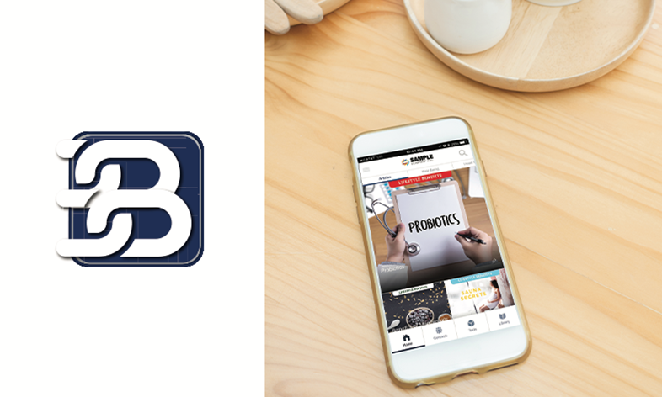
BenefitLink Mobile App
The BenefitLink App Gives You 24/7 Access to Your Benefits Information
Features
Download on the App Store or Google Play.
Username: cityoftulsa
Password: benefits
Lifestyle Benefits monthly newsletter
Benefits contact information
Reference Library
Health & Welfare calculators

Slide 78
PREPARING FOR ENROLLMENT
You will need to enter all your dependents and beneficiaries into the Empyrean/Compass system. Make sure you have all your dependents and beneficiaries’ dates of birth and social security numbers available when you enroll.
When adding dependents to your medical, dental, or vision coverage you will need to upload the following documents into Empyrean
  Spouse- Marriage License
  Children- Birth Certificates
  Step-children- Birth Certificate & Marriage License if spouse is not on the plan
  Birth Certificate or Final Adoption Court Order, Guardianship Court order
Additional information on the benefits being offered as well as the 2022 Benefits Guide can be found on the City of Tulsa Benefits web page at www.cityoftulsa.org/2022benefits.
If you have any questions, please contact insurance@cityoftulsa.org.

Slide 79

thank you!
The information contained in this presentation provides a summary of your benefits. For complete information, please refer to your summary plan document. In the event of an inconsistency, the plan documents prevail.

Slide 80
retirement
Retirement
Human Resources
Kerry Kavanaugh
Human Resources
October 17, 2018

Slide 81
Municipal Employees’
Retirement Plan (MERP)
MERP is a defined benefit plan and does not hold individual accounts for employees. It is based on a formula defined by the plan which provides a specified amount from the age of retirement until death.
Required employee contribution of 7.5% of your base pay, deducted on a pretax basis
City contributes 16.5% of your base pay.

Slide 82
MERP
To qualify to retire with a MERP benefit
Age of 65
Full retirement amount
Early Retirement
Minimum age of 60 to 65 with a reduction of 6% per year
Rule of 90
Age plus years of service = 90
Full retirement amount
Cannot borrow from MERP during employment
Effective 7-1-2018

Slide 83
MERP
How to calculate your retirement income
Average salary based on highest 30 months
of last 60 months
Income
Multiplier
Multiplier of 2%
Service
Continuous Years and Months of service

Slide 84
MERP
Final Average Earnings (Monthly Amount)
Multiplier (2%)
Years of Service
= Monthly Benefit

Slide 85
MERP
Type of Benefits
Straight Life | Joint and Survivor | Level Income | Partial Lump Sum | Pop Up
Monthly benefit for your lifetime only | Monthly benefit for your lifetime only and when you pass away, your Survivor will get a monthly benefit for their lifetime Monthly benefit is lower than Straight life amount | Monthly benefit for your lifetime. Can elect a Joint and Survivor benefit. Pays higher until 62. The amount after 62 plus Social Security will equal the amount received prior to 62 | While electing either Straight Life or Joint & Survivor Benefit, you can take a 1 year, 2 year, 3 year annual amount as well Monthly benefit is lower than Straight Life amount | Included in Joint and Survivor benefit. If your Survivor passes away before you, you would pop back up to a Straight life amount. Monthly benefit is lower than Straight Life amount
Once you receive first monthly pension check, you are no longer able to make changes to your plan

Slide 86
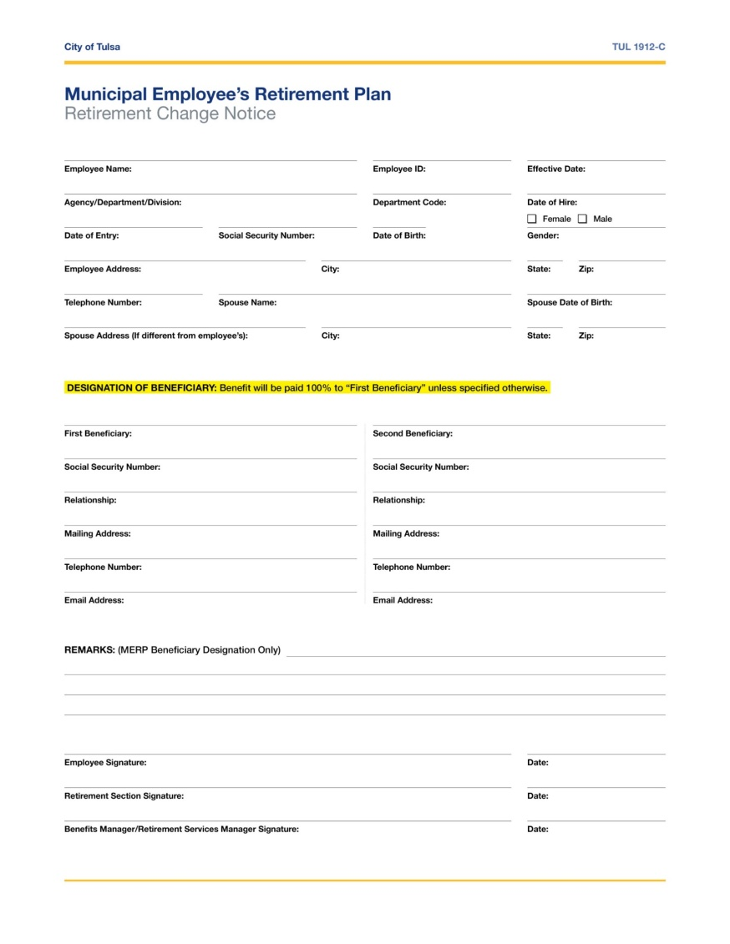
MERP
Beneficiary Designation
Fill out beneficiary information as ACCURATELY AS POSSIBLE
May receive one final payment of your benefit
Can change as often as you want
Can designate Contingent Beneficiary or Multiple Primary Beneficiaries
UPDATE contact information when necessary

Slide 87
MERP
If you decide to leave the City before Retirement
NOT VESTED
Less than 5 years of Service
Must take refund
Can roll over into an IRA account or take it as cash
Roll overs are not taxed if done appropriately. Cash will be taxed AT LEAST 20%
Check is mailed
VESTED
Over 5 years of Service
Can take it as a refund
Can leave it in place until 65
for Normal retirement
Reduction between age 60-65
Can select Straight Life or Joint
and Survivor
Please notify Retirement of Address changes

Slide 88
Deferred Compensation Plan
Similar to 401(k)
Account with your name on it
Can select how money is invested
Can start at any time
Minimum of $10.00 per pay period
City Match: $.50 for every dollar of employee contribution up to a maximum of $25.00 per month during the first two years of continuous contributions to the plan
Pretax or after Tax Roth contributions
Loans and unforeseeable emergency distributions available

Slide 89



Deferred Compensation Plan
Online
Call
Meet
  Tulsa457.com
  1-877-677-3678
  Monday-Friday | 7am-7pm
  Look for communication on our Nationwide Representative visiting various locations

Slide 90
Understanding Your Retirement
Offered Quarterly
Wide variety of information on Retirement topics such as Medicare, Social Security, financial planning
Must sign up in advance
Great for Newer employees and Employees getting close to retirement

Slide 91
Contact Us
retirement@cityoftulsa.org
Kristy Hutton
  khutton@cityoftulsa.org
  (918) 596-7322
Russell Kidd
  rkidd@cityoftulsa.org
  (918) 596-7469
Tonya Cromwell
  tcromwell@cityoftulsa.org
  (918) 596-7437

Slide 92
Tulsa Time / Munis
Retirement
Suzanne Grooms
Human Resources
Kerry Kavanaugh
Human Resources
October 17, 2018

Slide 93
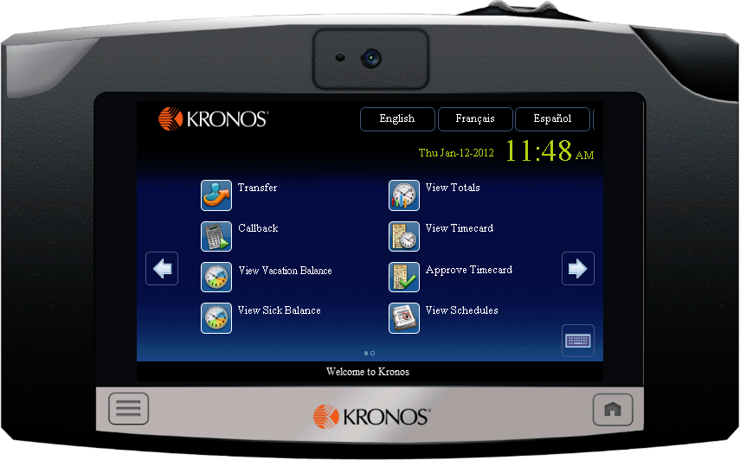

Tulsa Time / kronos
Everyone will have access to a Kronos kiosk no matter
their work station.
You can clock in and out with your badge for the day
and for lunch using this machine.
Jane
Doe
Position Title
DEPARTMENT TITLE
Issued:
01/01/2018
Official Employee Identification

Slide 94
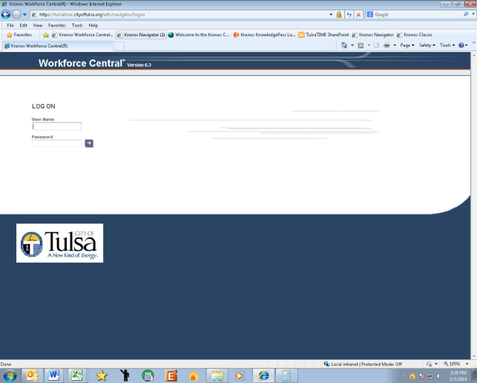
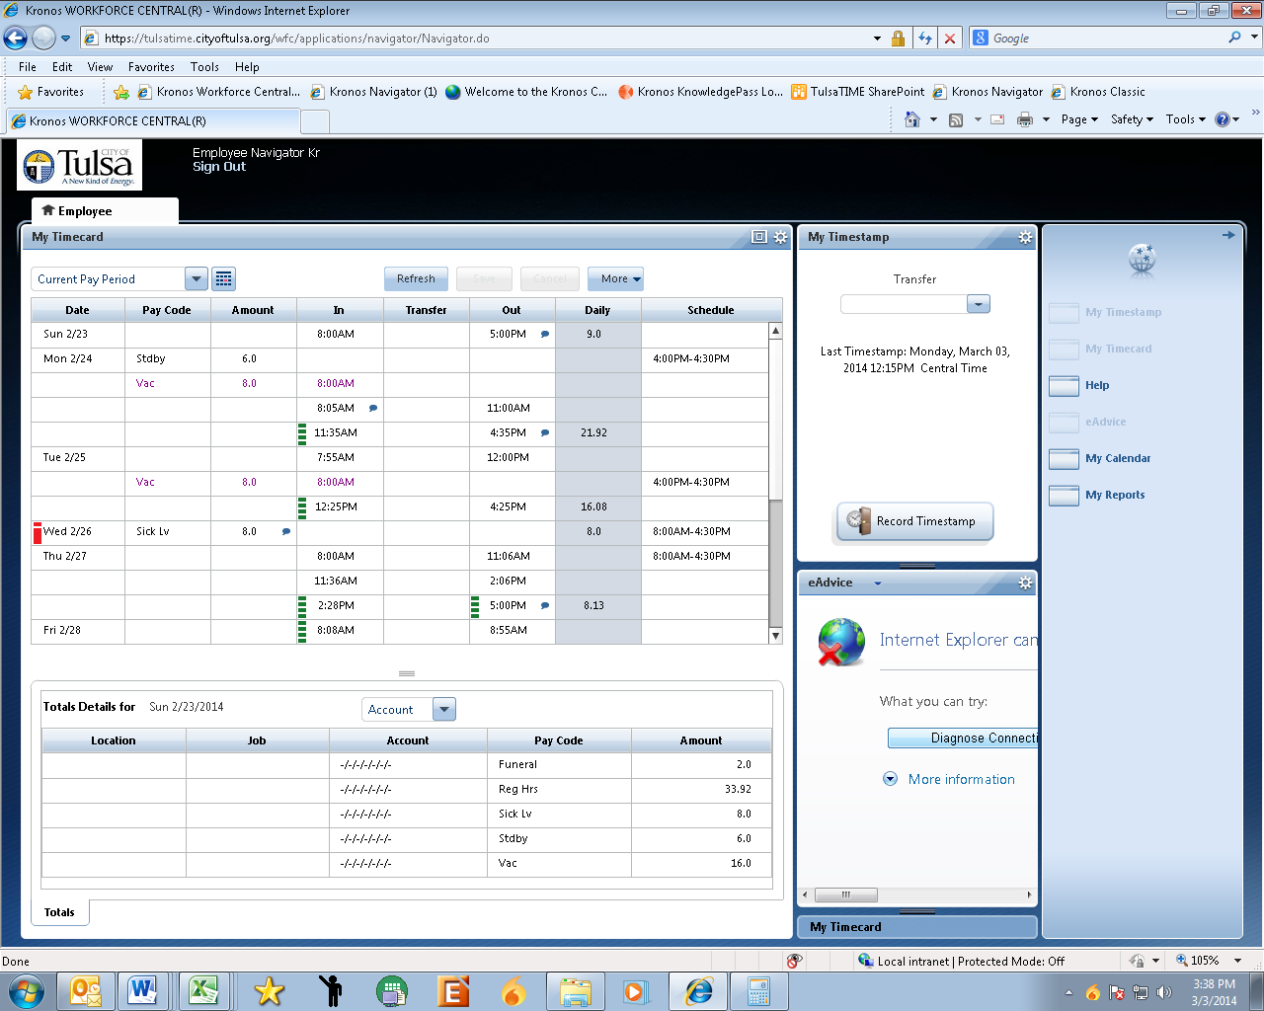
Tulsa Time / kronos in the office
When using Kronos at your desk you will click on the
Tulsa Time Icon.
It will then ask for a username and password and it will
be the same as your computer login info.

Slide 95
Tulsa time / Kronos Functions
Every other Friday look at your schedule on either the kiosk or online to make sure everything is correct and then approve your time card.
To request time off in the system click the calendar button.
When requesting time off put in the specific type of leave you want to use.

Slide 96
Munis
This is the system we use to keep track of all employees.
By the end of today all of you will be entered into the
Munis system.
This system has created a way for all employee's to have
an electronic personnel file online.

Slide 97
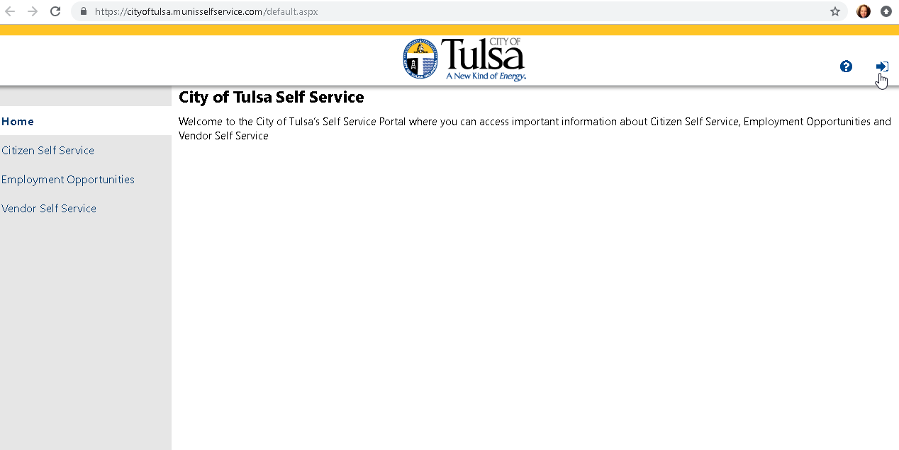
EMPLOYEE SELF-SERVICE (ESS) Login Page

Slide 98
ESS
Employee Self-Service Portal
You can access your employee self service portal from your desk top using the Munis Self Service Icon.
In the event that you are out of the office or you don’t work in an office setting we also have created two ways for you to access ESS remotely.

Slide 99
ESS Remotely
The first way you can access ESS remotely is by going to the following website: https://cityoftulsa.munisselfservice.com
It will then prompt you to fill out a username and password.
Your username is going to be your employee id number. Your password will be the last four (4) numbers of your social security number initially and then it will prompt you to change that password to something only you know.

Slide 100

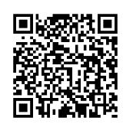
ESS Mobile App
The second way you can access ESS remotely is by using
the ESS mobile app.
First download it from the app store on your phone.
After that it will give you the option to scan the QR code.
You will have to login to ESS on the website first so you can
see the QR code and then you can scan that onto your app.

Slide 101
ESS Functions
There are several convenient things you can do from your
Munis Self- Service Portal.
You can change your address at any time and it will be updated throughout the system.
You can also change your name in the system as long as you submit
an updated SSN card.
Access your last five check stubs.
Change your W4 information.
You can see your W2s in ESS once they become available.
Change your direct deposit information.

Slide 102
Employment Opportunities
Another advantage of ESS is that you can view available jobs.
Once you have been in your current position for six months you free to apply for new positions.
Through ESS you can even sign up to receive e-mails when jobs post internally.

Slide 103
Performance Evaluations
During the beginning of your assignment you will meet with
your supervisor to discuss objectives and goals. This will be
your initial planning.
By the end of the year your supervisor will complete a full Planning and Performance Review or PPR.
Once your supervisor completes this you will be able to view
and accept your PPR through ESS.

Slide 104
Ask questions!
We are here to help!

Slide 105
Customer Service
Retirement
Kycia Davison & Juanita Stewart
Customer Care
Kerry Kavanaugh
Human Resources
October 17, 2018

Slide 106
Overview
Customer Accessibility
Who Are Our Customers
Do’s and Don’t of Customer Service
Customer Service Principles
Examples of Good and Bad Customer Service

Slide 107
Customer accessibility
Automated Phone System (Interactive Voice Response)
  Multiple Self-Service Paths
  Available 24/7
Mobile App, Web Self-Service/Tulsa311.com (Available 24/7)
Chat (Tulsa311.com)
311 Phone Line
Email: Tulsa311@cityoftulsa.org (Available 24/7)
Walk-Ins to City Hall
At Home Agents

Slide 108
Who are our customers?
Internal
  Peers
  Bosses
  Subordinates
External
  Vendors
  General Public
  Field Customers

Slide 109
Do’s of Customer Service
Identify yourself
Use appropriate tone of voice
Be respectful to the customer
Be friendly, helpful and knowledgeable
Take ownership. Never say they. Always use I, we use- The City of Tulsa
Talk slowly and articulate clearly
Use “Please” and “Thank You”

Slide 110
Do’s of Customer Service
Keep calm when a customer is upset
Let them vent
Apologize
Be empathetic
Be patient
Let the customer know you are here to help
Have a positive attitude
Be prepared to help the customer

Slide 111
Don’ts of Customer Service
Don’t use jargon or acronyms
Never talk over a customer
No Political or religious comments
Never guess. Make sure you know.
Never use words like “sweetie, honey or dude” be professional
Do not take what a customer says personally
Don’t make promises you can’t keep
Don’t make excuses to the customer on why you can’t solve their issue

Slide 112
Overview
Customer Accessibility
Who Are Our Customers
Do’s and Don’t of Customer Service
Customer Service Principles
Examples of Good and Bad Customer Service

Slide 113
Customer accessibility
Automated Phone System (Interactive Voice Response)
  Multiple Self-Service Paths
  Available 24/7
Mobile App, Web Self-Service/Tulsa311.com (Available 24/7)
Chat (Tulsa311.com)
311 Phone Line
Email: Tulsa311@cityoftulsa.org (Available 24/7)
Walk-Ins to City Hall
At Home Agents

Slide 114
Who are our customers?
Internal
  Peers
  Bosses
  Subordinates
External
  Vendors
  General Public
  Field Customers

Slide 115
Do’s of Customer Service
Identify yourself
Use appropriate tone of voice
Be respectful to the customer
Be friendly, helpful and knowledgeable
Take ownership. Never say they. Always use I, we use- The City of Tulsa
Talk slowly and articulate clearly
Use “Please” and “Thank You”

Slide 116
Do’s of Customer Service
Keep calm when a customer is upset
Let them vent
Apologize
Be empathetic
Be patient
Let the customer know you are here to help
Have a positive attitude
Be prepared to help the customer

Slide 117
Don’ts of Customer Service
Don’t use jargon or acronyms
Never talk over a customer
No Political or religious comments
Never guess. Make sure you know.
Never use words like “sweetie, honey or dude” be professional
Do not take what a customer says personally
Don’t make promises you can’t keep
Don’t make excuses to the customer on why you can’t solve their issue

Slide 118
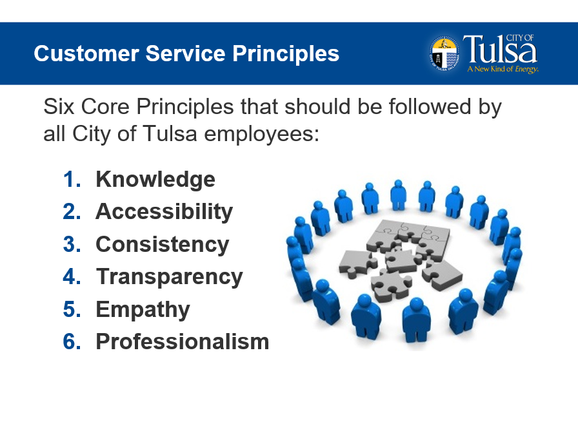

Slide 119
Customer Service Principles
Knowledge- Knowledgeable employees are empowered to deliver excellent service
Accessibility-We provide services and facilities that are easy to use and meet our customers’ needs
Consistency- We use efficient, consistent, and effective approaches to meet expectations. We apply policies and requirements consistently and fairly.

Slide 120
Customer Service Principles
Transparency- We ensure that our adopted laws, policies, guidelines, standards and process are up to date and accessible to all.
Professionalism- We remember the importance of our jobs with respect to the public. We listen to our customers and treat them with dignity and respect.
Empathy- We can relate to all customers because as residents we are also customer of our local governments. We do our best to see the interaction from their perspective.

Slide 121
Examples of bad customer service
What made it bad?
How did it make you feel?
What would you want them to do differently?
What could you do to make it a better experience?

Slide 122
Examples of good customer service
What made the experience good?
Describe different elements that you would want to copy
Who did you tell about the good experience?

Slide 123
Customer Service Highlights
We are always serving customer and have _____________ and ___________ customers,
You can reach the City of Tulsa by calling _____.
Our ______________allows you to take photos and automatically submit the location of an issue.

Slide 124
Customer Service Highlights
You can reach the City of Tulsa 24/7 by using our _________________, ______________, ________________, ______________.
When you think of the top three “Do’s of customer service you would say:
  1. Be ________________
  2. Be________________
  3. Be________________

Slide 125
Customer Service Highlights
The six customer service principles at the City of Tulsa are:
  1.____________________
  2.____________________
  3.____________________
  4.____________________
  5.____________________
  6.____________________

Slide 126
Drug Free Workplace
Steve Stewart
Community Care Employee Assistance Program

Slide 127
Employee Assistance Program
New Employee Orientation for Drug Free Workplace & the Department of Transportation

Slide 128
Drug Free Workplace & Department of Transportation Training
Drug-Free Workplace (Federal/State) and
Federal Omnibus Transportation Act (DOT)
Content provided by Community Care EAP and the
U.S. Department of Labor
Presented by
Steve Stewart, LPC, LADC, SAP
Community Care EAP Supervisor
128

Slide 129
Which are true or false?
Marijuana is legal in one state.
You can test positive for THC from second hand smoke in Oklahoma.
Social drinkers are more dangerous in the workplace than alcoholics.
Marijuana with the highest THC-level is “Oklahoma Skunk Weed”.
Average age of beginning drug use is 12.
The most dangerous withdrawals are related to Heroin.
129

Slide 130
Quiz
Most commonly abused illegal drug in the US is?
Marijuana
Percentage of drug addicts that are employed?
77%
Percentage of Alcoholics that are employed?
90%
What % of adults know someone who has reported for work under the influence of alcohol or other drugs.
70%
130

Slide 131
Which of the following industries has the lowest rate of alcohol/drug abuse?
Food Service
Construction
Retail
Repair Service
Manufacturing
Wholesale
Transportation
131

Slide 132
Reasons for a DFW & DOT Policy
The DFW & DOT Policy accomplishes three major things:
Sends a clear message that use of alcohol and drugs in the workplace is prohibited
Encourages employees who have problems with alcohol and other drugs to voluntarily seek help
Comply with the Drug-Free Workplace Act of 1988 and the Omnibus Transportation Act of 1991.
132

Slide 133
DFW Requires the Following Actions:
Prepare and distribute a formal drug-free workplace policy statement.
Establish a drug-free awareness program.
Take direct action against an employee convicted of a workplace drug violation.
Maintain an ongoing good faith effort to meet all the requirements of the Act throughout the life of the contract.
133

Slide 134
Prepare and distribute a formal drug-free workplace policy statement
This statement should clearly prohibit the manufacture, use, and distribution of controlled substances in the workplace and spell out the specific consequences of violating this policy.
134

Slide 135
Establish a drug-free awareness program
This program should inform employees of the dangers of workplace substance abuse; review the requirements of the organization’s drug-free workplace policy; and offer information about any counseling, rehabilitation, or employee assistance programs that may be available.
135

Slide 136
Take direct action against an employee convicted of a workplace drug violation
This action may involve imposing a penalty of some kind or requiring the offender to participate in an appropriate rehabilitation or counseling program.
136

Slide 137
DFW Substances in the Workplace
Marijuana
Stimulants (Methamphetamine, Amphetamines, Cocaine & Ecstasy)
Opiates (Narcotics & Pain Medications)
Hallucinogens (PCP, LSD, mescaline, Peyote and psilocybin )
Alcohol
DOT just added MDMA and reduced levels
NOTE: DFW allows more than a 5 panel test
137

Slide 138

Marijuana
Several regularly observed physical effects of marijuana include:
  Psychomotor Retardation
  Bloodshot eyes
  Dry mouth and throat
  Increased appetite
  Chronic sore throat
  Chronic infections
Use of marijuana also has mental effects that may include:
  impaired or reduced short-term memory and comprehension
  altered sense of time
  changed sensory perception--sight, smell, hearing, touch
  reduced ability to perform tasks requiring concentration and coordination, such as driving a car
138

Slide 139

Wrong Message ?
139

Slide 140
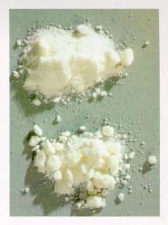
Stimulants (Methamphetamine , Amphetamine, Cocaine & Ecstasy)
SIGNS AND SYMPTOMS OF USE
Dilated pupils
Increased pulse rate
Elevated blood pressure
Insomnia
Loss of appetite
A/V & tactile hallucinations
Paranoia
Seizures
Anxiety, agitation
Periods of increased activity
followed by fatigue and depression
Wide mood swings
Difficulty in concentration
140

Slide 141

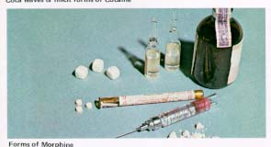
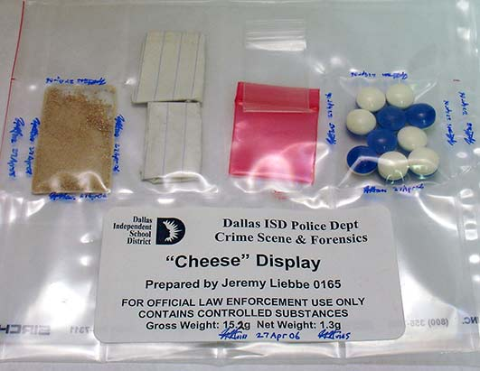
Opium (Narcotics & Pain Medications)
SIGNS AND SYMPTOMS OF USE
Drowsiness
Nausea and vomiting
Constricted pupils
Watery eyes and itching
Low and shallow breathing
Clammy skin
Impaired respiration
Convulsions
Coma
Possible death
141

Slide 142
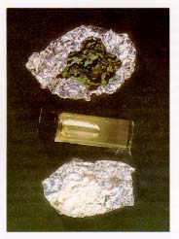
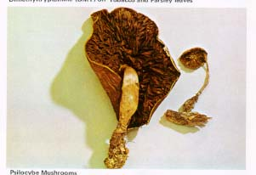
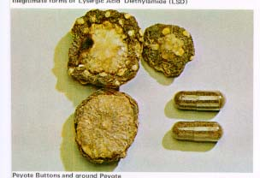

Hallucinogens & Phencyclidine (PCP)
SIGNS AND SYMPTOMS OF USE
Impaired concentration
Confusion and agitation
Muscle rigidity
Profuse sweating
Self-inflicted injuries
Memory problems
Depression
Anxiety
Severe disorientation
142

Slide 143



Alcohol
SIGNS AND SYMPTOMS OF ABUSE
Dulled mental processes
Lack of coordination
Slowed reaction time
Poor judgment\decision making skills
Reduced inhibitions
Withdrawal symptoms
A 12-oz. can of beer, a 5-oz. glass of wine and a 1.5-oz. shot of hard liquor all contain the same amount of alcohol (1 oz.).
143

Slide 144
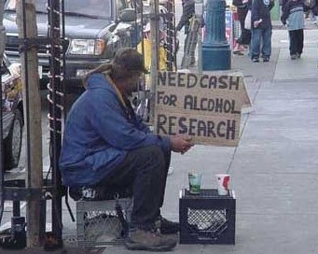
Research ??
144

Slide 145
Federal Motor Carrier Safety Administration (FMCSA)
Anti-drug and Alcohol Misuse Prevention Program Elements
145

Slide 146
Review of Federal Transportation Administration Drug Testing and Alcohol Misuse Prevention Programs,
Department of Transportation Procedures for Transportation Workplace
Drug and Alcohol Testing Programs
Background
Drug and alcohol testing of Department of Transportation (DOT) operational area employees was the result of the U.S. Government vigorously pursuing safety initiatives in the transportation industry. To achieve these safety goals and to prevent accidents involving prohibited drug and alcohol use, comprehensive drug and alcohol regulations were established to ensure that public safety is not compromised.
Since 1989, Federal regulations have required drug testing of certain DOT industry employees. In 1995, the DOT’s drug testing program was expanded to include alcohol testing regulations (Alcohol Misuse Prevention Program). In developing these regulations, the DOT carefully balanced the government’s commitment to public safety with the privacy rights of employees.
The U.S. Department of Health and Human Services (HHS) has approved testing protocols and positive thresholds for the five drugs in which urinalysis testing is required---cocaine, marijuana, opiates, phencyclidine (PCP) and amphetamines. These protocols and thresholds are crucial to the accuracy and integrity of the testing process. The U.S. Courts have upheld these same testing protocols and thresholds.
The Department of Transportation (DOT) published a final rule on drug testing, Procedures for Transportation Workplace Drug Testing Programs, (49 CFR Part 40) in 1988. This DOT regulation was based on HHS guidelines for Federal agency employee drug testing, with some changes to fit the transportation workplace. DOT added alcohol testing procedures to Part 40 in a 1994 final rule. DOT’s rule describes the required procedures for conducting workplace drug and alcohol testing for the Federally regulated transportation industry. All DOT drug and alcohol programs, must comply with Part 40. Only forensic laboratories certified by HHS may be used to conduct drug testing.
146

Slide 147
The following is an outline of the major program elements of FMCSA’s anti-drug and alcohol misuse prevention programs:
Employees who must be tested under Federally mandated drug and alcohol programs (49 CFR Part 382) are those who perform safety sensitive duties (directly or by contract for covered employers) as listed below:
Drivers
Mechanics
Management Drivers, who need a Commercial Drivers License (CDL), and who drive a Commercial Motor Vehicle* (CMV)
Transport of 16 occupants including driver
Any placarded vehicle
*Commercial motor vehicle means a motor vehicle or combination of motor vehicles that has a gross combination weight rating of 11,794 or more kilograms (26,001 or more pounds) inclusive of a towed unit with a gross vehicle weight rating of more than 4,536 kilograms (10,000 pounds); or has a gross vehicle weight rating of 11,794 or more kilograms (26,001 or more pounds); or is designed to transport 16 or more passengers, including the driver; or is of any size and is used in the transportation of materials found to be hazardous for the purposes of the Hazardous Materials Transportation Act (49 U.S.C. 5103(b)) and which require the motor vehicle to be placarded under the Hazardous Materials Regulations (49 CFR part 172, subpart F).
147

Slide 148
Substances for which testing must be conducted under Federally mandated drug and alcohol programs 49 CFR Part 40
Marijuana metabolites/THC
Cocaine metabolites
Amphetamines (including methamphetamine)
Opiates (including codeine, heroin, morphine)
Phencyclidine (PCP)
Alcohol (breath testing only)
148

Slide 149
Critical Information
Employers are REQUIRED to check your
job history for 3 years. Not properly following the guidelines can result in:
You not being allowed to work in the U.S.
Termination of your current employment
Lessening your chances for future employment
Sanctions on employers past/present
149
Notes:
40.25 Previous Employment Inquiries
http://www.fmcsa.dot.gov/rulesregs/fmcsr/regs/40.25.htm

Slide 150
Use of Controlled Substances (Rx)
If a controlled substance is used:
Driver shall not report to or remain on duty
Employer will not permit driver to perform safety sensitive functions
Driver may be required to inform the employer of any therapeutic drug use
150
Notes:
382.213
http://www.fmcsa.dot.gov/rulesregs/fmcsr/regs/382.213.htm

Slide 151
Consequences for employees engaging in prohibited conduct under FMCSA‑mandated drug and alcohol programs (49 CFR Part 382, and 49 CFR Part 40, Subpart O):
      Removal from safety-sensitive duties until return‑to‑duty process is completed.
      When an employee has engaged in a prohibited behavior, the employer shall advise the employee of the resources available, including names, addresses and phone numbers of qualified SAP’s
151

Slide 152
Types of testing required under FMCSA mandated drug and alcohol programs (49 CFR Part 382.303):
152
Pre-employment (not mandatory for alcohol but permitted)
Random
Post-Accident
Reasonable Cause/Suspicion
Return-to-Duty
Follow-Up
Retesting of covered employees with an alcohol content of 0.02 or greater but less than 0.04 (alcohol testing only)

Slide 153
Prohibited conduct by employees under FMCSA‑mandated drug and alcohol programs (49 CFR Part 382.201 through 211):
153
  Alcohol concentration of 0.04 and greater.
  Use of alcohol prior to performing safety-sensitive duties (within 4 hours after consuming alcohol).
  Use of alcohol while on duty.
  Use of alcohol after an accident.
  Use of prohibited drugs.
  Refusal to submit to testing (drugs and/or alcohol).

Slide 154
The following procedures must be followed before allowing an employee to resume working in a safety-sensitive position (49 CFR Part 382) and (49 CFR Part 40, Subpart O):
154
      Initial evaluation by a substance abuse professional.
      Employee must participate in the treatment program recommended by the substance abuse professional.
      Follow-up evaluation by a substance abuse professional to determine if the employee has successfully carried out the education and/or treatment recommendations.
      Employee must pass a return-to-duty test.
      Employee must submit to subsequent follow-up testing established by the substance abuse professional after resuming safety‑sensitive functions.

Slide 155
CommunityCare Employee Assistance Program
In Closing
155

Slide 156
IT Orientation
for New Employees
Sandy Liechti
IT Training and Development Coordinator
Notes:
Introduction
About yourself
How did you start working at the city?
A little about what IT Supports at the City- all the departments

Slide 157
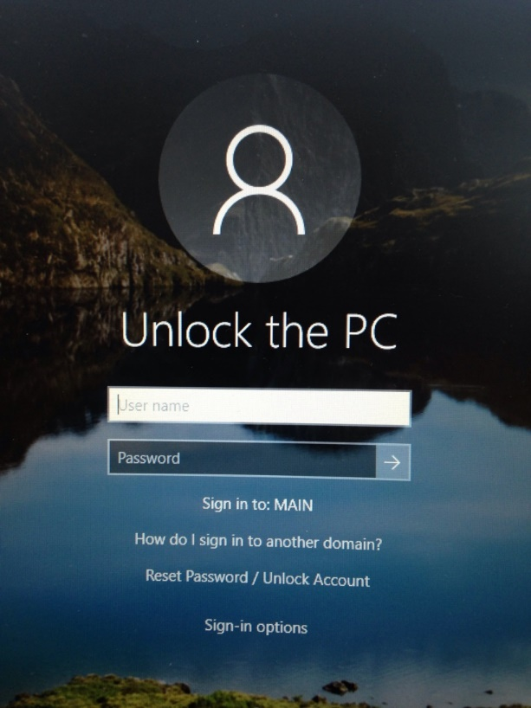
Login and Passphrase
Your initial login is provided by your supervisor
The initial password should be reset on the first login
City of Tulsa has recently switched to using passphrases for security purposes
Do not use your City of Tulsa passphrase for online purposes
Multi-Factor Authentication (MFA)
Notes:
12 characters, some complexity
Do not use identifiers like name, birthdate, addresses
Do not use passphrase for other purposes
Use many different longer passwords for online purposes
Length vs complexity- length is better and harder to crack
You might have to write them down- not on sticky notes
MFA- O365 will ask you to verify, you need to choose to use your cell or work phone for verification.
Personal devices for work are part of open records, legally MFA on your personal device does not qualify for open records.

Slide 158
IT Solution Center (918) 596-7070
servicedeskplus.cityoftulsa.org
Service Desk Plus is a direct line to the IT Department’s Solution Center
You can create a service “ticket” to help you with technology issues
The Solution Center providers will process the ticket and contact you with solutions to your IT needs
You may also call or email the Solution Center with IT issues and they will create a ticket for you
The IT Solution Center operates 8:00am-5:00pm. You may use the after- hours phone system to report IT emergencies
Notes:
Briefly go over- it is not working right now so emphasize the phone number to contact.
It is on the slide at the end of the presentation.

Slide 159
Technology usage dos and don’ts
Policy 817 and Policy 819
DO
Limit personal use of computer
and internet to lunch and breaks
Give credit when using copyrighted materials
Report offensive or disruptive content
Store personal data at your own risk
Contact the IT Department for help with computer issues
DON’T
Look at or download material that
is offensive, fraudulent, obscene,
or explicit
Use your City work credentials for financial gain
Add software or hardware without
IT permission
Move computers or other hardware without IT permission
Notes:
Share where the policies are located on the ESS page under Human Resources, personnel policies and procedures.
Go over a couple of these particularly limit personal use, offensive content, don’t add software/hardware without IT permission.
Programs may not run well with work related programs.

Slide 160

Information Safety
Public- name, email address, phone, job title
Internal- reports, data, projects, agendas, meeting notes
Restricted- SSN, health information (HIPAA), passphrases, financial information
Restricted data shared through email must be encrypted. It is against City and IT Policy to use someone else’s personal account or personal login information.
This Photo by Unknown Author is licensed under CC BY
Notes:
Government employees deal with lots of information.
Public information is OK to talk about.
Work related stays in the network and with your work colleagues.
Restricted information must be encrypted if sent through email. Don’t share your passphrase with anyone else.

Slide 161

Email/Calendar
(policy 818)
The City of Tulsa uses Outlook for email and calendar
All email messages are property of the City of Tulsa and are subject to the Open Records Act.
Limit personal use
Don’t send or receive offensive content
Don’t use someone else’s email account
Report violations of email policies to supervisor
If you are unfamiliar with Outlook, ask your supervisor to contact Sandy Liechti for Outlook training.
This Photo by Unknown Author is licensed under CC BY-SA
Notes:
Read through slide. Emphasis on Open Records.
Let them know they are working for “government” meaning transparency is necessary.
Your email should be used for work purposes only. Don’t use it to sign up for things, coupons, advertisements, etc.
Don’t use it on social media accounts like Facebook or Instagram, not even LinkdIn

Slide 162
Open Records Info
Open Records – Involve the transaction of City Business, spending City Funds, or administering City property.
Using the City's cloud-based software tools on your device does not make your device subject to the Open Records Act. Saving records on your device could.
Any device with City Records stored on them makes the device subject to being searched. Only the City Records could become open. Content is the determining factor.
Each Department has a designated Records Custodian to receive and process requests for records. They are listed on the City's website.
  https://www.cityoftulsa.org/government/departments/finance/public-records/

Slide 163




Office 365
“Cloud-based”- meaning it mostly functions over the internet.
Accessible- you can use it on your work computer or on a mobile device like a tablet or a phone.
Manageable- it looks the same; you don’t need to be a tech genius to use it.
Functions across devices.
Notes:
Accessible- you can access apps and content any time through mobile devices. It functions on any of your devices at any time, hence the “365” days a year.
Manageable- you don’t need to be a technology genius to use it; it is essentially very user friendly.
Secure- it is current- always up to date, no need for upgrades. Updates are easy to install.
We are able to use Microsoft resources, which means added protection. As a government entity, we have more safety features than the public would through Microsoft.
*

Slide 164

What is Phishing?
Understand
Prevent
Report
Notes:
Many emails, advertisements, and websites found on the web are safe and useful. However, it is important for computer users to understand how scammers and hackers may try to lure them into giving out personal information or into downloading malicious content. This presentation will explain methods scammers may use to trick you, how to recognize and prevent those tricky scams, and how to report them to IT security at the City of Tulsa. Our goal is to educate all employees so that we can continue to work online in a safe and productive environment.

Slide 165


Phishing defined
Phishing- the process of attempting to acquire sensitive information such as usernames, passwords, and credit card details while masquerading as a trustworthy entity
Notes:
Phishing is the process of attempting to acquire sensitive information such as usernames, passwords, and credit card details while masquerading as a trustworthy entity. As technology becomes more advanced, so do the techniques used by cyber criminals. Being aware of these techniques is the first step toward online safety.

Slide 166

Common types of Phishing
Email/Spam
Social Engineering
Spear Phishing/Whaling
Notes:
Although there are many phishing techniques used by cyber criminals, this tutorial will address email and spam attacks, social engineering, spear phishing and whaling, and finally website forgery or fraud.

Slide 167
Email/Spam Phishing
An email message requiring the user to enter personal credentials or update account information. This is usually accomplished through an urgent tone or request convincing the user to click on a link.
Ex. “Someone may have accessed your account! Please change your password immediately by clicking here.”
“Your password has been compromised! Login to your account using the following link to change your security information.”
Account@cityottulsa.org
Notes:
Phishing through email or spam mail uses email messages requiring the recipient to enter personal credentials or update account information. This is usually accomplished through an urgent tone or request convincing the user to click on a link. The first example shows urgency which entices the recipient to click the link. This may be followed by a request for personal information or an attempt to download malicious content to your computer. The second example is similar to the first in that it requests the email recipient to follow what will surely end up being a bad link. What is wrong with the second example?

Slide 168
Social Engineering
The user is tricked into clicking on questionable or malicious content using familiar site brands. These often take the form of links or attachments in an email.
Ex. “Your friend tagged you in a photo on Facebook! Click here to see who tagged you!”
“Pay Pal requires a response to your recent transaction. Please open the attached document to complete your transaction.”
Notes:
With social engineering, the user is tricked into clicking on questionable or malicious content using familiar site brands. These often take the form of links or attachments in an email. As you see from the examples, social engineering uses brand familiarity to trick the user into following malicious content. Facebook, PayPal, Amazon, and LinkedIn are all common brands used by cyber criminals to trick people into giving up personal information including passwords, social security numbers, and credit card information.
You should never use your City email to sign up for social websites. Also, remember to use a different password for your city login.

Slide 169
Spear Phishing/Whaling
The hacker targets a particular group or organization with information specific to them. Whaling targets high-profile employees with extensive access to sensitive information.
Ex. “All Blue Cross Insurance members must update account information by June 1. Access your Blue Cross account by clicking on the link provided.” www.bluecrosinsurance.org
“All City of Tulsa employees must complete this survey by January 1st.” (Sent from a high-level employee.)
Notes:
With spear phishing, the scammer targets a particular group or organization with information specific to them. In a similar manner, whaling targets specific, high-profile employees who have extensive access to sensitive information. This may take the form of an email which looks like it comes from a person high up in the organization. As a municipality, the City of Tulsa is particularly vulnerable to spear phishing and whaling. It is best practice to verify any suspicious email sent out to a large group from a source that you typically don’t interact with. We at the City often get survey requests, you can make sure you’ve seen notification that there is a survey being done or verify with the sender through a new email, not reply, that the survey is the real thing. And remember, it is always better to report a suspicious request rather than opening up the City network to hackers.
You will typically get an email from Communications or from IT stating that there is a city-wide survey taking place.

Slide 170

Preventing Attacks
Understand phishing risks
Think before you click
Hover over links to determine origin
Use strong passwords
Be cautious with popups
Never give out personal information
Check for https and a closed lock in website URLs
Keep your system up to date
Notes:
The City of Tulsa has many safety measures in place to help prevent these attacks from cyber criminals, but there are some things you can do to help prevent attacks. Understanding the methods used by scammers can go a long way in keeping our City network secure. Pause and think before you click on any link sent through an email, even from a person you work with and know. Hover your cursor over the link to match the URL to the content or the origin. If it doesn’t match, the link may need to be verified with the sender or reported. Our City passwords should be 12 character or longer, should contain some complexity with numbers and characters, and should not be the same password you use on other sites. Be aware of popups, particularly those asking for personal information or passwords. On a website, look for “https rather than http” and/or the lock symbol near the URL. These signify a safe website. Finally, keep your computer up to date. IT runs weekly updates on Monday nights. Leaving your computer on Monday when leave work will ensure your computer receives the weekly update.

Slide 171

Reporting Attacks
IT Security uses the “Phish Alert Report” button
The button is located on your Outlook home page on the tool bar
It is only accessible through the installed Outlook client and not through the Outlook Web App
Notes:
The City has a new tool to help in the fight against cyber criminals.
IT Security will be deploying the “Phish Alert Report” button.
The button will be located on your Outlook home page in the tool bar.
It is only accessible through the installed Outlook client and not through the Outlook Web App. (But this may soon change)

Slide 172
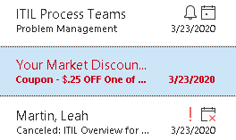
Reporting Attacks
To report suspicious email, make sure the suspicious email is highlighted in the message preview pane
Click on the “Phish Alert Report” button in the Outlook tool bar at the top of the Outlook home screen
Notes:
To report suspicious email, make sure the suspicious email is highlighted in the message preview pane.
Click on the “Phish Alert Report” button in the Outlook tool bar at the top of the Outlook home screen.

Slide 173
IT Security Response
Hello,
The attached email was marked as spam by our email system but we have reviewed it and found that it is a legitimate email and does not contain any known malicious content.
City of Tulsa IT Security Team
City of Tulsa Information Technology Department
175 E. 2nd St., Tulsa, OK 74103
Hello,
We have reviewed the email that you reported and found that it contains malicious content or a phishing attempt. Please delete the message. If you have clicked on any links or attachments, please change your password immediately.
Original email subject: [Possible Scam Fraud]Hi Friend
Thank you for reporting it.
City of Tulsa IT Security Team
City of Tulsa Information Technology Department
175 E. 2nd St., Tulsa, OK 74103
Hello,
We have reviewed the email that you reported and found that it is a spam message but does not contain any known threats.
Original message subject: 5oz water + THIS = Flatter Belly By Morning
City of Tulsa IT Security Team
City of Tulsa Information Technology Department
175 E. 2nd St., Tulsa, OK 74103
Notes:
IT will evaluate the email and determine its credibility. You will get an email letting you know if the email is spam or if it is malicious.
You will be prompted to delete a malicious email and to change your network password.

Slide 174


KnowBe4 Security Training
You will receive an email from IT Security within the first few days of employment
The email contains instructions and a link to the Know Be 4 security training website
Complete the training within 30 days of receiving the email
KnowBe4 security training is a yearly mandatory training for City of Tulsa employees

Slide 175

IT Training SharePoint Site
For access to IT videos, documents and updates, visit:
https://thecityoftulsa.sharepoint.com/sites/ITTraining

Slide 176
Contact the IT Solution Center with any IT questions or issues
We are here to provide cost effective and highly efficient technology services for our clients.
Through Service Desk Plus at: http://servicedeskplus.cityoftulsa.org
By email at:
servicedesk@cityoftulsa.org
By phone at:
(918) 596-7070
Sandy Liechti
(918) 596-9940
sliechti@cityoftulsa.org

Slide 177
Respectful
Workplace
Mayo Baugher
Human Resources

Slide 178
Discrimination
Discrimination is based on an individual’s protected class status. Protected statuses are as follows:
Race
Color
Religion
Age (40 and older)
Sex (Gender and sexual orientation)
Disability
Pregnancy/ Childbirth and related medical conditions
National Origin

Slide 179
Defining Harassment in the Workplace
Any behavior that is unreasonably interfering with someone’s work or creates an intimidating, hostile, and or offensive workplace.
Disrespectful jokes or “horseplay”
Name-calling, malicious gossip, or verbal harassment
Excluding others with the “silent treatment”
Written/ Electronics media that ridicules, intimidates or demeans others.

Slide 180
Hostile Work Environment
Occurs when an employer creates or permits the existence of an atmosphere of offensive conduct or speech so pervasive that a reasonable employee could not tolerate working under such conditions.
It can be more difficult to determine whether a City policy was violated
The key issues in determining Hostile Work Environment are frequency and severity.

Slide 181
Unwelcome Harassment
You may think, “If no one told me what I was doing was unwelcome, then my conduct could not have violated the policy because I was not made aware that it was unwelcome or offensive.”

Slide 182
Sexual Harassment and/or Unwelcome Physical Contact
Bumping into or rubbing against someone
Touching a persons’ hair clothes or body
Giving neck or Shoulder rubs/ massages
Hugging, patting, stroking, or kissing
Cornering someone or blocking their path

Slide 183
Verbal examples of Sexual Harassment
Whistling or making kissing sounds at someone
Making sexual comments or innuendos
Telling sexual jokes and/or stories
Spreading rumors regarding an individuals sex life

Slide 184
Social Media
Be careful when using social media
If you put on your Facebook or Twitter account that you
work for the City, be willing to take responsibility of all things
that are posted.
* Especially if you post something during work hours about a controversial subject.

Slide 185
What to do about Harassment…
Usually a best first step of action is to communicate with your harasser. (Tell them their actions make you feel uncomfortable and you want them to stop.)
Another option is to speak with your supervisor or department director regarding the situation.
If the harasser is your supervisor or you don’t feel comfortable going to your supervisor you can take your complaints straight to Human Resources.

Slide 186
Wrap-Up
Keep conversations professional at all times
Do not talk about protected class statuses
Do not flirt with, leer at, make any sexual comments to, or touch your coworkers.
Treat coworkers and supervisors with civility at all times
Follow the City’s policy against nepotism and fraternization

Slide 187
Leave iNFORMATION
Suzanne Grooms
Human Resources

Slide 188
Leave Policy
Vacation
Sick Leave
Floating Holidays
Holidays
Other Leave

Slide 189
Vacation Leave
All new employees accrue 9.333 vacation hours a month.
Vacation leave cannot be used by new employees until 3 months of service have been completed.
Vacation leave may be used in small increments.
Unused vacation leave will carry over.

Slide 190
Sick Leave
All employees accrue one day of sick leave per month
for a total of 12 sick days per year.
  *NOTE* If you belong to a collective bargaining group, you may
  have a waiting period before you can use your sick leave benefit. Please check your contract. Otherwise, you can use sick leave,
  if needed, after accruing at least one day.
Sick leave may be used in small increments.
Unused sick leave will carry over.

Slide 191
Floating Holidays
Floating holidays are like two additional vacation days an employee
is allowed every calendar year.
New employees have to put in at least 60 days of service before they
can use their floating holidays.
For new employees, floating holidays are prorated your first year depending on your start date:
  If hired January 1 through April 30 = 2 days
  If hired May 1 through August 31 = 1 day
  If hired September 1 through December 31 = 0 days
Floating holidays must be used within each calendar year; they do not carry over; use it or lose it policy.

Slide 192
Holidays
All City holidays are indicated on the card in your packet.
If you work a standard 8am to 5pm, Monday through Friday shift, you likely will have the indicated holiday off.
If you work a different shift, check with your immediate supervisor or manager to see how they allow each employee to take their holiday.

Slide 193
Other Leave
Court and Jury Leave
Funeral Leave
Military Leave
Leave Without Pay
Family Medical Leave Act
Check out the policies and procedures on the City of Tulsa’s website to find out more information regarding leave.

Slide 194
FMLA( Family Medical Leave Act) Employee Training
Suzanne Grooms
Human Resources

Slide 195
Family Medical Leave Act (FMLA)
FMLA is a benefit for employees and eligible family members for qualifying medical conditions
What you need to know about FMLA
Who to contact for FMLA
Understanding your rights and responsibilities under FMLA

Slide 196
Important employee information
You may have a maximum for 480 hours of FMLA per year if you are approved.
In order for you to be approved you must have worked 1250 hours of service. This service can be part time, temporary or seasonal work which may count towards the 12-months of employment.
You do not have the option to use FMLA. It is mandatory.
You can have multiple FMLA approvals on file at any time, but the maximum hours you can use per 12-months is 480.

Slide 197
Important Employee information
You will be protected by FMLA for qualifying absences.
Your Paid time will be used for your FMLA leave. This means you will use your sick time first, then vacation, floating holidays and then you will move into leave without pay (LWOP) per your personnel policy.
Understand that FMLA is NOT an additional paid leave.

Slide 198
All Supervisors should know
You as a supervisor must notify Human Resources immediately on the same day you think an employee may have a need for FMLA.
You cannot ask for more information, such as a doctor’s note for every FMLA-related absence because this can be considered interreference with the employee’s use of FMLA; Conversely as a supervisor you should contact HR if you suspect an employee is abusing FMLA
You have the burden of compliance with FMLA, there can be individual fines for interference.

Slide 199
Who’s Who
Lead
Contact information
Sarah Palmer
FMLA@cityoftulsa.org
Cathy L. Carter
FMLA@cityoftulsa.org

Slide 200
AFSCME LOCAL 1180
Tulsa Works Because We Do!
American Federation of State, County and Municipal Employees
AFSCME

Slide 201


WHO IS a.f.s.C.M.E.?
2
+
1. The American Federation of State, County, and Municipal Employees.
2.AFSCME is the everyday, behind the scenes, men and women working to keep our City moving forward into a brighter Tomorrow.
2
+

Slide 202
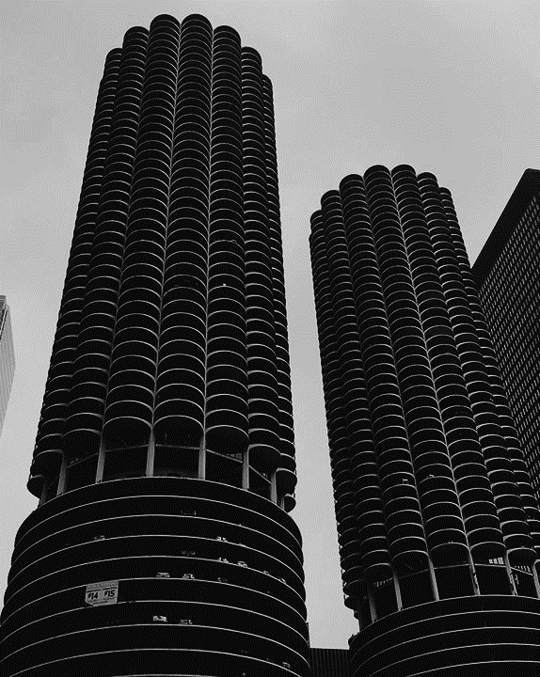
A Voice for the worker.
2
+
While you are working hard to serve the citizens of our City, AFSCME Local 1180 works to serve you.
We take a team of members every year and negotiate our pay, benefits, and working conditions with the City of Tulsa.
By Law you are covered by those contracts whether you want to be or not. We are your one and only voice in the workplace.

Slide 203

A Local Voice
2
+
AFSCME LOCAL 1180 TULSA
Is supported by AFSCME International consisting of approximately 3,400 local unions and 58 councils and affiliates in 46 states, the District of Columbia and Puerto Rico.
We are a proud part of the 1.5 million AFSCME members in the United States.
All of our Local Union Officers are elected by the Members from the Membership here at the City of Tulsa, we work everyday right by your side, serving our City and our Members.
Our Local Office is located at 1285 S Detroit Ave right here in Tulsa

Slide 204

Title
NON-MEMBER
MEMBER
The Right to Vote whether to accept or reject the Negotiated contracts.
The right to special discounts and benefits designed for members such as a Free Online Associates Degree, a free $3000.00 Accidental Death and Dismemberment Insurance Policy, access to Free Legal advice from our Local Union Attorneys and much more.
Open Pathways for your Voice to be heard.
Covered under AFSCME Negotiated Contracts.

Slide 205



How to Become A Member?
Ways to Connect.
Monthly Membership Meeting
4th Tuesday of every Month @ 6:00 PM 1285 S. Detroit Ave.
1180tulsa.org
Tulsa AFSCME
@afscme1180
All you have to do to be a member is fill out our Membership Application Form and turn it in to either our Local Office or to the Union Shop Steward who covers your area. ( A Call to the Union Office will put you in contact with a Steward overseeing your work area. 918-584-0334 ) There is Monthly Membership dues that is automatically deducted from your paycheck every two weeks for the amount of $19.05

Slide 206
Thank YOu

