Slide 1


SWOT Analysis
Planning Office

Slide 2
What is SWOT Analysis?
A technique you can use to measure four key aspects of a neighborhood, district, or area.
2

Slide 3
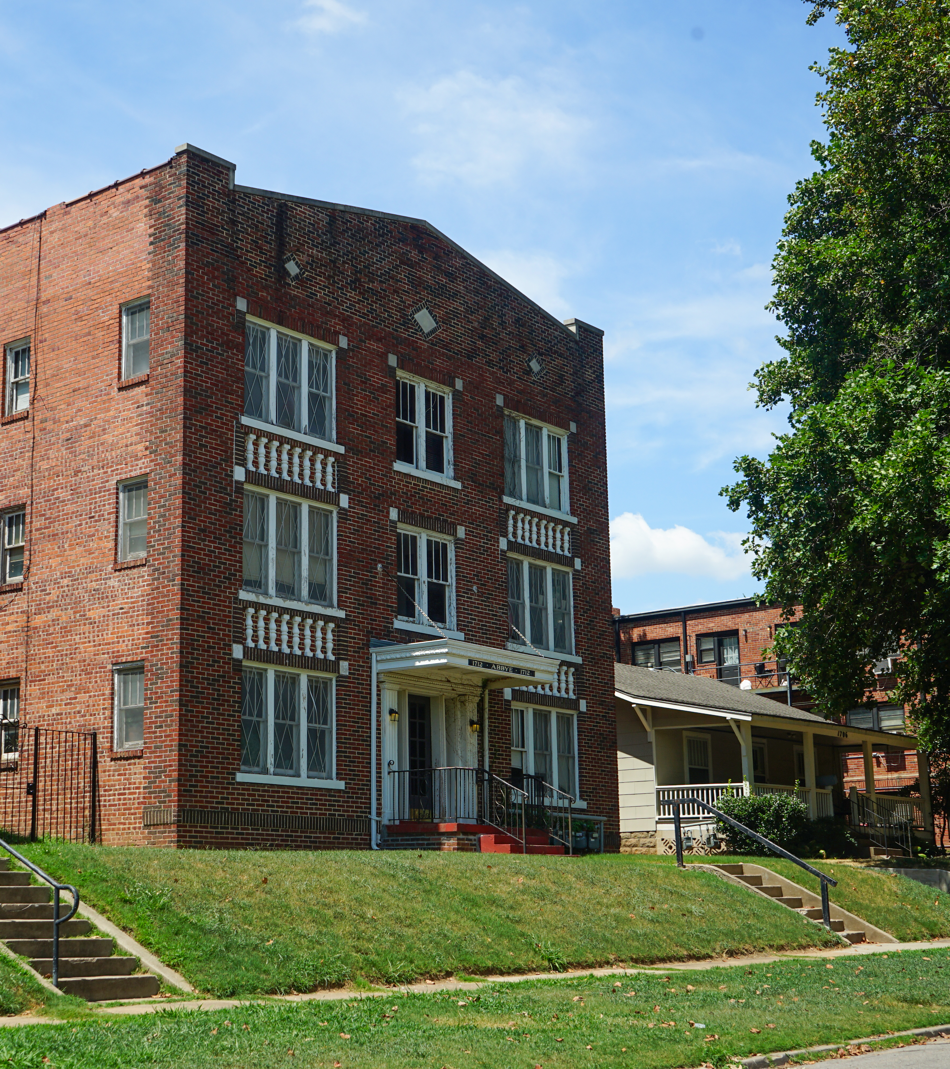
What is SWOT Analysis?
SWOT stands for…
Strengths
Weaknesses
Opportunities
Threats
3

Slide 4
SWOT analyzes internal and external factors to understand what’s going on inside your neighborhood and what’s impacting it from the outside.
SWOT Analysis
INTERNAL
EXTERNAL
STRENGTHS
WEAKNESSES
OPPORTUNITIES
THREATS
4

Slide 5
Benefits of SWOT Analysis
Challenge: Helps to challenge assumptions or perceptions about your neighborhood or district.
Uncover: Uncovers issues and blind spots of the area in each of the four aspects of SWOT Analysis.
Identify: Helps to identify opportunities that you may not have previously consider or known about.
5

Slide 6
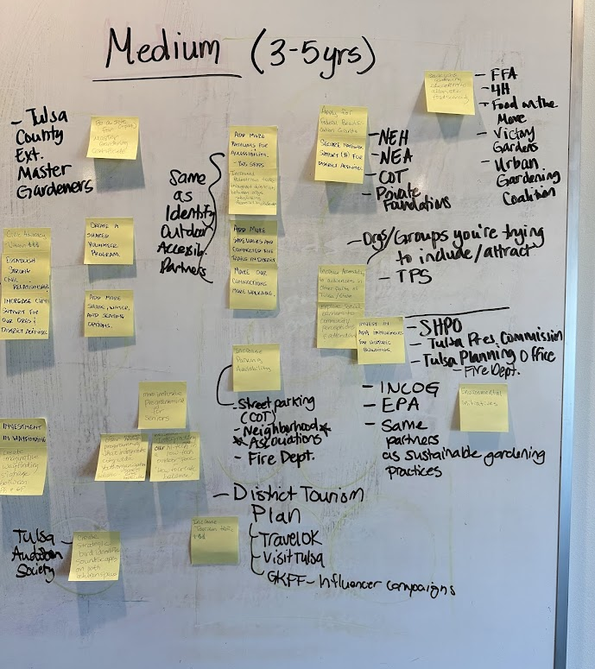
How to Conduct SWOT Analysis
Follow the SWOT Analysis Instructions.
Use this power point template to guide you.
Your facilitator will lead and guide you through the activity.
6

Slide 7
Make a list for each aspect. Use the SWOT prompts and questions to help guide you.
  Be Specific
  Be Honest
  Be Forward-Thinking
  Be Realistic
  Be Concise
7

Slide 8
SWOT Analysis
(5 minutes per aspect)
8

Slide 9
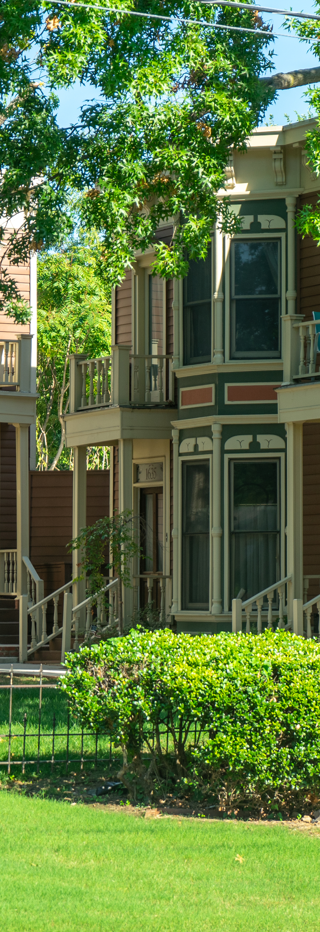
Strengths
(internal)
Build & Enhance
Strengths are things that your neighborhood does particularly well or that distinguishes you from other neighborhoods or areas.
Think about the advantages your neighborhood has over others.
What does your neighborhood do well?
What unique resources do you have?
What do others see as your strengths?
What attractions or landmarks are within your area?
9

Slide 10

Weaknesses
(internal)
Resolve & Reduce
Weaknesses, like strengths, are inherent features of your neighborhood so focus on your resources, infrastructure, assets, businesses, and attractions (or lack thereof).
Think about what you could improve and the sorts of projects, practices, programs, policies, etc. that your neighborhood should avoid.
What could your neighborhood improve?
Where do you have fewer resources than others?
What are others likely to see as weaknesses?
10

Slide 11
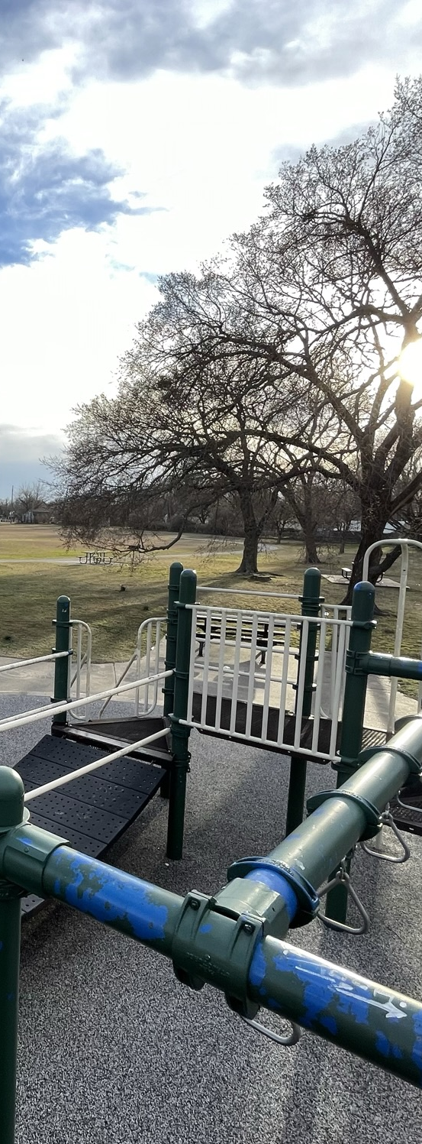
Opportunities
(external)
Exploit & Expand
Opportunities are openings or chances for something positive to happen, but you’ll need to claim! They usually arise from situations outside of your neighborhood and require a future mindset.
Think about good opportunities that you can exploit immediately. They don’t need to be game-changers (even small advantages can increase your neighborhood’s competitiveness). Opportunities can be policy, funding, grants, capital improvements, etc.
What opportunities are open to your neighborhood or area?
What trends could you take advantage of?
How can you turn your strengths into opportunities?
What are neighborhoods you view as vibrant and thriving doing?
11

Slide 12
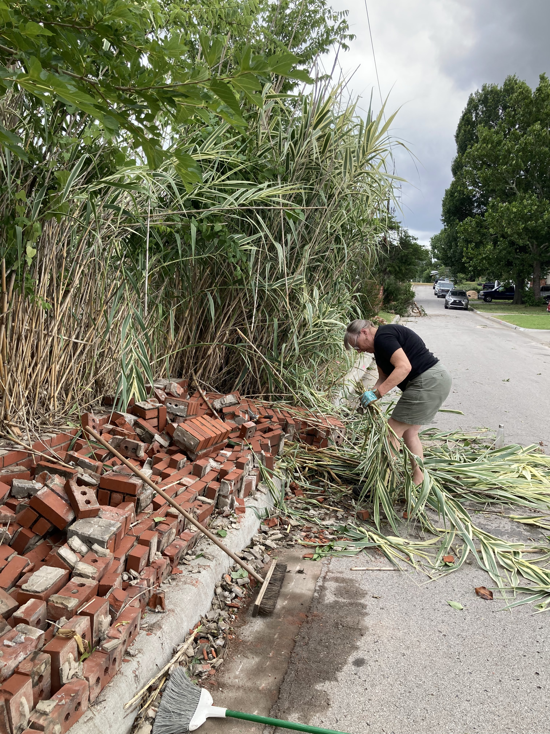
Threats
(external)
Avoid & Mitigate
Threats include anything that can negatively affect your neighborhood or area from the outside, such as private developments, extreme weather, shifts in funding, or a shortage of resources.
Threats can be obstacles your neighborhood faces.
What threats could harm your area?
What threats do your weaknesses expose to your neighborhood?
What trends threaten your neighborhood?
What obstacles continue to stop or slow positive change in your neighborhood?
12

Slide 13
Recap Conclusions
13

Slide 14
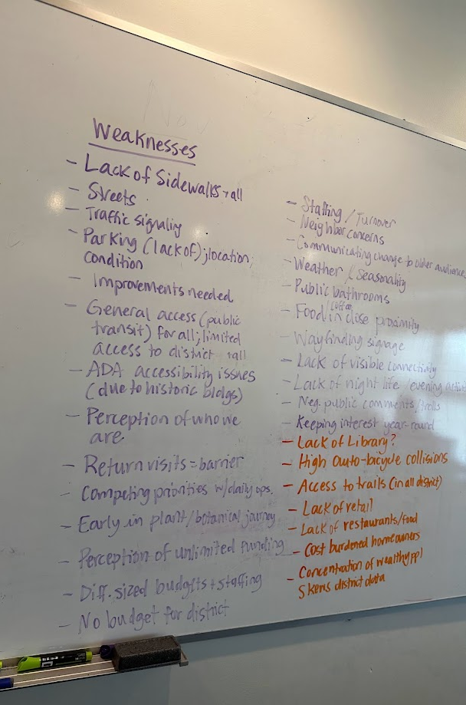
For each aspect…
Ask yourselves:
  Is there anything missing on this list?
  Is there anything we'd like to add to this list?
  Is there anything that doesn't quite fit that we want to move to the "Parking Lot"?
14

Slide 15
Side-by-Side Comparisons
15

Slide 16
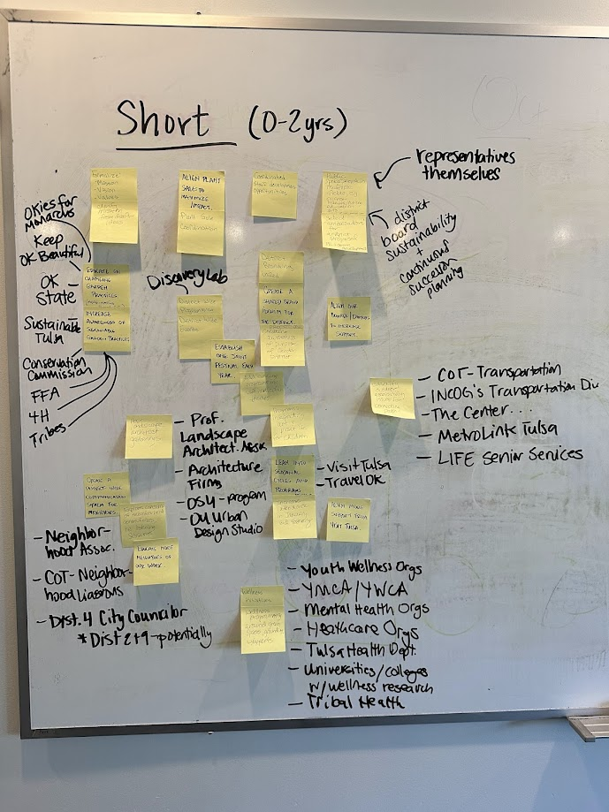
Comparing lists to one another…
Ask yourselves:
  Is anything out of place? What needs to potentially move from one board to another?
  Are there any connections?
  Are there any contradictions? Does anything cancel each other out?
  What are the top 5 priorities on each board?
  Which items are immediate priorities and which are long-term priorities?
16

Slide 17
Wrap Up & Next Steps
17

Slide 18

Wrapping up the SWOT Analysis
Next Steps
Review your conclusions based off each list
Identify research needed
Assign tasks
Schedule a follow up meeting to turn the SWOT analysis into action
Snap a photo of each list. Transcribe list into word document or spreadsheet.
18

Slide 19
Converting SWOT Analysis into Action & Planning
19

Slide 20
Use Results to:
Understand your neighborhood better
Set goals
Identify projects
Advocate for policy or other neighborhood level change
Plan for long-term growth of your neighborhood
Create action plans
Strengthen your neighborhood association
20

